Slide 1
  Proposal of OmniRAN architecture for Data Offload Service
  through Wireless P2P Networks
Document Number:
omniran-13-0001-00-0000
Date Submitted:
  2013-01-08
Source:
  Hyunho Park Email: hyunhopark@etri.re.kr
  Hyeong-Ho Lee Email: holee@etri.re.kr
  (ETRI)
Re:
omniran-12-0004-02-ecsg
Base Contribution:
  None.
Purpose:
  This document proposes OmniRAN architecture for data offload Service through wireless P2P Networks.
Notice:
  This document does not represent the agreed views of the IEEE 802 OmniRAN EC Study Group. It represents only the views of the participants listed in the “Source(s)” field above. It is offered as a basis for discussion. It is not binding on the contributor(s), who reserve(s) the right to add, amend or withdraw material contained herein.
Copyright Policy:
  The contributor is familiar with the IEEE-SA Copyright Policy <http://standards.ieee.org/IPR/copyrightpolicy.html>.
Patent Policy:
  The contributor is familiar with the IEEE-SA Patent Policy and Procedures:
      <http://standards.ieee.org/guides/bylaws/sect6-7.html#6> and <http://standards.ieee.org/guides/opman/sect6.html#6.3>.
  Further information is located at <http://standards.ieee.org/board/pat/pat-material.html> and <http://standards.ieee.org/board/pat >.

Slide 2
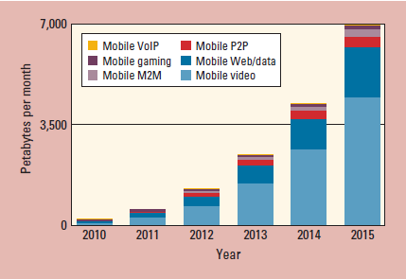
Characteristics of
Video Mobile Data Traffic
Growing portion in mobile data traffic
Data offload for video mobile data traffic is an important issue
In 2015, video mobile data traffic will be 66 percent of the world’s mobile data traffic.
Reference: “Global Mobile Data Traffic Forecast, 2010.2015,” white paper, Cisco Visual Networking Index, Feb. 2012.

Slide 3
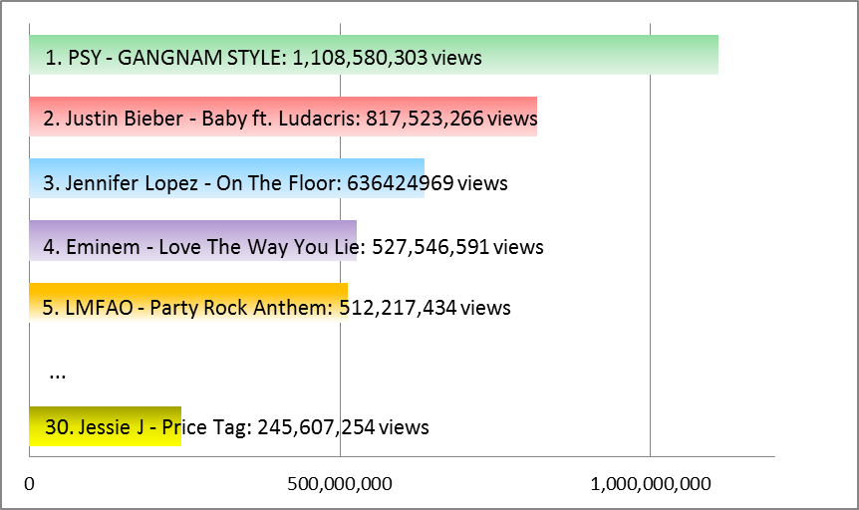
Characteristics of
Video Mobile Data Traffic (Cont’d)
Clear preferences on video contents
The preferred contents can be shared between peer to peer communications.
Most viewed videos of YouTube charts on Jan. 2nd, 2012

Slide 4
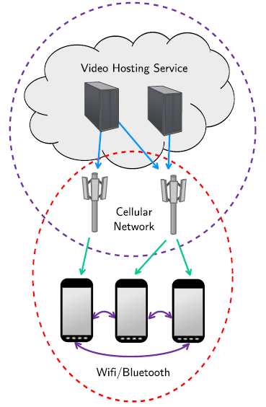
Data Offload through Wireless P2P Networks
MicroCast (A paper in Mobisys’ 12)
A group of smartphone users, within proximity of each other, are interested in watching the same video at the same time. Each smartphone connects to the video source (e.g., UStream, YouTube, or Netflix) using its cellular (3G or 4G) connection.
The base station may be the same or different for different users, depending on the provider they use.
Each smartphone can receive packets from the source as well as from other smartphones in the neighborhood through device-to-device (e.g., WiFi) links.
“Micro” indicates locality: there is a small number of users and they are all within proximity of each other.
“Cast” indicates a multicast scenario: all users in the group are interested in the same content sent by a single source, and local broadcast is used.
Reference: L. Keller, A. Le, and B. Cici,,” MicroCast: Cooperative Video Streaming on Smartphones,” MobiSys’12, pp. 57-69, June 2012.

Slide 5



Data Offload through
Wireless P2P Networks (Cont’d)
Use case scenario
  Tom likes PSY, and thus downloaded PSY’s music video (MV) in her smart phone through a cellular network.
  Tom’s school mates also want to download PSY’s MV.
  However, the cellular network cannot transmit PSY’s MV in appropriate. throughput, because Tom’s school mates are so numerous.
  Data offload through Wireless P2P network is decided, and then the smartphones of the Tom’s school mates discover Tom’s smart phone, that downloaded PSY’s MV for Tom’s school mates.
    Contents billing & payment, and security between mobile nodes should be considered.
  Tom’s smart phone transmit PSY’s MV to her school mate.
    Tom’s smart phone may multicast PSY’s MV using multicast scheme because of transmission efficiency.
Video hosting server
Cellular Networks
PSY’s MV transmission through Cellular Networks
Tom’s Smartphone
PSY’s MV transmission through WLAN Multicast
Classmate 2’s Smartphone
Classmate 1’s Smartphone
Classmate 2’s Smartphone

Slide 6
Data Offload through
Wireless P2P Networks (Cont’d)
Advantages
  Can support data offload without a point of attachment (PoA) such as a base station (BS) of cellular networks and a WLAN access point (AP)
  Can solve load balance problem for cellular networks
  Can support higher quality of service (QoS) than cellular network
  May support multicast of the contents to increase transmission efficiency using a wireless link

Slide 7
Functional Items for Data Offload Service through Wireless P2P Networks
Decision of data offload through wireless P2P networks should be considered.
  High load of cellular networks can be a reason for data offload.
  Low QoS of cellular networks can be a reason for data offload.
Discovery of the donor device for contents should be considered.
  Need to know which device has the contents downloaded before.
  Location information of the donor device can be used to discover the closest donor device.
Security issues between donor and receiver devices should be considered.
  Security for multicast user
  Security for contents
Billing and payment of downloading the video contents should be considered.
Multicast group management is needed.
  Multicast transmission of video contents should be considered.
  Management for multicast groups should be considered for multicast transmission.

Slide 8
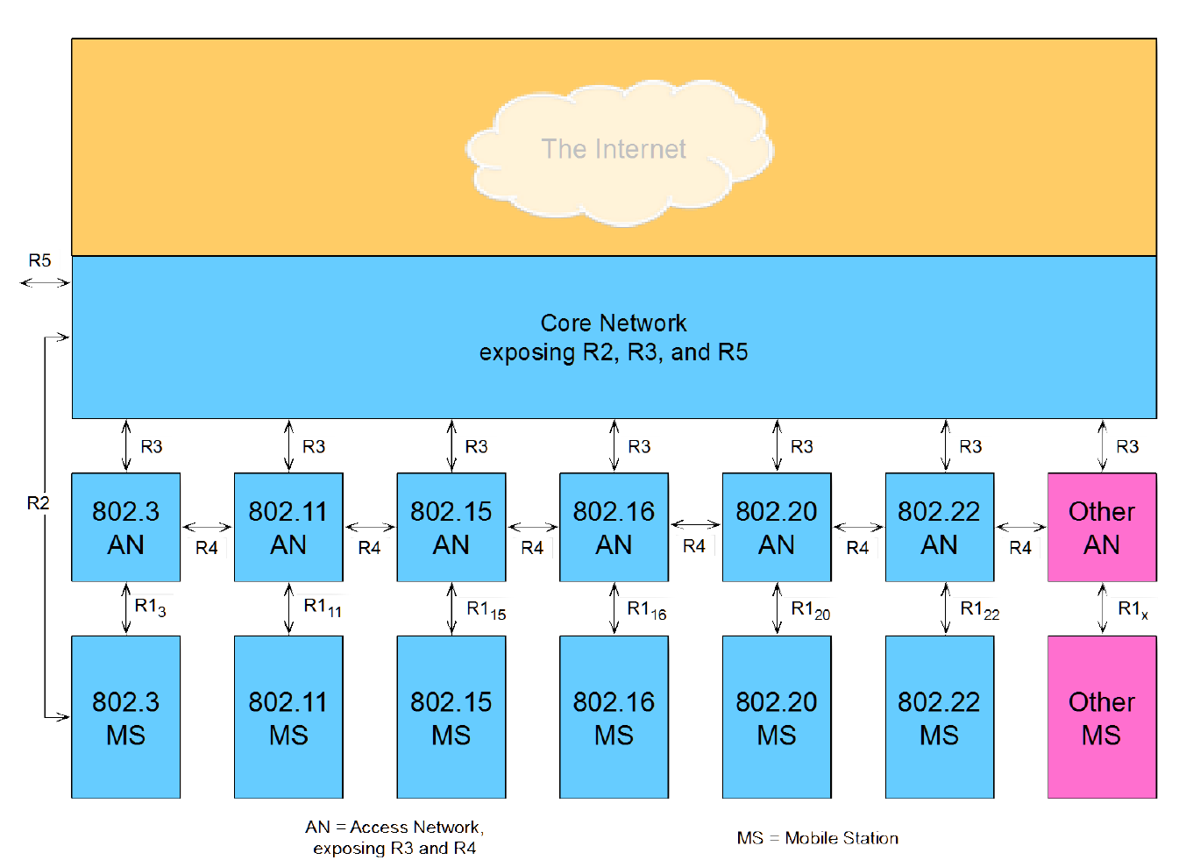
OmniRAN Architecture
Reference: OmniRAN Overview and status (DCN# omniran-12-0002-02-escg)

Slide 9

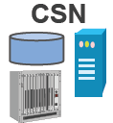
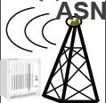
OminRAN Architecture for Data Offload Service through Wireless P2P Networks
ASP
Application Service Provider (ASP)
  ASP provides contents.
  Contents: Video data, firmware, etc.
  Network Service Provider (NSP)
  R2: NSP provides service discovery of donor users.
  R2 & R3: NSP handles security and billing for users.
  Network Access Provider (NAP)
  R4: NAP decide whether data offload through Wireless P2P networks is needed or not.
  R1: NAP provides service discovery of donor users.
  Users
    Data exchanges between users
    Multicast should be considered for efficiency of data transfer.
The donor user receives the contents from ASP
Internet
Core Network
R2
NSP
R3
R5
AN
  The user that already downloaded the contents from ASP.
NAP
R4
R1
  The user that downloads the contents from a donor user
Multicast of contents
Donor User
Receiver Users
Connectivity Serving Network (CSN)
Access Serving Network (ASN)

Slide 10
OminRAN Architecture for Data Offload Service through Wireless P2P Networks (Cont’d)
Procedure
Donor User
Receiver Users
NAP
NSP
Received contents
Request for Contents
Decision of Data Offload through Wireless P2P Networks
Response of Donor MN’s ID
Multicast Group Management between Donor User and Receiver Users
Request for Contents
P2P data transfer
of Contents

Slide 11
OminRAN Architecture for Data Offload Service through Wireless P2P Networks (Cont’d)
Internet
Need of the new reference point between MSs
  Connection establishment between MSs are needed.
  Multicast management between a donor user and receiver users are needed.
Core Network
R3
802.XX AN
R1
R1
802.XX MS
802.XX MS
?
New Reference Point between MSs

