Slide 1
OmniRAN
Introduction and Way Forward
2013-02-28
Max Riegel
(OmniRAN SG Chair)

Slide 2



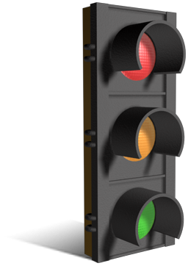
OmniRAN
OmniRAN is about attaching terminal devices deploying IEEE 802 technologies to communication networks.
OmniRAN aims to define interfaces and network functions for access networks based on IEEE 802 technologies
  including IEEE 802.3!
BTW: What does OmniRAN stand for?
  Open mobile network interface for omni-Range Area Networks

Slide 3

Dynamic attachment of terminals to networks
Terminal
Access Network
Core
Network
Services
Internet
Communication networks supporting dynamic attachment of terminals are usually structured into
  Access Network
    Distributed infrastructure for aggregation of multiple network access interfaces into a common interface
  Core Network
    Infrastructure for control and management of network access and end-to-end IP connectivity
  Services
    Infrastructure for providing services on top of established IP connectivity

Slide 4
Functions for establishment of end-to-end IP Connectivity
Access Network
Core Network
Network advertisement
IEEE 802.xx PHY and MAC
Authentication, authorization and accounting client
L2 session establishment
  w/ QoS and Policy Enforcement
L2 mobility management inside and across access networks
Mobility Gateway (MAG)
Traffic forwarding to core
Authentication, authorization and accounting server
IP address management
Policy & QoS management based on a SLA
Mobility among multiple access networks (LMA)
IP connectivity establishment to Internet and services
Roaming via other core networks
Technical issues solved for legacy communication networks.
Open issues might exist for heterogeneous networks and
new domains of communication network deployments.

Slide 5
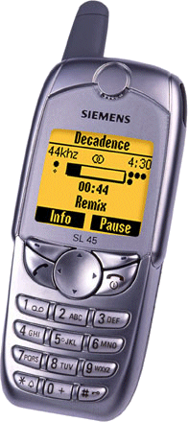
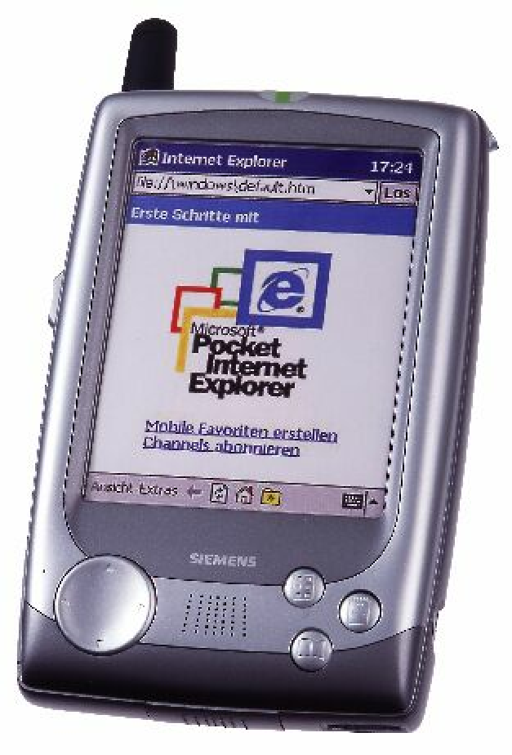
Legacy Communication Networks
Close relationship between user terminal, access network and service provider
  Single interface in terminal
  Single access network topology
  Single operator
    single entity (operator, IT department) controls complete service chain
Operators with long-time experience in network operation.
Core
Access

Slide 6


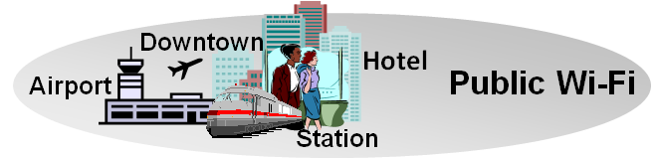
OmniRAN for Hetereogeneous Networks
User-Terminals have to support
  multiple network interfaces
    e.g. Cellular, IEEE 802.3, IEEE 802.11, …
  multiple access network topologies
    e.g. IEEE802.11 in residential, corporate and public
  multiple network subscriptions
    e.g. multiple subscriptions for same interface
Generic solution to cope with complexity
Cellular
802.11
802.15

Slide 7
OmniRAN for Emerging Networking Markets
Many more (huge) networks are coming up by everything gets connected
  e.g. SmartGrid, HomeAutomation, Car, …
Many new markets for IEEE 802 access technologies
  e.g. factory automation, in-car communication
New deployments often suffering by the same old networking issues
  e.g. service control, security, provisioning
  new operators lacking long-time experience
Generic solution to foster market growth

Slide 8
Functional Scope of OmniRAN
Network detection and selection
  Finding the most appropriate network access
Setting up the access link
  Scope of individual IEEE 802.xx specifications
Authentication
  Framework, based on IEEE 802.1X
Setting up the e2e communication link
  Authorization, service management
Maintaining the user data connection
  Mobility support to maintain connectivity when changing access points
Usage and inventory reporting
  Accounting, service monitoring, location
Subscription management
  Adding new users to a network and maintaining existing subscriptions
Management of terminals
  Initial configuration and provisioning and update of policies

Slide 9
OmniRAN Architecture and Reference Points
Terminal
R2
Access
Core
R1
R3
Internet
R4
R3
Access
Core
R3
Access
Authentication
Authentication
Authorization
Authorization
R5
Accounting
Accounting
Location
Location
CoA
CoA
Mobility
DataPath
Mobility
Access
R3
Core
Encapsulation
Encapsulation
Transport
Internet
Reference Points represent a bundle of protocols between peer entities
  - Similar to real IP network interfaces

Slide 10
OmniRAN Interfaces
R1: Access link, technology specific
R2: User & terminal authentication, subscription & terminal management
R3: Authorization, service management, user data connection, mobility support, accounting, location
R4: Inter-access network coordination and cooperation, fast inter-technology handover
R5: Inter-operator roaming control interface
All interfaces may comprise a number of different protocols. However, only the protocols related to required functionality have to be present on the interfaces.
  Approach allows for a common specification framework for various applications covering very simple to extremely complex network functionality.

Slide 11
Heterogeneous Networking w/ OmniRAN

Slide 12
What OmniRAN would provide to 3GPP
SaMOG is defining a gateway controlling the Trusted Non-3GPP access network by the EPC
OmniRAN would provide an interface (R3) to which 3GPP would be able to reference.
  Expanded beyond IEEE 802.11/802.16
R3

Slide 13
No desire to re-invent the wheel…
Limiting the effort to create beneficial results
There are plenty of specifications available which OmniRAN can leverage
  IETF protocols
  WiMAX specifications
  Wi-Fi Alliance solutions
  ZigBee specifications
  …
Step-wise development allows to provide valuable results early, e.g.:
  Interface by interface
    e.g. starting with R1 and R2, then R3, adding R4 and R5 later
  Functional complexity
    e.g. starting with simple nomadic scenario, adding dynamic service control, later L3 mobility management and inter-AN optimizations
  …
OmniRAN EC SG is searching for the single most wanted access network function to be specified for IEEE 802.

Slide 14
Establishing the initial OmniRAN PAR
OmniRAN EC SG had its initial meeting in January 2013
  Good participation throughout the industry
  Call for contributions for use cases document issued.
Plan for creation of initial PAR proposal until July 2013:
  Creation of use cases document illustrating the most important deployments of OmniRAN
  Circulating the use cases document among stakeholders for comments and confirmation
  Deriving common functional requirements from the agreed use cases document
  Prioritization of the derived functional requirements
  Gap analysis to existing solutions starting from the most prior functional requirements
  Decision about topic to be addressed first based on scope, purpose, need and support of stakeholders
  Develop draft PAR based on selected initial topic
  Submission of PAR proposal to IEEE 802 EC

Slide 15
Planned Timeline of OmniRAN EC SG
Initial meeting
Use cases contributions
Draft Use cases document
Call for comments on Use cases document
Use cases document finalization
Classification of functional requirements
Prioritization of functional requirements
Gap analysis to existing solutions
Decision about initial topic
Draft PAR proposal
Finalization of PAR proposal
Conf Call
?
?
?
?
F2F meeting
Jan
Feb
Mar
Apr
May
Jun
Jul

Slide 16
Questions & Comments
Questions and comments from the IETF?
…
Our Questions to the IETF:
Which IETF WGs would be interested in OmniRAN?
What would be the best way for timely discussions between IEEE 802 and IETF on OmniRAN?
Can IETF add to the decision process to determine most urgent issue in IEEE 802 access networks?
Recommendations on the network specifications to leverage for OmniRAN?

