Slide 1
A Unified Management Framework for autonomic and software-defined networks
Date: 2013-03-20
Authors:
Name | Affiliation | Phone | Email
Marc Emmelmann | Fraunhofer FOKUS | +49 30 3463 7268 | emmelmann@ieee.org
Notice: This document does not represent the agreed view of the OmniRAN EC SG. It represents only the views of the participants listed in the ‘Authors:’ field above. It is offered as a basis for discussion. It is not binding on the contributor, who reserve the right to add, amend or withdraw material contained herein.
Copyright policy: The contributor is familiar with the IEEE-SA Copyright Policy <http://standards.ieee.org/IPR/copyrightpolicy.html>.
Patent policy: The contributor is familiar with the IEEE-SA Patent Policy and Procedures: <http://standards.ieee.org/guides/bylaws/sect6-7.html#6> and <http://standards.ieee.org/guides/opman/sect6.html#6.3>.
Abstract
Overview on Unified Management Framework of the Univerself Project.
Objective is to query OmniRAN’s interest in receiving further information on considered use cased, requirements, and generic KPIs and parameters used for applying UMF for heterogeneous network.

Slide 2
OVERVIEW
MOTIVATIONS
UMF IN A NUTSHELL
Topics of potential immediate interest to OmniRAN

Slide 3
MOTIVATIONS

Slide 4
MOTIVATIONS
PROBLEM STATEMENT
Simple facts/observations on today’s networks:
  Increasing volume of traffic
  Increasing number of devices/interactions (e.g. Machine-to-Machine)
  Increasing number of services and related QoS constraints
  (still) technology heterogeneity and legacy
  (still) technology/administrative silos
Which generates the following problematic situation and detrimental impacts:
  Complexity of distributed systems and their control/management
  Reaching the limit of current management/operation practices
    scalability, speed, highly human–dependent
  Network capabilities under-utilization
    worst-case/over provisioning, unused advanced features
  New service or application deployment difficulty
    slow time-to-deploy and tedious multi-techno/vendor mapping

Slide 5
MOTIVATIONS
GOAL
The ultimate goal of self-managing networks is to overcome these limits by providing intelligent, adaptive, modular, and automated carrier-grade control functions for seamless, end-to-end and cross-technology interworking
Objectives
  Multi-facet unification
    Federation of existing architectures and unification management principles across multiple technologies
  Network empowerment
    Embed intelligence to achieve true self-managing networks
  Industry readiness
    Demonstrate deployability and develop migration strategies for adoption by telcos/vendors
  Trust and confidence
    Demonstrate the reliability of every autonomic solution and develop standard testing and certification
In this context, standardization is a must!

Slide 6
MOTIVATIONS
CHALLENGES
  Genuine research challenges (still) exist to design and develop algorithms and mechanisms capable of replacing human operation | expertise | reasoning.
  An important and complex research challenge arises for the coordination of interactions among autonomic entities (conflict-resolution, stability assurance, multi-objective optimization)
  New solutions have to be extensively and rigorously tested and exercised on real use cases and field trials to prove their applicability in carrier-grade environments and build trust and confidence from the operators in their performance and safe behaviors.
  A unified framework is then needed to enable seamless, plug-and-play deployment and interoperable operations of the autonomic mechanisms. Designing this unified framework is a challenge in itself besides the required efforts for (pre-)standardization.
Most importantly, these four research challenges should be addressed concurrently which increases the difficulty of the task.

Slide 7
UMF IN A NUTSHELL
Notes:
Importance of addressing recommendations
Open, listen
Treat
Outline what remains open.

Slide 8
UMF IN A NUTSHELL
TOWARDS A REFERENCE FRAMEWORK
Solid, well-recognized understanding and knowledge of a specific domain, aiming at improving reuse of design expertise and productivity, facilitating the development of systems of that domain^{[1]}
[1] Nakagawa et al., Using systematic review to elicit requirements of reference architectures, in WER 2011.

Slide 9
UMF IN A NUTSHELL
NETWORK EMPOWERMENT MECHANISM
Approach: The right key to the lock
  Use the relevant method to solve a concrete operational problem in a specific networking environment
  Realize a purposeful self-management function (closed control loop)
NEM = method + objective + context
  Use of Bayesian inference for fault diagnosis in FTTH networks
  Use of Genetic algorithm for interference coordination in LTE networks
  Use of Self-organizing maps for Congestion Prediction in Core IP networks
NEM = abstraction of an autonomic function
  External interfaces (called “skin” in the UMF terminology)
  Description, properties, capabilities, behavior (called “manifest” in the UMF terminology)
  Enabling to capture also interactions and relationships with other NEMs
  Providing uniform model and control means

Slide 10
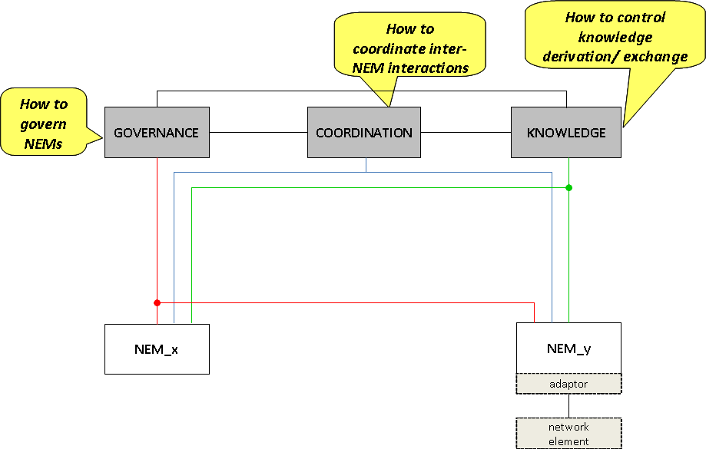
UMF IN A NUTSHELL
UMF CORE FUNCTIONAL BLOCKS
Seamless deployment and trustworthy interworking of NEM army require:
  Tools for the operators to deploy, pilot, control and track progress of NEMs in a unified way
    GOVERNANCE functional block
  Tools to identify/avoid conflicts and ensure stability and performance when several NEMs are concurrently working
    COORDINATION functional block
  Tools to make NEMs find, formulate and share relevant information to enable or improve their operation
    KNOWLEDGE functional block
  APIs to enable NEMs “plug and play” deployment, interoperability and monitoring/configuration
    NEM Skin
    Specific adaptors
Objective of the UMF Core:
Seamless and trustworthy deployment of NEMs
Interfaces
Coordination schemes
Communication patterns
Knowledge structures
Policy translation levels
Ontology
Recommendations for NEM development
(lifecycle, generic structure…)
Accomplished by specification, and then standardization, of:

Slide 11
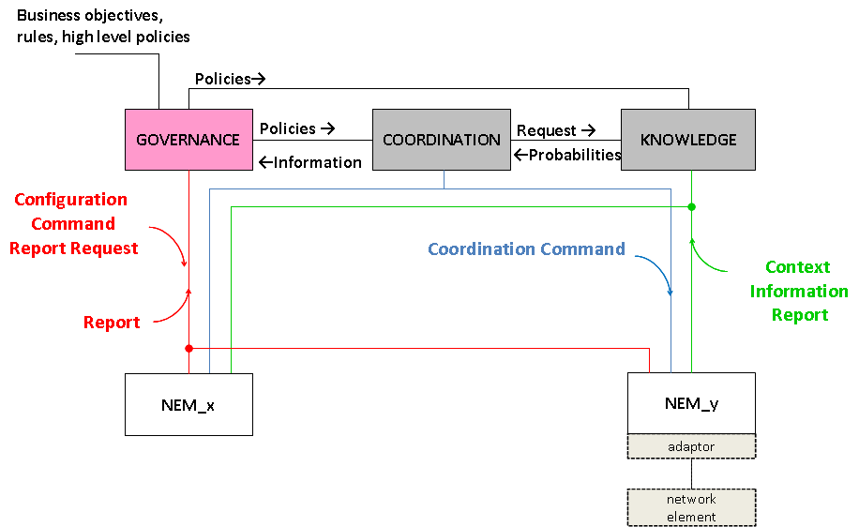
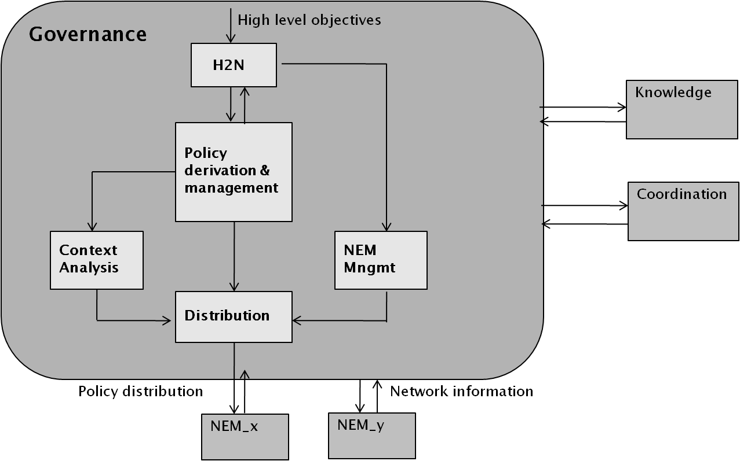
UMF IN A NUTSHELL
UMF CORE FUNCTIONAL BLOCKS
Responsible for:
  The interaction between human operator and its network→ express business goals report on critical states of self-managed operations/devices
  Driving NEMs’ behavior→ policy-based framework for translating business-level, service specific goals/requests into low level, policies and configuration commands
Functional decomposition
GOVERNANCE ←→ NEM:
  Commands to set NEM’s status/mode (e.g. active, idle, stopped) and configure its operational parameters.
  Report on the NEM’s operational conditions and configuration characteristics (e,g. performance indicators, capabilities/behaviour, interaction with other NEMs).
11

Slide 12
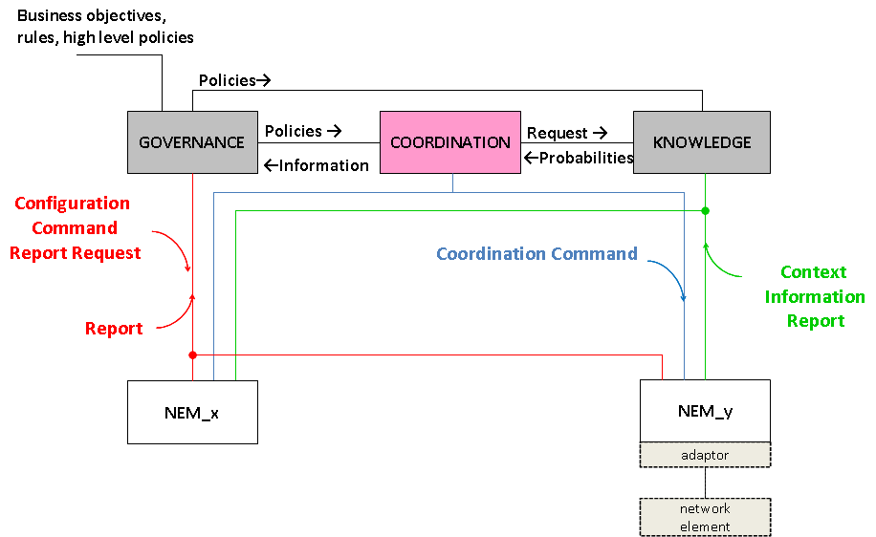
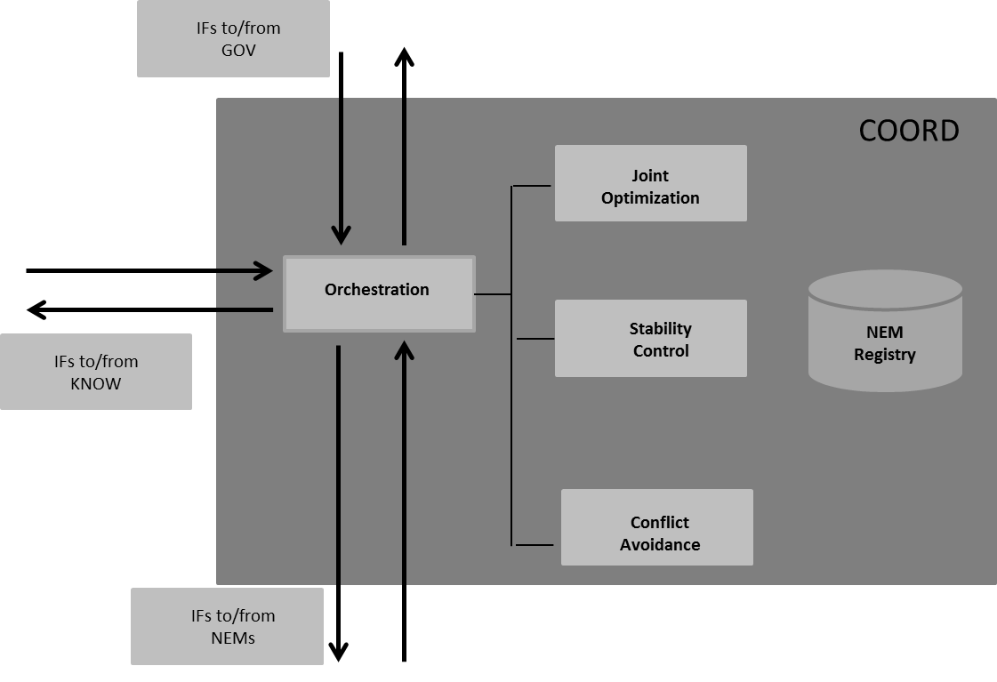
UMF IN A NUTSHELL
UMF CORE FUNCTIONAL BLOCKS
Responsible for:
  Ensuring the proper sequence in triggering of NEMs and the conditions under which they will be invoked taking into account:
    Operator and service requirements,
    Needs for Conflict avoidance, joint optimization and stability control.
Functional decomposition
COORDINATION ←→ NEM:
  Commands to drive coordination including: tokens, timing, constraints, status (active/idle), etc.
  Information on the NEMs operation including: parameters, metrics, scope, utility functions, etc.
12

Slide 13
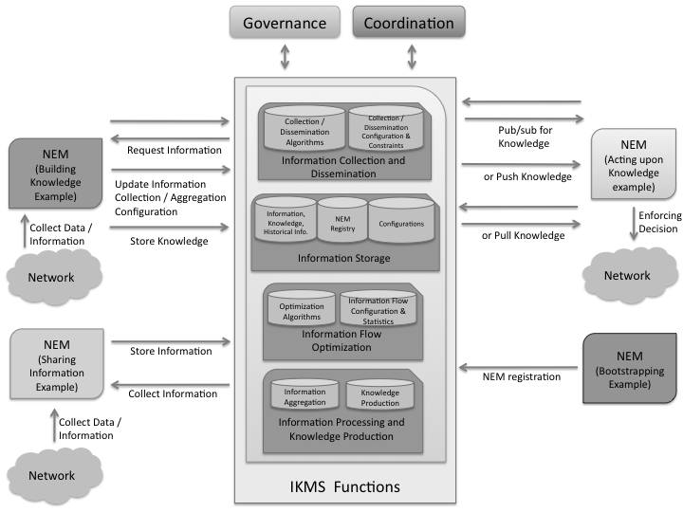
UMF IN A NUTSHELL
UMF CORE FUNCTIONAL BLOCKS
Responsible for:
  Providing the suitable probabilistic models methods and mechanisms for derivation and exchange of Knowledge, based on :
    Context and configuration information from NEMs,
    Policies from Governance,
    Information on NEM interactions from coordination
Functional decomposition
KNOWLEDGE ←→ NEM:
  Commands to retrieve, share, derive and manage knowledge including: publish, subscribe, push, pull, request, store, notify … messages.
  Registration of NEMs.
13

Slide 14
UMF IN A NUTSHELL
SUMMARY
A unified framework to deploy and control self-managing functions
  Specifications of the UMF core functional blocks
  Specifications of the NEM
  UMF and NEM APIs (skin) and workflows/sequence charts
  Publicly available specifications, developer guidelines
  Implemented, tested, modular and re-usable components
    NEM skin
    RESTful APIs
The UMF is applied within UNIVERSELF to use cases exploiting key performance indicators (KPIs) and parameters of underlying networks.
  Need to be standardized
  Relates to functional scope of OmniRAN
    Usage and inventory reporting: Accounting, service monitoring, location
    Setting up the e2e communication link: service management
    Management: configuration and provisioning and update of policies

Slide 15
Univerself and OmniRAN

Slide 16

What OmniRAN could be interested in:
R2
Terminal
R1
Access
R3
Core
Scenarios
Use-Cases, and
Requirements
Derived (abstraction of) key KPIs and parameters needed to support heterogeneous access network technologies
Likely relating to OmniRAN Reference Points R2, R3, and R5
Help in drafting PAR, OmniRAN UseCase and Requirements documents
Internet
R4
R3
Access
R5
Access
R3
Core
Internet

Slide 17





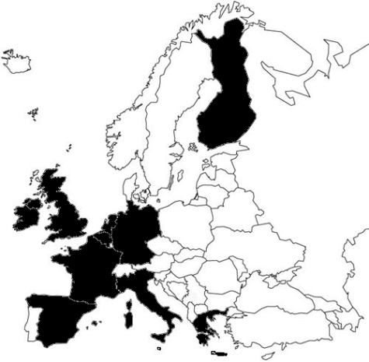

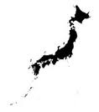








Contributors to this work
Japan
IETF 86 – 29th NMRG meeting
17

Slide 18
Questions / Discussions

