Slide 1
IEEE 802 Scope of OmniRAN
Date: 2013-05-16
Authors:
Name | Affiliation | Phone | Email
Max Riegel | NSN | +49 173 293 8240 | maximilian.riegel@nsn.com
Notice: This document does not represent the agreed view of the OmniRAN EC SG. It represents only the views of the participants listed in the ‘Authors:’ field above. It is offered as a basis for discussion. It is not binding on the contributor, who reserve the right to add, amend or withdraw material contained herein.
Copyright policy: The contributor is familiar with the IEEE-SA Copyright Policy <http://standards.ieee.org/IPR/copyrightpolicy.html>.
Patent policy: The contributor is familiar with the IEEE-SA Patent Policy and Procedures: <http://standards.ieee.org/guides/bylaws/sect6-7.html#6> and <http://standards.ieee.org/guides/opman/sect6.html#6.3>.
Abstract
IEEE 802 covers networking functions represented by the PHY and DL layers of the 7-layer OSI/ 5-layer Internet model.
OmniRAN provides an abstraction of access networks based on IEEE 802 technologies to foster interoperability and integration into common control infrastructures.
The Reference Points of OmniRAN reflect IEEE 802 specific attributes which potentially are transferred by IP protocols. The definition of the attributes is completely within the scope of IEEE 802.

Slide 2
IEEE 802 Scope of OmniRAN
Architectural models and functional views of OmniRAN in the scope of IEEE 802

Slide 3
IEEE 802 Architecture
IEEE 802 Scope of OmniRAN

Slide 4
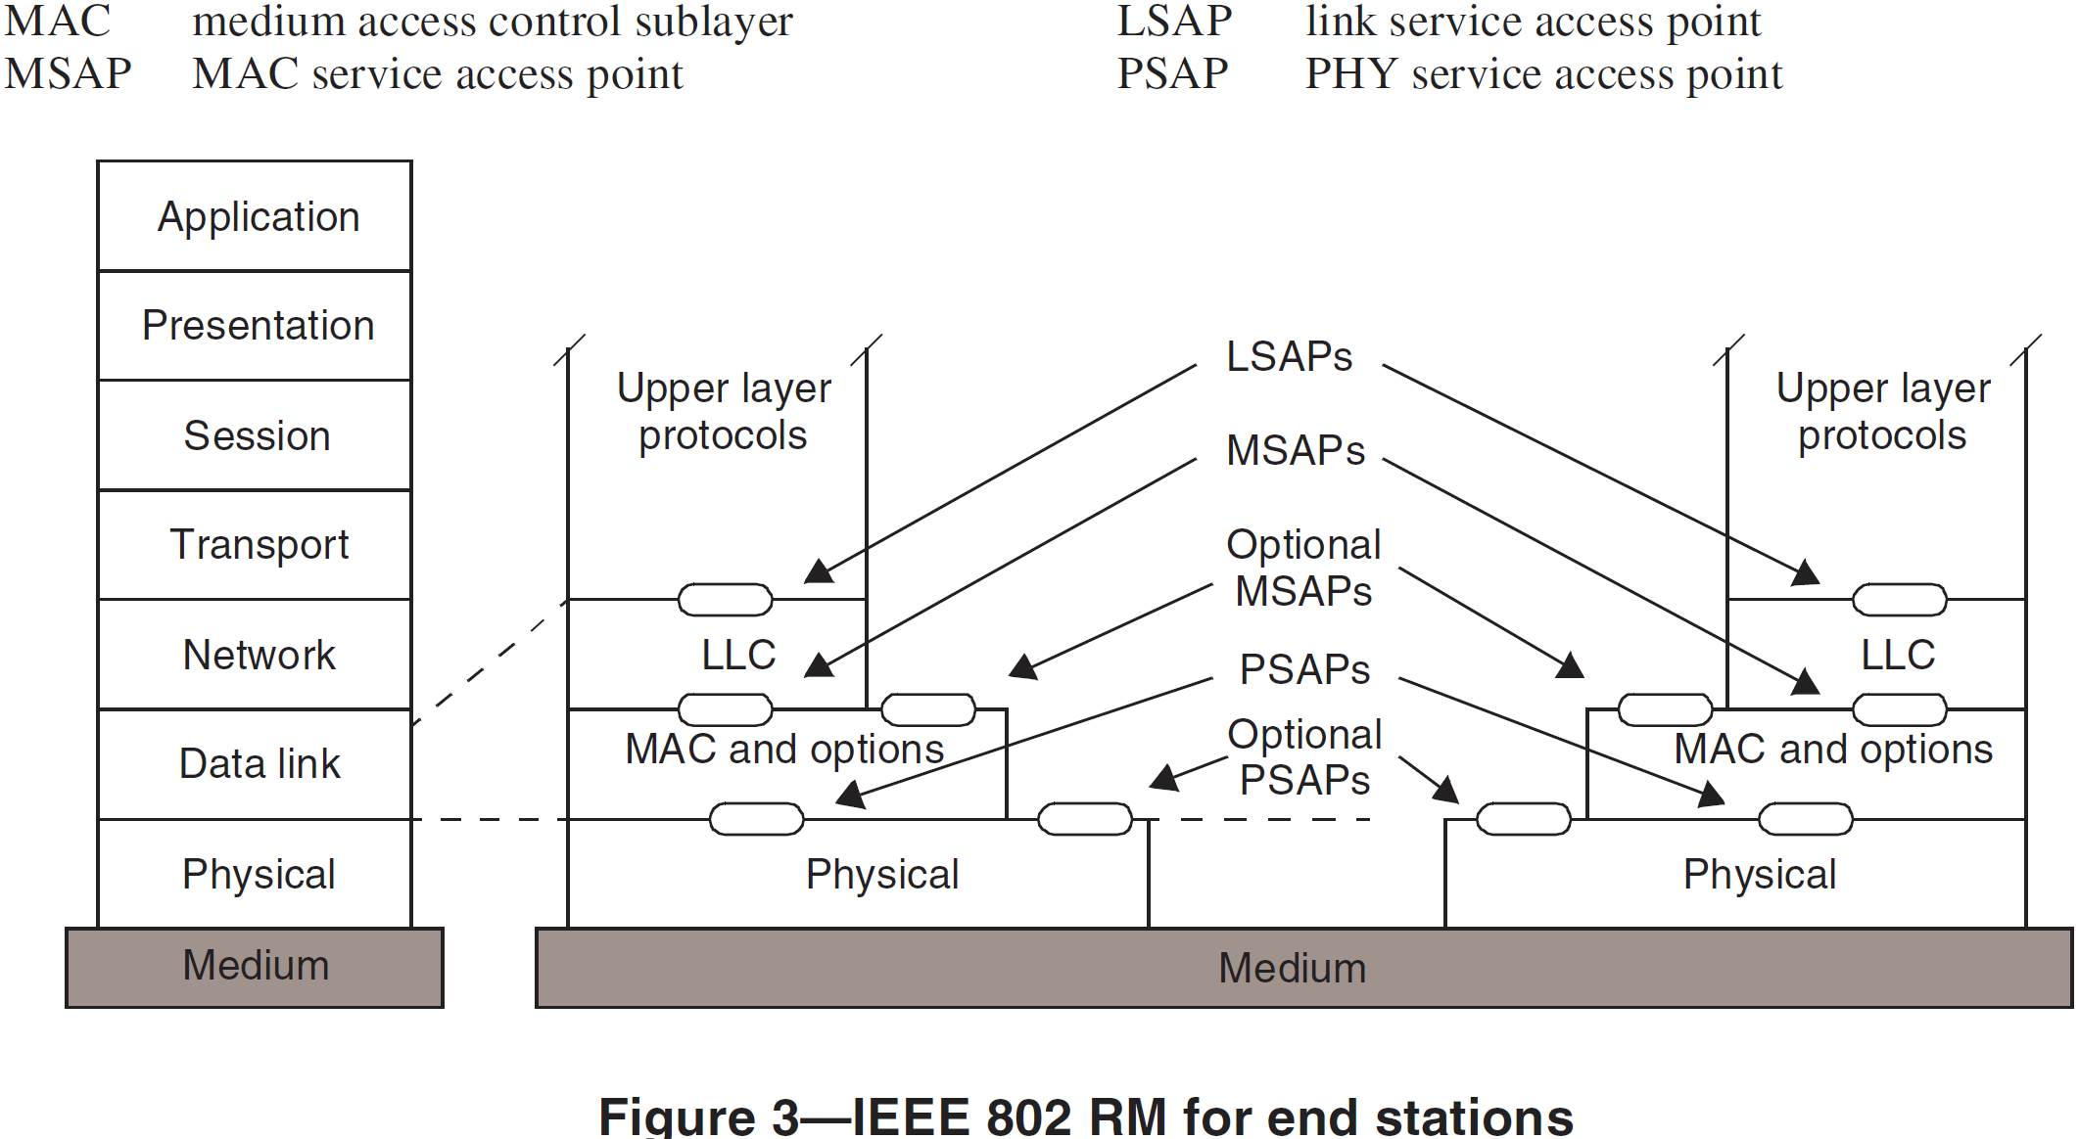
IEEE 802 Reference Model for End-Stations
(802rev-D1.6)
Reference Model within the 7 layer ISO-OSI model
Reference Model exposing specific IEEE 802 functions
IEEE 802 provides link layer connectivity to the overall communication architecture
It covers the Physical and the Data link layer of the ISO-OSI 7 layer model/Internet 5 layer model
Data link layer is represented in IEEE 802 by MAC and LLC sub-layers
Functionality above Data link layer is considered as ‘higher layer’.
The IEEE 802 end-station model comprises a management plane and a plane representing IEEE 802.21 MIH.
The network management model of IEEE 802 provides the definition of managed objects for each of the layers of the IEEE 802 RM
The MICF of IEEE 802.21 provides SAPs towards the PHY-, MAC- and Higher layers of the RM

Slide 5
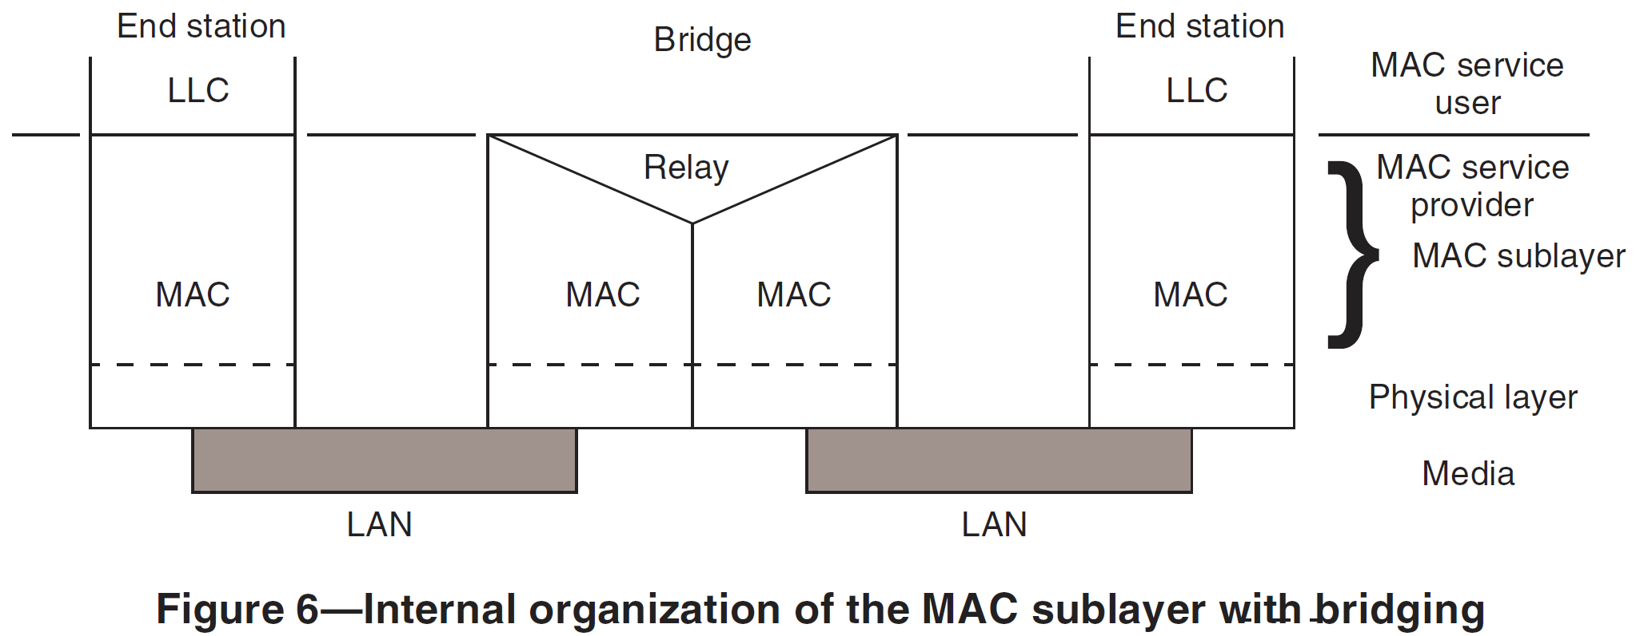
IEEE 802 Reference Model for Bridges
IEEE 802 provides a bridging model for interconnection of multiple network segments based on data link layer functionality
Different bridging protocols can handle the issues of various topologies including avoidance of data loops and establishment of ‘optimized’ filtering and forwarding decisions.
Bridging protocols have been extended to cope with multiple operational domains of hierarchical provider structures.

Slide 6
ACCESS NETWORK ArchitecturAL VIEWS
IEEE 802 Scope of OmniRAN

Slide 7

Access Networks enable the dynamic attachment of terminals to networks
Terminal
Access Network
Core
Services
Internet
Communication networks supporting dynamic attachment of terminals are usually structured into
  Access Network
    Distributed infrastructure for aggregation of multiple network access interfaces into a common interface
  Core
    Infrastructure for control and management of network access and end-to-end IP connectivity
  Services
    Infrastructure for providing services over IP connectivity

Slide 8
Functional decomposition of dynamic network access
Access Network
Core
Network advertisement
Pre-association signalling
Authentication, authorization and accounting client
L2 session establishment
  w/ QoS and Policy Enforcement
L2 mobility management inside access networks
Traffic forwarding to core based on L2 addresses
Subscription management
Terminal provisioning
Authentication, authorization and accounting server
IP address management
IP connectivity establishment to Internet and services
Policy & QoS management server (policy decision)
Mobility Anchor
Roaming support to other cores

Slide 9
Mapping Access Networks to the architectural model of IEEE 802
Terminal
Access Network
Core
Application
Application
Transport
Transport
Network
Network
Scope of IEEE 802
Data Link
Data Link
Data Link
Data Link
Data Link
Data Link
Physical
Physical
Physical
Physical
Physical
Physical
Medium
Medium
Medium
IEEE 802 is dealing with packet data transport functions in the Data Link and Physical layers.
Access networks are dynamically controlled Layer 2 network infrastructures.

Slide 10
Access Network Control and User Plane
Terminal
Access Network
Core
Service
Control Plane
Scanning
Network Selection
Association
Authentication
Host Configuration
Application
User Plane
Application
Application
Transport
Transport
Network
Network
Network
Network
Scope of IEEE 802
Data Link
Data Link
Data Link
Data Link
Data Link
Data Link
Data Link
Data Link
Physical
Physical
Physical
Physical
Physical
Physical
Physical
Physical
Medium
Medium
Medium
Medium

Slide 11
Access Network Control Plane Functions
Access Network
ANQP
AAA
Policy
Configuration
DHCP
Application
Scanning
Network Selection
Association
Authentication
Authorization
Accounting
Host Configuration
Application
Policy Control
Application
Host Config Release
Disassociation
Accounting
Legend:
L2 Protocol
L2 Attributes
L2 Protocol
L3+ Attributes
L3+ Protocol
L2 Attributes
L3+ Protocol
L3+ Attributes

Slide 12
Control Protocols used by Access Networks
Scanning: Finding out about the existence of potential communication peers
  Scope of individual IEEE 802.xx specifications
Network selection: Finding the most appropriate network access
  IEEE 802.xx protocol for higher layer information
Association: Setting up the access link
  Scope of individual IEEE 802.xx specifications
Authentication
  EAP framework, supported by IEEE 802.1X or IEEE 802.xx technology specific solutions
Authorization: Setting up the IEEE 802 communication link
  Attributes and functions including specifics of IEEE 802.xx technologies
Accounting: Usage and inventory reporting
  Attributes including specifics of IEEE 802.xx technologies
Policy Control: Adjustment of the user data connection
  Attributes including specifics of IEEE 802.xx technologies
Host Configuration: Getting the IP communication parameters
  IP protocol for IP configuration parameters
Application: Setting up the productive use of the communication infrastructure
  IP protocol for control of application
Host Config Release: Releasing the IP communication parameters
  IP protocol for IP configuration parameters
Disassociation: Releasing the access link
  Scope of individual IEEE 802.xx specifications

Slide 13
OmniRAN WITHIN
The SCOPE of IEEE 802
IEEE 802 Scope of OmniRAN

Slide 14
Access Network Abstraction by OmniRAN
Terminal
Access Network
Core
Service
OmniRAN Architecture
R2
Terminal
Access Network
Core
R1
R3
OmniRAN provides a generic model of an access network based on IEEE 802 technologies
Application
Application
Transport
Transport
Network
Network
Network
Network
Data Link
Data Link
Data Link
Data Link
Data Link
Data Link
Data Link
Data Link
Physical
Physical
Physical
Physical
Physical
Physical
Physical
Physical
Medium
Medium
Medium
Medium

Slide 15
OmniRAN Reference Points capture the functions of an access network
Reference Points denote the interconnections between functional entities of an access network, i.e.:
  R1 between terminal and base station:
    Access link, technology specific
  R2 between terminal and core network:
    User & terminal authentication, subscription & terminal management
  R3 between access network and core network:
    Authorization, service management, user data connection, mobility support, accounting, location
  R4 between access networks:
    Inter-access network coordination and cooperation, fast inter-technology handover
  R5 between core networks to enable co-use of access networks:
    Inter-operator roaming control interface
Reference Points build the foundation for realizing interoperability for real world access networks.
The Reference Points capture the control information necessary to allow dynamic control of network functions by a central entity (core).

Slide 16

OmniRAN architecture example showing all different reference points
Terminal
R2
Access
Core
R1
R3
Internet
R4
R3
Access
Core
R3
Access
Authentication
Authentication
Authorization
Authorization
R5
Accounting
Accounting
Location
Location
CoA
CoA
Mobility
DataPath
Mobility
Access
R3
Core
Encapsulation
Encapsulation
Transport
Internet
Reference Points represent a bundle of functions between peer entities
  - Similar to real network interfaces

Slide 17
OmniRAN Control Functions on R2 and R3
Access Network
ANQP
AAA
Policy
Configuration
DHCP
Application
Scanning
Network Selection
Association
Authentication
Authorization
Accounting
Host Configuration
Application
Policy Control
Application
Host Config Release
Disassociation
Accounting
IEEE 802 Access Technologies
IEEE 802 OmniRAN

Slide 18
Mapping of OmniRAN Reference Points to IEEE 802 Reference Model
Higher Layers
Higher Layers
Higher Layers Control
Higher Layers Control
R2 R3
R3
Current scope of IEEE 802
Data Link
Data Link
Data Link
Data Link
Data Link
Data Link
Physical
R1
Physical
Physical
Physical
Physical
Physical
Medium
Medium
Medium
Reference Points can be mapped onto the IEEE 802 Reference Model
  R1 represents the PHY and MAC layer functions between terminal and base station
    Completely covered by IEEE 802 specifications
  R2 represents the L2 control protocol functions between terminal and central entities for control and AAA.
  R3 represents the L1 & L2 control interface from a central control entity into the network elements
‘R2’ and ‘R3’ are build upon IEEE 802 specific attributes
  However IP based protocols are used to carry control information between network elements and core
  Effectively each of IEEE 802 network elements contains an IP communication stack on top of the IEEE 802 data path for the exchange of the control information.

Slide 19
Handling IEEE 802 Attributes in IP Protocols
Handling of IEEE 802 specific attributes of IP protocols within the activities of IEEE P802:
  IEEE P802 has an established routine for defining the MIBs of IEEE 802 technologies
    Partly done by itself and partly within the IETF
  Processes for defining other IEEE 802 related attributes in IETF vary depending of protocol
    e.g. AAA attributes are mainly done by IETF with some informal review by IEEE 802 WGs
Cooperation between IEEE 802 and IETF is currently reviewed and refined in [draft-iab-rfc4441rev-04.txt]

Slide 20
Conclusion
IEEE 802 Scope of OmniRAN

Slide 21
Conclusion
OmniRAN provides an abstraction of access networks based on IEEE 802 technologies.
  Defining a common framework for deployment of IEEE 802 technologies for network access for various purposes
  Creating unified control interfaces to enable integration of various IEEE 802 access technologies into a common architecture and control infrastructure
  Supporting new developments for networking like SDN
Reference Points reflect IEEE 802 specific control information
  R1 is completely covered by IEEE 802 specifications
  R2 and R3 are mainly carrying control information for IEEE 802 functions
  R4 enhances direct cooperation among multiple IEEE 802 access networks
  R5 is present for conceptual purposes to forster the cooperation among cores.
    Attributes carried on R5 may mostly be identical to the attributes defined for R3
OmniRAN Specification in the scope of IEEE 802 would consist of
  an normative part defining control attributes and referencing the DL SAP
  an informative part outlining the overall architecture
  an informative part proposing the usage of particular IP protocols and the mapping of the IEEE 802 attributes into the IP protocols.

