Slide 1
OmniRAN SoA and Gap Analysis
Date: [2013-05-14]
Authors:
Name | Affiliation | Phone | Email
Antonio de la Oliva | UC3M | +34657079687 | aoliva@it.uc3m.es
Juan Carlos Zúñiga | InterDigital |  | j.c.zuniga@ieee.org
Notice: This document does not represent the agreed view of the OmniRAN EC SG. It represents only the views of the participants listed in the ‘Authors:’ field above. It is offered as a basis for discussion. It is not binding on the contributor, who reserve the right to add, amend or withdraw material contained herein.
Copyright policy: The contributor is familiar with the IEEE-SA Copyright Policy <http://standards.ieee.org/IPR/copyrightpolicy.html>.
Patent policy: The contributor is familiar with the IEEE-SA Patent Policy and Procedures: <http://standards.ieee.org/guides/bylaws/sect6-7.html#6> and <http://standards.ieee.org/guides/opman/sect6.html#6.3>.
Abstract
This presentation explain the key concepts on the protocols related to current OmniRAN activities and performs a GAP analysis of missing functionality.

Slide 2
OmniRAN SoA and Gap Analysis
OmniRAN contribution

Slide 3
Protocols studied and perspective
This presentation focuses on configuration protocols related to OmniRAN from an SDN point of view
We have split the analysis in two main areas:
  Interface configuration protocols: Used to configure Radio + MAC parameters in the actual Point of Attachment
    CAPWAP/SNMP
  Forwarding path configuration protocols: Used to configure data and control paths between Access Network and Internet GWs (Generic Backhauling/Core)
    MVRP/OpenFlow

Slide 4
CAPWAP
Control And Provisioning of Wireless Access Points (RFC5415, binding for 802.11 RFC5416)
CAPWAP is a standard, interoperable protocol that enables a controller to manage a collection of wireless access points
This protocol differentiates between data traffic and control traffic
Only the control messages are transmitted in a secured tunnel

Slide 5
SNMP
Simple Network Management Protocol (RFC3410)
SNMP exposes management data in the form of variables on the managed systems, which describe the system configuration. These variables can then be queried (and sometimes set) by managing applications

Slide 6
MVRP
Multiple VLAN Registration Protocol (IEEE 802.1ak)
  Replaces GARP VLAN Registration Protocol (GVRP) defined in IEEE 802.1Q-2005
Within a layer 2 network, MVRP provides a method to dynamically share VLAN information and configure the needed VLANs
  Example: in order to add a switch port to a VLAN, only the end port, or the VLAN-supporting network device connected to the switch port, needs to be reconfigured, and all necessary VLAN trunks are dynamically created on the other MVRP-enabled switches

Slide 7
OpenFlow
Described by the OpenFlow specification (http://www.OpenFlow.org/documents/OpenFlow-spec-v1.1.0.pdf)
Southbound interface that enables the configuration of switches and the creation of isolated virtual networks sharing the same physical resources
It works by creating entries in flow tables, each entry is able to modify the switching of specific packets and the packet itself

Slide 8
Comparison of CAPWAP and SNMP
 | CAPWAP | SNMP
Centralized/distributed | Centralized Access Controller manages the network | Centralized Network Management System manages the network
Control/Data separation | It can work in several modes, local and split MAC. In local MAC the WTP can send packets directly using bridging or encapsulate packets to AC. In split MAC several MAC operations are performed by the AC, data packets are encapsulated to the AC. CAPWAP only provides radio configuration to WTPs, it does not handle the forwarding configuration between AC and WTP (supports L2 and L3). | Only considers control path, it does not handle at all or controls the data path
Handling of user data / forwarding path | It handles user data. There are deployment options where the WTP does not send all data to AC but typically it is used in a mode of operation that encapsulates all traffic to AC | No
Configuration parameters | It can configure most of MIB parameters of the defined bindings | It can configure all parameters on the latest MIB for each technology
Configuration target (supported RAT) | Different technologies supported by specific technology bindings. Currently only WLAN truly supported | Any technology with MIB
QoS | Supports configuring and defining QoS configuration for packets and how to handle that in WTP. Also supports certain configuration in the MN (802.11e) | Supports QoS related actions in MIB
User subscription management | Authentication can be performed in AC and shared across all WTPs | No
Support of fast handover configuration (same as before - related to R4) | Authentication can be made available at WTPs before handover, reducing HO time | No
Support of latest 802.11 features | Missing latest features, e.g. 802.11n. Protocol does not allow flexibility for adding new parameters dynamically | Yes
Transport protocol | UDP, UDP-lite, DTLS | UDP, TCP
MN configuration | Partial | Partial
Secure control plane | Yes | Only in SNMPv3 (current version)
Firmware update capable | Yes | No
Link configuration (terminal and backhaul) | No | No
Spectrum agility configuration | No | No
WTP: Wireless Transmission Point
AC: Access Controller
MIB: Management Information Base

Slide 9
Comparison MVRP and OpenFlow
 | MVRP | OpenFlow
Control Path | Mechanism for distributing the VLAN tags associated to a L2 network. Bridges configured with the tags are able to distribute and form a consistent VLAN network across multiple bridges. | Centralized control path enables the configuration of the different elements in the network. The controller can be associated with any switch supporting OpenFlow and the configuration protocol requires L3 transport
Data Path | Data path is based on L2 VLAN switching | Data path can be modified and configured, based on template matching of packets and switching
Split control/data | No | Yes
Configuration target | L2 switches and IEEE 802 nodes supporting IEEE 802.1Q and IEEE 802.1ak | Switches supporting OpenFlow specification
Heterogeneous Technologies | 802 nodes supporting 802.1Q and 802.1ak | Only OpenFlow switches at the moment, some 802.11 APs also supporting the specification (e.g. OpenWRT)
Centralized/Distributed | Distributed. Limited centralized operation is possible when some proprietary extensions are used | Controller runs centralized, although it can be distributed
Packet matching rule | L2 headers only (e.g. VLAN tag/MAC) | Mostly all header fields up to the IPv4/6 header and transport protocol, no tunneling analysis supported (e.g., GTP)
Dynamic configuration | Dynamic creation/configuration of VLANs (e.g. upon user’s arrival) seems not supported | Dynamic modification of the rules is possible
Modification of packets | VLAN tags only | Yes. MAC address, VLAN ID, priority, MPLS parameters, IP addresses, ToS, DS, TTL, transport ports, etc
Configuration of Radio | No | No
Transport protocol | Uses transport over L2 (does not use IP) | TCP/TLS
Data Statistics | No | Yes. Number of packets, bytes, etc matching, dropping, errors, queue
Dynamic actions | No | Dynamic actions over the packet and over the flow tables. Drop, modify other actions, etc
Radio Statistics | No | No

Slide 10
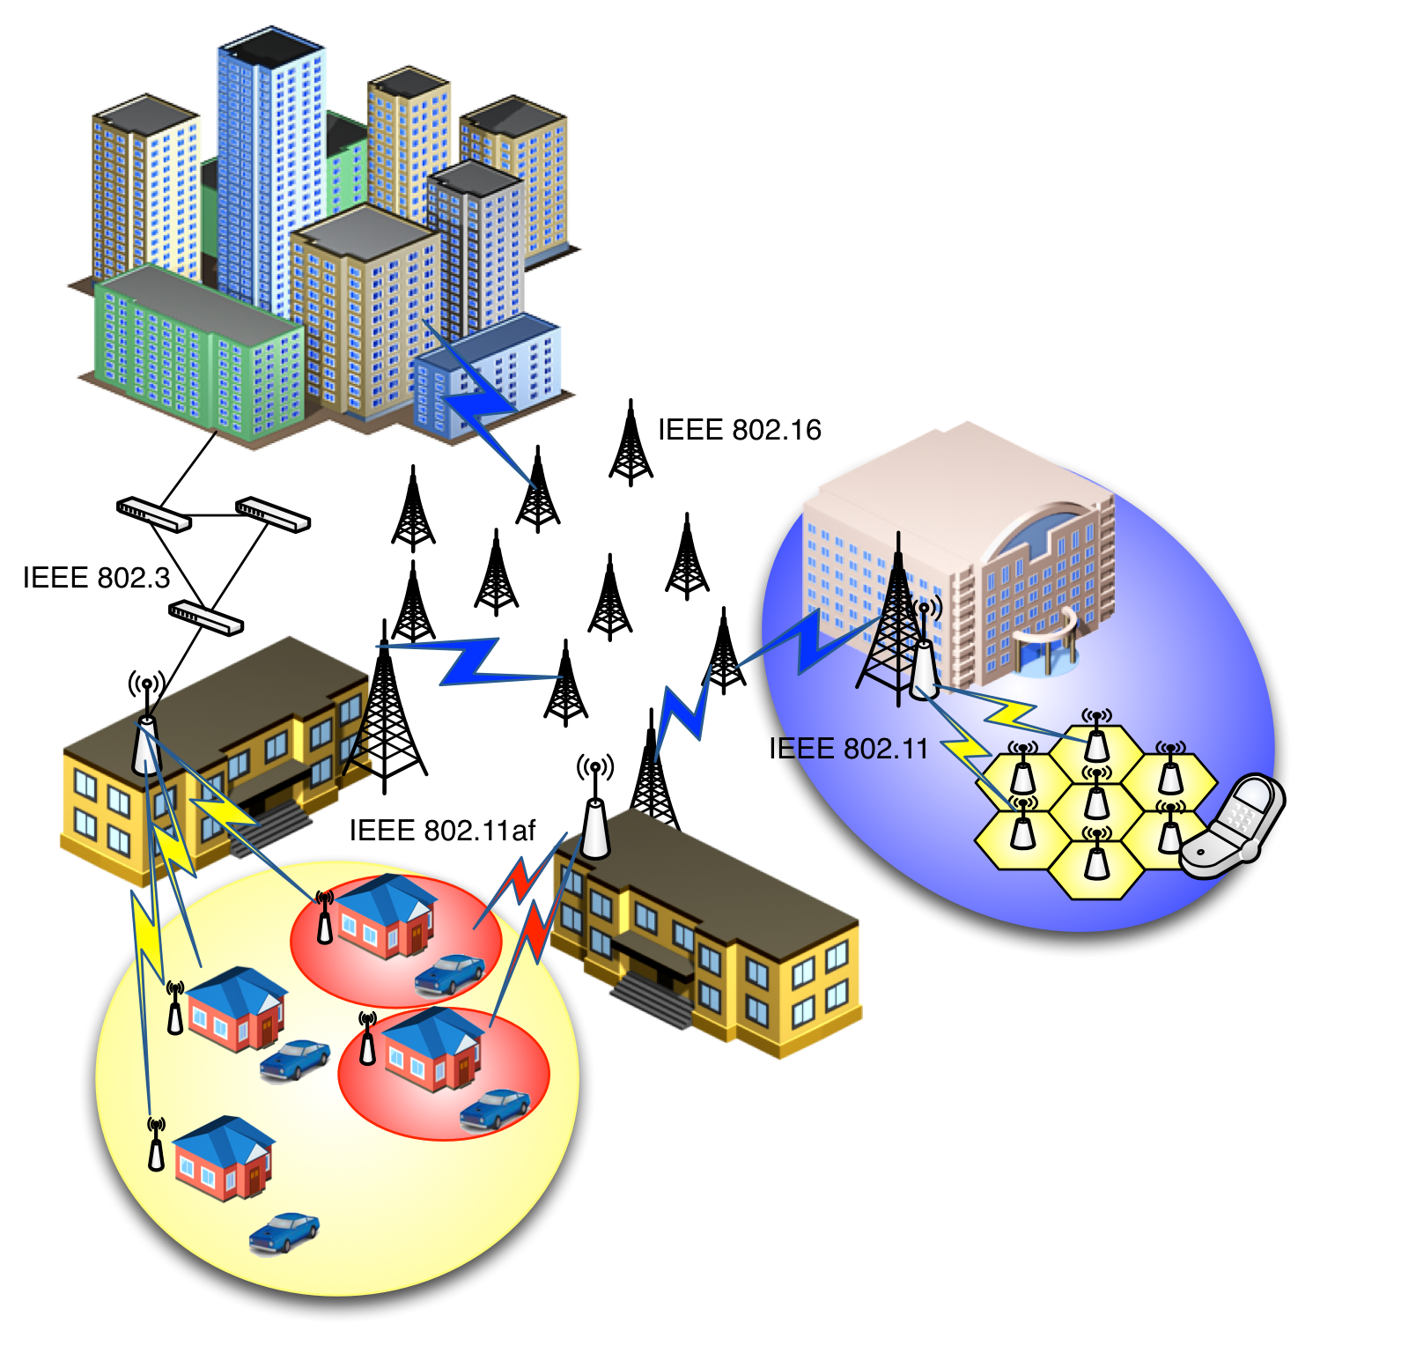
Scenario

Slide 11
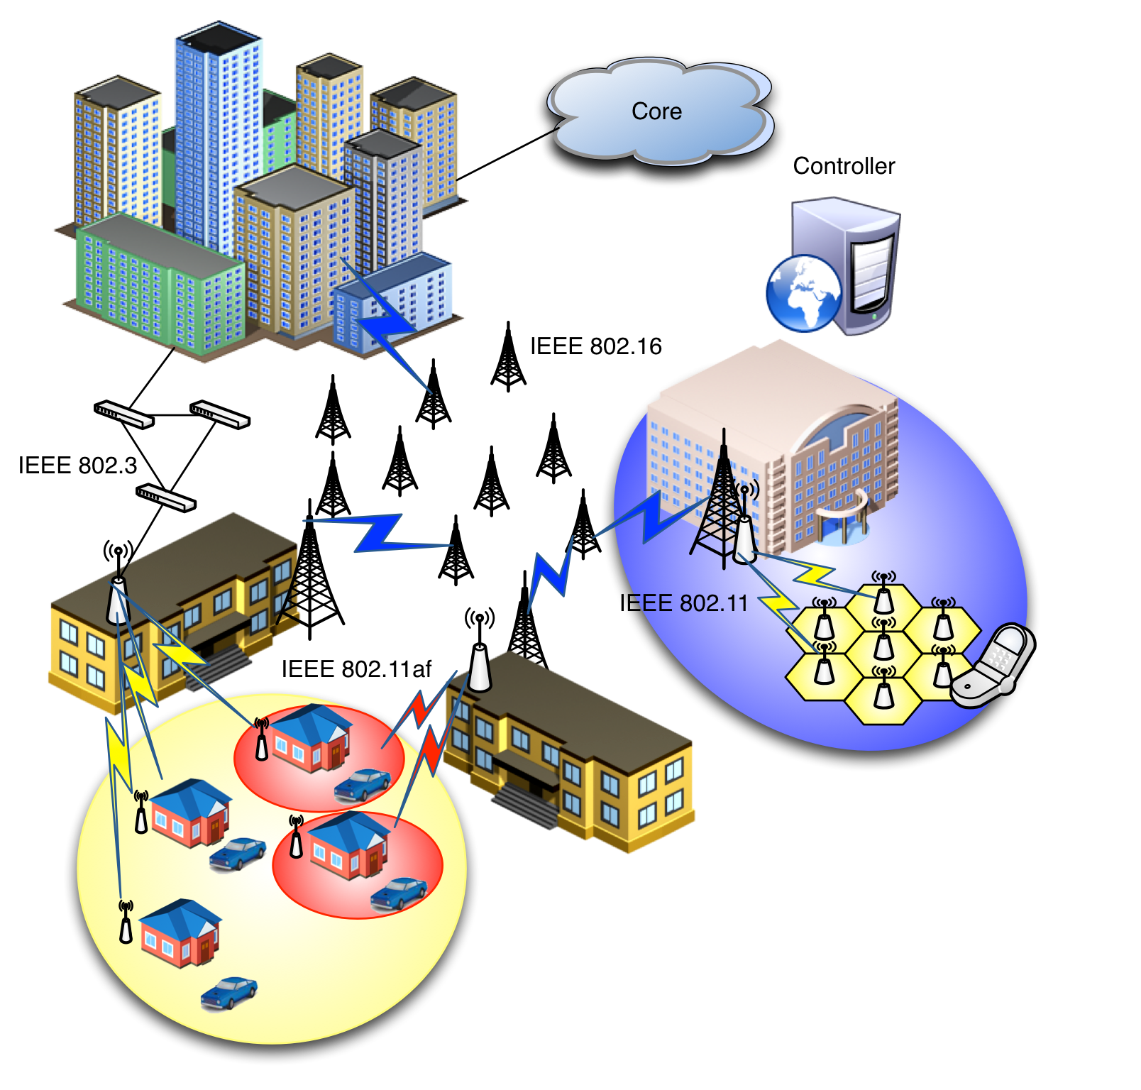
Scenario
Configuration of links from backhaul/core to terminal
Dynamic creation of data paths with dynamic reconfiguration and mapping to the terminal

Slide 12
GAP analysis
Currently the following missing functionalities have been identified:
  Configuration of heterogeneous IEEE 802 Links, including radio parameters (e.g. R1)
  Creation of data paths across 802 links (i.e. R3 provisioning)
    Configuration of end to end QoS characteristics per flow
  Mapping of user’s traffic to data paths across heterogeneous backhaul/core technologies (e.g. R2)
  Mobility support (e.g. R4 context transfer)
  User plane management of the multiple-interfaced MN
    Generic 802-based logical interface to present to IP

