Slide 1
Orchestration of SON features for WiFi Offloading using Network Empowerment Mechanisms
Date: 2013-05-15
Authors:
Name | Affiliation | Phone | Email
Marc Emmelmann | Fokus | +49 30 3463 7265 | Marc.emmelmann@fokus.fraunhofer.de
Notice: This document does not represent the agreed view of the OmniRAN EC SG. It represents only the views of the participants listed in the ‘Authors:’ field above. It is offered as a basis for discussion. It is not binding on the contributor, who reserve the right to add, amend or withdraw material contained herein.
Copyright policy: The contributor is familiar with the IEEE-SA Copyright Policy <http://standards.ieee.org/IPR/copyrightpolicy.html>.
Patent policy: The contributor is familiar with the IEEE-SA Patent Policy and Procedures: <http://standards.ieee.org/guides/bylaws/sect6-7.html#6> and <http://standards.ieee.org/guides/opman/sect6.html#6.3>.
Abstract
This slideset presents the analysis of SON-based Offloading to WiFi use case as enabled by Univerself Network Emporwerment Mechanism. The presentation identifies functional requirements for reference points of the OmniRAN architecture.
Reference: http://www.univerself-project.eu

Slide 2
Orchestration of SON features for WiFi Offloading using Network Empowerment Mechanisms

Slide 3
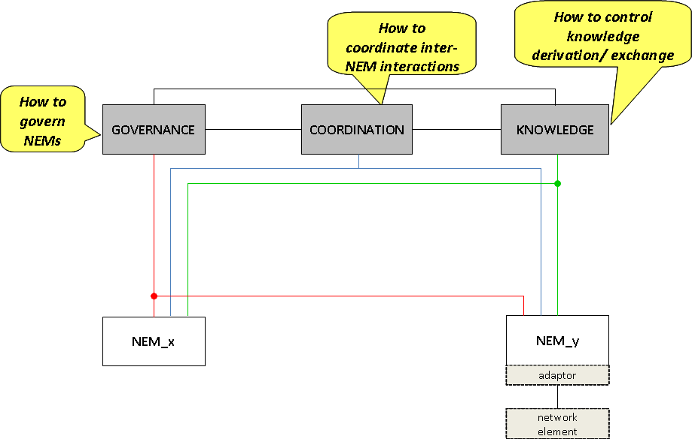
Use Case And Problem Statement
Self-orchestration of SON
features for WiFi-Offloading
Goal: Simplify network operation
and improve its performance
by means of coordinated
SON entities enforcing
operator objectives
Problem: the governance and
orchestration of offloading schemes
requires technology-agnostic interfaces
for managing connections over a specific
technology, as well as obtaining KPIs as
input to decision algorithms.
Network Empowerment Mechanisms provide such a north-bound abstraction → OmniRan can provide the south-bound solution

Slide 4
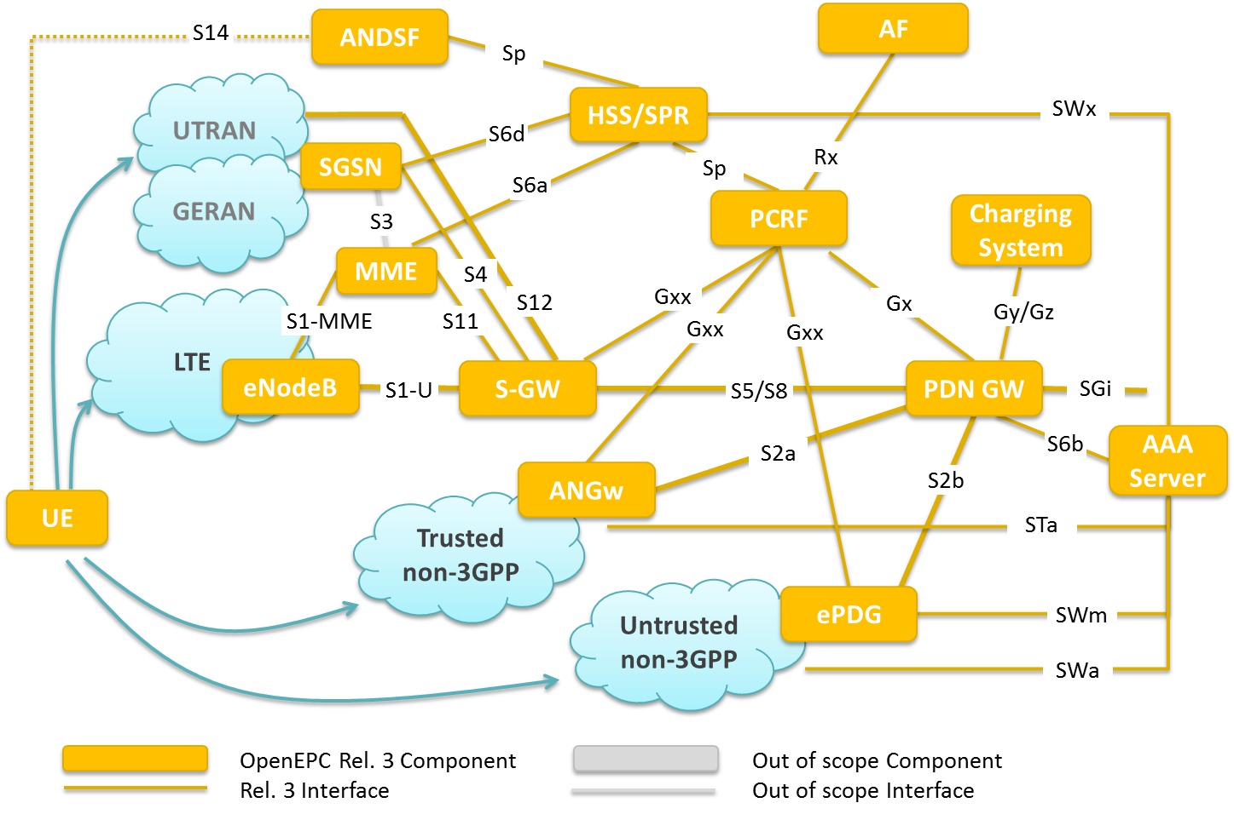
Required Technology Agnostic Abstraction for WiFi Offloading
Evolve towards a “technology agnostic” IEEE-based access network and associated Network Empowerment Mechanisms

Slide 5
Abstraction of KPIs for technology agnostic offloading employing self-organization
HO related counters/indicators
Indicators/counters composed for too late HOs, too early HOs, HOs to a wrong cell and HOs subsequent to a connection setup
HO/(re)selection
Number of HOs (incoming+outgoing etc.)
Antenna config. (tilt, MIMO etc.)
Ping-pong HOs
QoS counters/indicators
HOSR
DL transmit power (RS+TCH)
Traffic/capacity counters/indicators
BER
UL transmit power
BLER
Cell switch ON/OFF
Outage
Avg. throughput
Scheduling (RB assignment/preferences)
Number of calls
hours and/or data communicated
ICIC thresholds (reporting, RSRP)
CSSR
System/cell load information
Parameters related to SFR, FFR schemes
Delay counters/indicators
Energy expenses
OPEX linked to energy expenses
RACH related parameters
Coverage counters/indicators
Access delay
Call setup delay
CCO
MRO
ICIC
HO delay
ES
MLB
IR
RACH
BCR
DCR

Slide 6
Relation OmniRAN 3GPP
R2 – maybe S14, but is all functionality provided?
R1 – SWw
R3 -- ???

Slide 7
Functional Requirements – what is missing for building NEMs via OmniRAN
R1:
  Tighter control of access prioritization per terminal
R2:
  Control of choice of access network and technology
  Exposure of KPIs including details on link states of R1 interface
R3:
  Control of allowing access of particular mobiles to a given technology, even to specific access nodes

Slide 8
References
http://www.univerself-project.eu
Univerself D4.3 -- Assessment Results of Trust in Autonomics
http://www.openepc.net

