Slide 1
Brief Introduction to OmniRAN P802.1CF
Date: 2013-12-19
Authors:
Name | Affiliation | Phone | Email
Max Riegel | NSN | +49 173 293 8240 | maximilian.riegel@nsn.com
Notice: This document does not represent the agreed view of the OmniRAN EC SG. It represents only the views of the participants listed in the ‘Authors:’ field above. It is offered as a basis for discussion. It is not binding on the contributor, who reserve the right to add, amend or withdraw material contained herein.
Copyright policy: The contributor is familiar with the IEEE-SA Copyright Policy <http://standards.ieee.org/IPR/copyrightpolicy.html>.
Patent policy: The contributor is familiar with the IEEE-SA Patent Policy and Procedures: <http://standards.ieee.org/guides/bylaws/sect6-7.html#6> and <http://standards.ieee.org/guides/opman/sect6.html#6.3>.
Abstract
OmniRAN ECSG successfully proposed a P802.1CF PAR on Recommended Practice on Network Reference Model and Functional Description of IEEE 802 Access Network.
This slide set provides a brief introduction into the rationales and thoughts leading to the PAR proposal and also outlines the intended content of the 802.1CF specification.

Slide 2
Brief Introduction to
OmniRAN P802.1CF
Max Riegel
2013-12-19
(NSN)

Slide 3
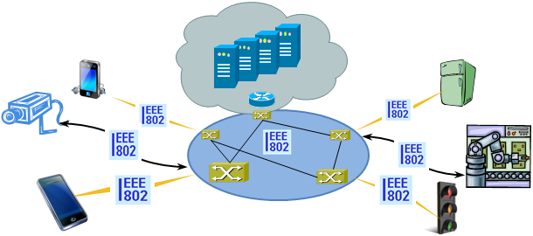
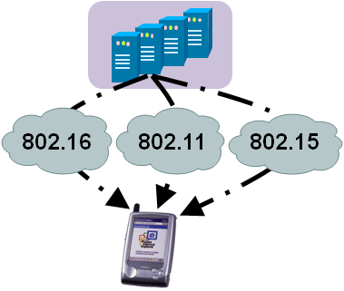


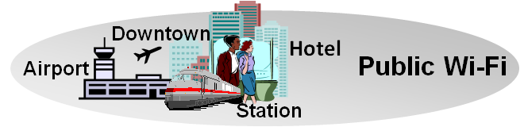
There is Evidence to consider Commonalities of IEEE 802 Access Networks
More (huge) networks are coming
up by everything gets connected
  e.g. SmartGrid, ITS, IoT, …
New markets for
IEEE 802 access technologies
  e.g. factory automation, in-car communication, home automation, …
IEEE 802 access is becoming more heterogeneous
  multiple network interfaces
    e.g. IEEE 802.3, IEEE 802.11, IEEE 802.15…
  multiple access network topologies
    e.g. IEEE802.11 in residential, corporate and public
  multiple network subscriptions
    e.g. multiple subscriptions for same interface
New emerging techniques, like SDN and virtualization

Slide 4

Gap Analysis to define the standardization needs for a common IEEE 802 access network
Defining a simplistic network reference model,
a couple of use cases were investigated:
  3GPP Trusted WLAN Access to EPC
    TS 23.402 V11.6.0 (2013-03)
  ZigBee SEP2 Smart Grid Use Case
    ZigBee docs-09-5449-33-0zse
  SDN-based OmniRAN Use Case
Initial investigations show missing functionalities in some IEEE 802 specifications regards the investigated use cases.
  Sharing of findings in progress with the related working group and investigations will continue directly together with working groups.
Main issue was, that it was less than obvious how the pieces of IEEE 802 are fitting together
  There is need for better documentation how IEEE 802 protocols work together to create access networks for particular deployments
  There is no consistent way how IEEE 802 handles the IEEE 802 information elements going over IP protocols (external control interfaces)
Terminal
R2
Access
Ctrl
R1
R3
Internet

Slide 5
IEEE 802 demands a kind of ‘Stage 2’
Network Specification in 3 Stages
For the specification of the Integrated Services Digital Network the ITU-T defined in its Rec. I.130 a sequential 3 stage process,.
This process is nowadays commonly used in most telecommunication network standardization activities.
A Stage 2 specification provides a mapping of protocols to a functional network model, which facilitates easier evaluation.
‘External’ requirements from the
service/deployment perspective
Develop a logical/functional model
for evaluation of those requirements;
Available IEEE 802 specifications
of protocols and attributes.
?
?
More Information: ETSI: Making Better Standards
  http://docbox.etsi.org/MTS/MTS/10-PromotionalMaterial/MBS-20111118/protocolStandards/stagedApproach.htm

Slide 6
IEEE 802 demands a kind of ‘Stage 2’
Network Specification in 3 Stages
For the specification of the Integrated Services Digital Network the ITU-T defined in its Rec. I.130 a sequential 3 stage process,.
This process is nowadays commonly used in most telecommunication network standardization activities.
A ‘Stage 2’ specification would provide a mapping of the existing IEEE 802 protocols to a functional network model, which facilitates easier evaluation and better understanding of end-to-end behavior.
‘External’ requirements from the
service/deployment perspective
Develop a logical/functional model
for evaluation of those requirements;
Available IEEE 802 specifications
of protocols and attributes.
?

Slide 7
P802.1CF Project Authorization Request
Project Title:
Network Reference Model and Functional Description of IEEE 802 Access Network
Scope:
This Recommended Practice specifies an access network, which connects terminals to their access routers, utilizing technologies based on the family of IEEE 802 Standards by providing an access network reference model, including entities and reference points along with behavioral and functional descriptions of communications among those entities.
Purpose:
Heterogeneous networks may include multiple network interfaces, multiple network access technologies, and multiple network subscriptions. In some cases such heterogeneous functionality must be supported in a single user terminal.
This Recommended Practice supports the design and deployment of access networks based on IEEE 802 technologies, guides the developers of extensions to the existing standards in support of a heterogeneous access network, and enables the use of IEEE 802 standards in new network deployments by specifying the functions of the IEEE 802 technologies when deployed in access networks.

Slide 8
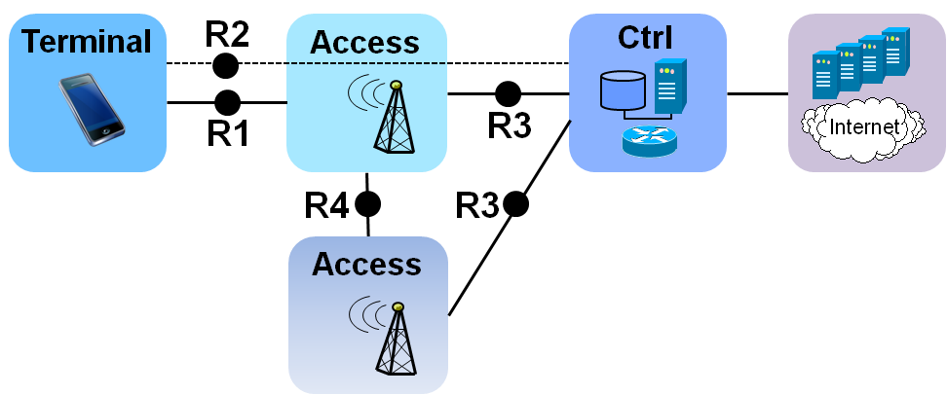
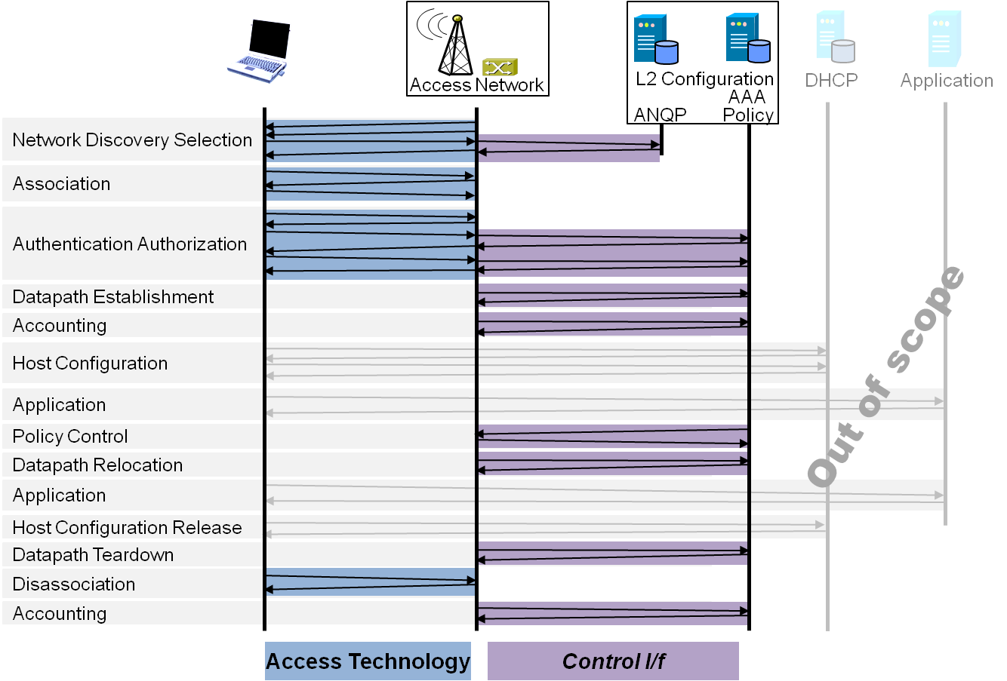
Draft ToC of the proposed specification
Introduction and Scope
Abbreviations, Acronyms, Definitions, and Conventions
References
Identifiers
Tenets for IEEE 802 Access Network Systems
Network Reference Model
  Overview
  Reference Points
  Access Network Control Architecture
    Multiple deployment scenarios
Functional Design and Decomposition
  Network Discovery and
  Selection
  Association
  Authentication and Authorization
  Datapath establishment
  QoS and policy control
  Datapath relocation
  Datapath teardown
  Disassociation
  Accounting

