Slide 1
IEEE 802 based RAN Setup
Date: 2014-02-xx
Authors:
Name | Affiliation | Phone | Email
Yonggang Fang | ZTE |  | yfang@ztetx.com
Bo Sun | ZTE |  | sun.bo1@zte.com.cn
Notice: This document represents only the views of the participants listed in the ‘Authors:’ field above. It is offered as a basis for discussion. It is not binding on contributors, who reserve the right to add, amend or withdraw material contained herein.
Copyright policy: The contributor is familiar with the IEEE-SA Copyright Policy <http://standards.ieee.org/IPR/copyrightpolicy.html>.
Patent policy: The contributor is familiar with the IEEE-SA Patent Policy and Procedures: <http://standards.ieee.org/guides/bylaws/sect6-7.html#6> and <http://standards.ieee.org/guides/opman/sect6.html#6.3>.
Abstract
This contribution provides IEEE 802 based RAN architecture for shared access and high level setup procedures in Recommended Practice document.

Slide 2
RAN architecture
IEEE 802 RAN Recommended Practice

Slide 3




IEEE Based RAN Architecture – Option 1
AP1
Access Abstraction
SDN
(backhaul)
Core
Operator
R4-C
R4-D
R3-D
Internet
Station
AP2
Backhaul Abstraction
Core Network(s)
R1
Access Abstraction
Access Abstraction
R2
R3-C/R3-M
Shared Access
DataBase
AP1
SDN
Controller
Access Abstraction
RAN
Data path
Control/Management path

Slide 4
IEEE Based RAN Architecture – Option 2
AP1
Access Abstraction
SDN
(backhaul)
Core
Operator
R4-C
R4-D
R3-D
Internet
Station
AP2
Backhaul Abstraction
Core Network(s)
R1
Access Abstraction
Access Abstraction
R2
R3-C
Shared Access
DataBase
SDN
Controller
AP1
Access Abstraction
R3-M
SA
Controller
RAN
Data path
Control/Management path

Slide 5
IEEE Based RAN Architecture
Functional Entities
  Access Point (AP):
    IEEE 802 based AP provides radio access connectivity to the IEEE 802 based stations in the license-exempt frequency channel(s) or shared access in authorized license frequency channel(s).
  SDN Controller:
    Manage the radio access network and backhaul network setup and configuration
    Control the user data plane setup and configure traffic forwarding
  SA Controller (for option 2):
    Manage radio access network setup and configuration.

Slide 6
IEEE Based RAN Architecture
Functional Entities (continued)
  Shared Access Database (SA-DB)
    SA-DB is used to store information (for such as TV white space) of
      shared access spectrum frequency band and channels information
      shared access spectrum geo-location information
      maximum transmit power in the authorized shared access spectrum
      Primary service provider and secondary service providers and their operating status
    SA-DB may not be necessary for operating in the license-exempt bands.

Slide 7
IEEE Based RAN Architecture
Separated Planes
  Data Plane Functionalities:
    carrying, sequencing, tunneling, forwarding the user data traffic between the Core network, AN and Stations
  Control Plane Functionalities:
    service management, user traffic connection setup, mobility management, accounting management, etc.
  Management Plane Functionalities
    carrying signals used for authenticating, controlling and managing IEEE 802 based RAN infrastructure; and support configuration for SDR (such as shared access) and SDN.

Slide 8
RAN setup Procedure
IEEE 802 RAN Recommended Practice

Slide 9
Shared Access RAN Setup Procedure
IEEE 802 RAN
IP Network
STA
AP
SDN/SA Controller
SDN
PDN-GW
SA-DB
Setup the control link and
Configure the backhaul connection
SA Registration Request
SA Registration Request
SA Registration Response
SA Registration Response
SA Information Request
SA Information Request
SA Information Response
SA Information Response
SA Use Notification
SA Use Notification
SA Use Response
SA Use Response
Configure IEEE 802 radio
Tx beacon

Slide 10
License Exempt RAN Setup Procedure
IEEE 802 RAN
IP Network
STA
AP
SDN/SA Controller
SDN
PDN-GW
SA-DB
Setup the control link and
Configure the backhaul connection
Scan license exempt bands to
find a less congested channel
Configure IEEE 802 radio
Tx beacon

Slide 11
backup
IEEE 802 RAN Recommended Practice

Slide 12
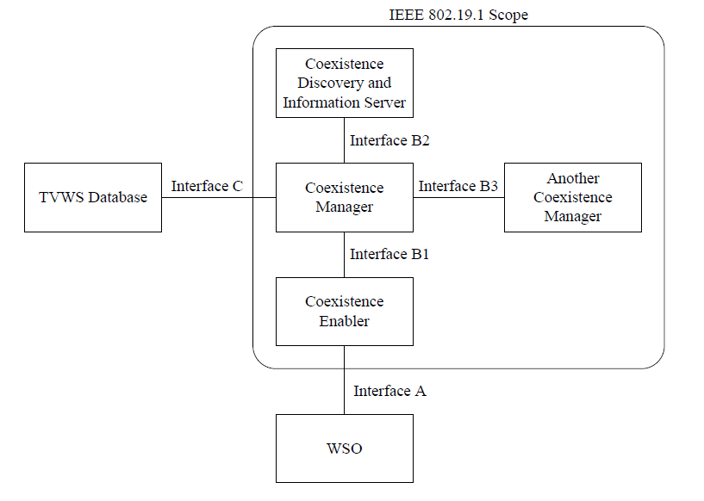
Backup
IEEE 802.19.1 Co-existence architecture for shared access

Slide 13
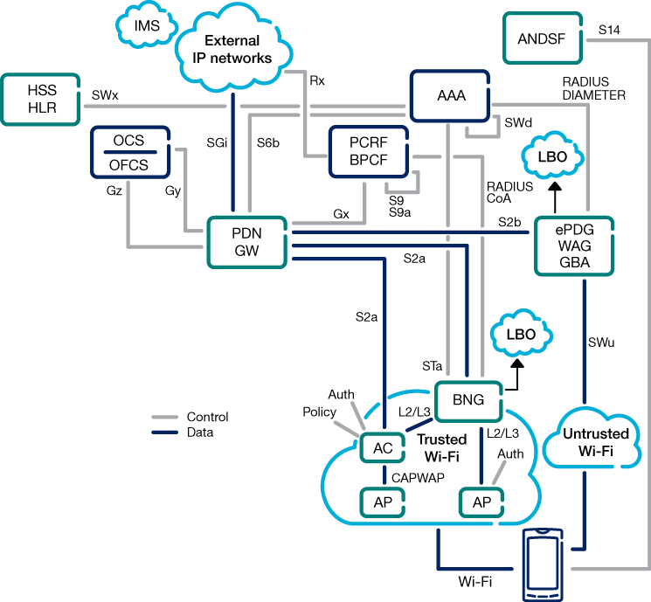
Backup
3GPP-WLAN Interworking Architecture

