Slide 1
Cooperations for
OmniRAN P802.1CF
Max Riegel, NSN
(Chair OmniRAN TG)

Slide 2
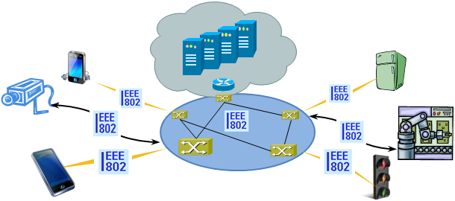
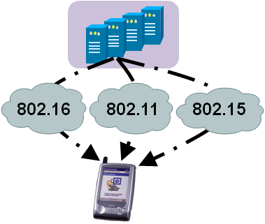


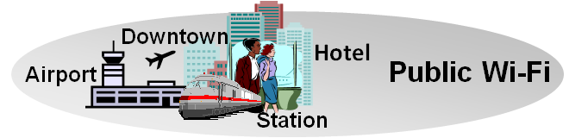
There is Evidence to consider Commonalities of IEEE 802 Access Networks
More (huge) networks are coming
up by everything gets connected
  e.g. SmartGrid, ITS, IoT, …
New markets for
IEEE 802 access technologies
  e.g. factory automation, in-car communication, home automation, …
IEEE 802 access is becoming more heterogeneous
  multiple network interfaces
    e.g. IEEE 802.3, IEEE 802.11, IEEE 802.15…
  multiple access network topologies
    e.g. IEEE802.11 in residential, corporate and public
  multiple network subscriptions
    e.g. multiple subscriptions for same interface
New emerging techniques, like SDN and virtualization

Slide 3
OmniRAN P802.1CF provides a kind of ‘Stage 2’ Specification for IEEE 802
The ITU-T defined in its Rec. I.130 a sequential 3 stage process, which is nowadays commonly used in most telecommunication network standardization activities.
A ‘Stage 2’ specification provides a mapping of the existing IEEE 802 protocols to a functional network model, which facilitates easier evaluation and better understanding of end-to-end behavior.
‘External’ requirements from the
service/deployment perspective
Develop a logical/functional model
for evaluation of those requirements
Available IEEE 802 specifications
of protocols and attributes.
?

Slide 4
P802.1CF Project Authorization Request
Project Title:
Network Reference Model and Functional Description of IEEE 802 Access Network
Scope:
This Recommended Practice specifies an access network, which connects terminals to their access routers, utilizing technologies based on the family of IEEE 802 Standards by providing an access network reference model, including entities and reference points along with behavioral and functional descriptions of communications among those entities.
Purpose:
Heterogeneous networks may include multiple network interfaces, multiple network access technologies, and multiple network subscriptions. In some cases such heterogeneous functionality must be supported in a single user terminal.
This Recommended Practice supports the design and deployment of access networks based on IEEE 802 technologies, guides the developers of extensions to the existing standards in support of a heterogeneous access network, and enables the use of IEEE 802 standards in new network deployments by specifying the functions of the IEEE 802 technologies when deployed in access networks.

Slide 5
Key constraints for P802.1CF
Essential task is to reverse engineer a ‘Stage 2’ document based on the existing IEEE 802 protocols to document an IEEE 802 access network
  Show, how the IEEE 802 protocols fit together
  Show, that required functionality is available
  Gaps may appear, but addressing them is not in the scope of OmniRAN
The specification establishes a Recommended Practice
  It provides common understanding however does not exclude other solutions
  It may lead to better alignment of capabilities of IEEE 802 access technologies (wired as well as wireless)
Aim is to sharpen the understanding of IEEE 802 for the deployment in access networks
  Provide a kind of cookbook to network engineers
  Provide a reference specification to other organizations and operators

Slide 6
OmniRAN in the big picture of the Internet
Internet
Peer
(Client)
Peer
(Server)
Internet/Web Applications
WWW
WWW
HTTP
HTTP
TCP
TCP
IP
IP
IP
IP
IP
IP
IP
IP
LINK
LINK
LINK
LINK
LINK
LINK
LINK
LINK
LINK
LINK
LINK
LINK
PHY
PHY
PHY
PHY
PHY
PHY
PHY
PHY
PHY
PHY
PHY
PHY
OmniRAN Domain
Access
Router
UE

Slide 7

Scope of OmniRAN P802.1CF mapped to the IEEE 802 Reference Model
STA
Higher Layers
Control Entity
CORE
Higher Layers Control I/f
Higher Layers Control I/f
Scope of IEEE 802
Data Link
Access Network
Data Link
Data Link
Data Link
Data Link
Data Link
Physical
R1
Physical
Physical
Physical
Physical
Physical
Medium
Medium
Medium
P802.1CF will define an abstraction of an access network based on IEEE 802 technologies
  The access network provides the link between a station (IP host) and the first hop router
The abstraction leads to very few generic interfaces for all kind of implementations
  R1 represents the PHY and MAC layer functions between terminal and base station, which are completely covered by the IEEE 802 specifications
  R2 represents a control interface between terminal and central control entity, e.g. for authentication
  R3 represents a control interface between the access network and a central control entity and the data path interface towards the first hop router, which is defined by the IEEE 802 Data Link SAP.

Slide 8
SDN is part of OmniRAN
Control Entity
CORE
Higher Layers Control I/f
Data Link
Data Link
Physical
Physical
Medium
Medium
Openflow Switch Specification v1.3.2
SDN is based on the same architectural model as used by OmniRAN to describe the access infrastructure within the scope of IEEE 802
Effectively access networks enabling dynamic attachment of terminals to a communication infrastrucute have always been a kind of ‘software defined’ networks.
  ‘Software’ can just be considered as a synonym of the control protocols of the legacy access networks models.

Slide 9
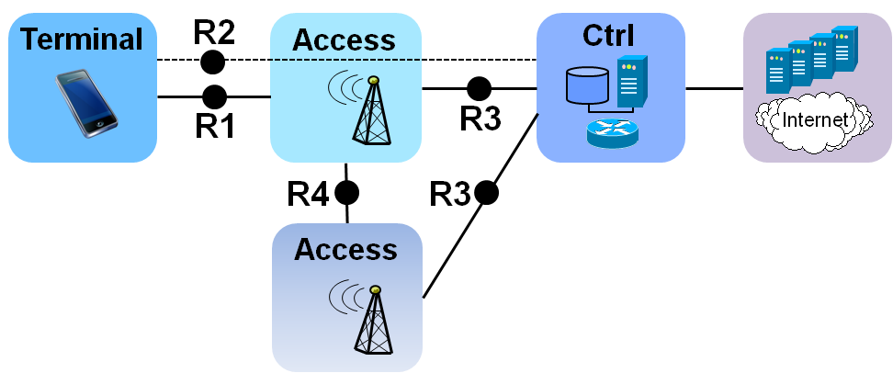
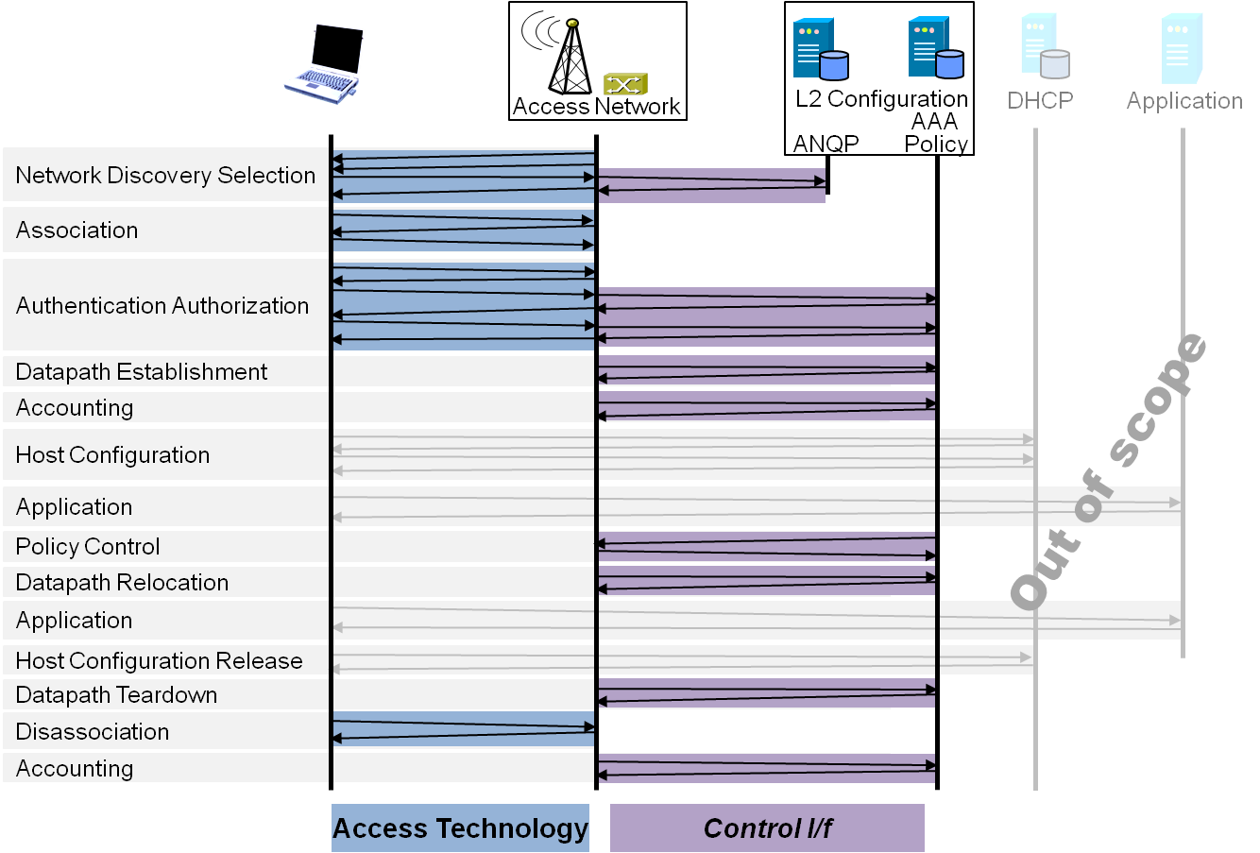
P802.1CF Draft ToC
Introduction and Scope
Abbreviations, Acronyms, Definitions, and Conventions
References
Identifiers
Network Reference Model
  Overview
  Reference Points
  Access Network Control Architecture
    Multiple deployment scenarios
Functional Design and Decomposition
  Access Network Preconfiguration
  Network Discovery and Selection
  Association
  Authentication and Authorization
  Datapath establishment
  QoS and policy control
  Datapath relocation
  Datapath teardown
  Disassociation
  Accounting
SDN Abstraction
  Terminal
  Access and Backhaul
Annex:
  Tenets (Informative)

Slide 10
Example Chapter Structure
Functional Design and Decomposition
  Access network preconfiguration
  Network Discovery and Selection
    Generic functional requirements and information flows
    Ethernet functional design <- 802.3
    WPAN functional design <- 802.15
    WLAN functional design <- 802.11
    WMAN functional design <- 802.16
    WRAN functional design <- 802.22
  Association
  Authentication and Authorization
  Datapath establishment
  QoS and policy control
  Datapath relocation
  Datapath teardown
  Disassociation
  Accounting

Slide 11




NDS Functional Requirements
IEEE 802 network discovery and selection should support more complex scenarios:
  Multiple access technologies
  Multiple different access networks
  Multiple subscriptions
  Specific service requirements
  No a-priori knowledge about offered services
Access Network
>1<
CORE
A
CORE
C
Access Network
>2<
CORE
B
Access
Network
>3<

Slide 12
NDS Roles and Identifiers
User
  One or more Subscriptions
    Subscription Identifier {NAI} + Subscription Name {String}
Terminal
  Station
    STA {EUI-48}
Access Network
  One or more Access Network Interfaces
    ANI {EUI-48}
  Access Network
    AN Identifier {EUI-48} + AN Name {String}
  Supported Subscription Services
  Supported User Services
  Access Network Capabilities
    Record of capabilities {t.b.d. (ANQP???}
CORE
  Subscription Service – ‘Termination point of AAA’
    SSP Identifier {FQDN} + SSP Name {String}
  User Service – ‘Termination point of IEEE 802 user plane’
    USP Identifier {???} + USP Name {String}
FFS: Is model sufficient for complex roaming scenarios?
Split of CORE into SSP and USP (control- & user plane functions)?

Slide 13
Network Discovery and Selection
Functions
A process which allows a station to retrieve the list of all access network interfaces in reach by
  Passive scanning
  Active scanning
  Data base query
Retrieving supplementory information for each of the access network interfaces to learn about
  Identity of the access network
  Supported Subscriptions
  Supported Services
Some algorithm in the station, which processes all the retrieved information, for determination of the ‘best’ access network interface to connect to.

Slide 14
NDS Technology Specific Design
 |  | 802.3 | 802.11 | 802.15 | 802.16 | 802.22
Identifiers | STA | EUI-48 | EUI-48 | EUI-64 | EUI-48 | EUI-48
 | ANI | EUI-48 | EUI-48 | EUI-64 | EUI-48 | EUI-48
 | AN-id | ??? | EUI-48 | ??? | EUI-48 | EUI-48
 | AN-name | 256 Char | 30 Char | ???
Subscriptions |  | NAI | NAI/PSK | ???/PSK | NAI | NAI
Multiple COREs |  | Info | ANQP | - | ? | -
Discovery process |  | manual | passive, active | passive, active | passive | passive
A specific section for each of the IEEE 802 access technologies should explain, how the generic requirements are supported and realized.
  It would be great, if references into the specifications would be provided.
OmniRAN would like to engage subject matter experts of the 802 WGs for creating the contributions on the particular access technologies.
  Necessary effort should be managable once a kind of template is established.
A thorough review should be performed by the WGs to ensure that the access technology specific content of P802.1CF is correct.

Slide 15

Cooperation inside 802.1
E.g.: PtP Link Behavior for Access Networks
CORE
A
CORE
B
Point-to-point link behavior is required to
  Enforce all traffic passing through the CORE
  Isolate terminal communication in a shared infrastructure
Mobility support is required in the bridged infrastructure
  Without impacting IP connectivity, i.e. IP session has to be maintained while moving
Point-to-point link state signalling required towards CORE

Slide 16
Realization of point-to-point link behavior in Access Networks
Access Network Model – the desired solution
STA
AP/BS
AR/Ctrl
IP
DLL
DLL
IP
DLL
DLL
PHY
DLL
DLL
PHY
DLL
DLL
PHY
PHY
PHY
PHY
PHY
PHY
Access Network Model – nowadays real world solution
STA
AP/BS
GW
AR/Ctrl
IP
ETH
ETH
IP
DLL
DLL
GRE
GRE
ETH
ETH
PHY
PHY
IP
IP
PHY
PHY
ETH
ETH
ETH
ETH
PHY
PHY
PHY
PHY

Slide 17
PtP Link Solution Approaches
Establish dedicated VLAN for each terminal
  Q-in-Q
    Scalability issue, max 4094 ptp links may not be enough
  MAC-in-MAC
    Seems to be feasible, for further study
Establish secured connection for each terminal across bridged infrastructure
  MACsec
    Seems to be feasible, for further study

Slide 18
Conclusion
The P802.1CF specification provides a kind of functional framework across all IEEE 802 access technologies.
The creation of the OmniRAN P802.1CF specification requires cooperation
  within IEEE 802.1
  but also with most of the other IEEE 802 WGs.
Subject matter experts wanted across all WGs to contribute and review technology specific input for P802.1CF.
  Most convenient working methods in OmniRAN TG required to make contributions happen
    E.g., a kind of template for each kind of contribution may reduce the necessary effort.

