Slide 1
IEEE 802.1 OmniRAN TG
November 2014 F2F Meeting
2014-11-06
Max Riegel, Nokia Networks
(OmniRAN TG Chair)

Slide 2
November 2014 F2F Meeting
Venue
  Grand Hyatt San Antonio,
  600 East Market Street, San Antonio, TX USA
Sessions; meeting room (2nd level)
  Mon, Nov 3rd, 14:00 - 18:00; Mission A
  Tue, Nov 4th, 13:30 - 18:00; Lone Star B
  Wed, Nov 5th, 13:30 - 18:00; Mission A
  Thu, Nov 6th, 09:00 - 12:30; Mission A

Slide 3
Participants, Patents, and Duty to Inform
All participants in this meeting have certain obligations under the IEEE-SA Patent Policy.
Participants [Note: Quoted text excerpted from IEEE-SA Standards Board Bylaws subclause 6.2]:
  “Shall inform the IEEE (or cause the IEEE to be informed)” of the identity of each “holder of any potential Essential Patent Claims of which they are personally aware” if the claims are owned or controlled by the participant or the entity the participant is from, employed by, or otherwise represents
    “Personal awareness” means that the participant “is personally aware that the holder may have a potential Essential Patent Claim,” even if the participant is not personally aware of the specific patents or patent claims
  “Should inform the IEEE (or cause the IEEE to be informed)” of the identity of “any other holders of such potential Essential Patent Claims” (that is, third parties that are not affiliated with the participant, with the participant’s employer, or with anyone else that the participant is from or otherwise represents)
The above does not apply if the patent claim is already the subject of an Accepted Letter of Assurance that applies to the proposed standard(s) under consideration by this group
Early identification of holders of potential Essential Patent Claims is strongly encouraged
No duty to perform a patent search

Slide 4
Patent Related Links
All participants should be familiar with their obligations under the IEEE-SA Policies & Procedures for standards development.
Patent Policy is stated in these sources:
  IEEE-SA Standards Boards Bylaws
  http://standards.ieee.org/develop/policies/bylaws/sect6-7.html#6
  IEEE-SA Standards Board Operations Manual
  http://standards.ieee.org/develop/policies/opman/sect6.html#6.3
Material about the patent policy is available at
  http://standards.ieee.org/about/sasb/patcom/materials.html
If you have questions, contact the IEEE-SA Standards Board Patent Committee Administrator at patcom@ieee.org or visit http://standards.ieee.org/about/sasb/patcom/index.html
This slide set is available at
https://development.standards.ieee.org/myproject/Public/mytools/mob/slideset.ppt

Slide 5
Call for Potentially Essential Patents
If anyone in this meeting is personally aware of the holder of any patent claims that are potentially essential to implementation of the proposed standard(s) under consideration by this group and that are not already the subject of an Accepted Letter of Assurance:
  Either speak up now or
  Provide the chair of this group with the identity of the holder(s) of any and all such claims as soon as possible or
  Cause an LOA to be submitted

Slide 6
Other Guidelines for IEEE WG Meetings
All IEEE-SA standards meetings shall be conducted in compliance with all applicable laws, including antitrust and competition laws.
Don’t discuss the interpretation, validity, or essentiality of patents/patent claims.
Don’t discuss specific license rates, terms, or conditions.
  Relative costs, including licensing costs of essential patent claims, of different technical approaches may be discussed in standards development meetings.
    Technical considerations remain primary focus
Don’t discuss or engage in the fixing of product prices, allocation of customers, or division of sales markets.
Don’t discuss the status or substance of ongoing or threatened litigation.
Don’t be silent if inappropriate topics are discussed … do formally object.
---------------------------------------------------------------
  See IEEE-SA Standards Board Operations Manual, clause 5.3.10 and “Promoting Competition and Innovation: What You Need to Know about the IEEE Standards Association's Antitrust and Competition Policy” for more details.

Slide 7
Resources – URLs
Link to IEEE Disclosure of Affiliation
  http://standards.ieee.org/faqs/affiliationFAQ.html
Links to IEEE Antitrust Guidelines
  http://standards.ieee.org/resources/antitrust-guidelines.pdf
Link to IEEE Code of Ethics
  http://www.ieee.org/web/membership/ethics/code_ethics.html
Link to IEEE Patent Policy
  http://standards.ieee.org/board/pat/pat-slideset.ppt

Slide 8
Nov 2014 Agenda Graphics
 | Mon 11/3 | Tue 11/4 | Wed 11/5 | Thu 11/6 | Fri 11/7
08:00 10:00 | 802 EC Opening | 802.11 WNG | 802.11 ARC |  | 802.11 Closing
10:30 12:30 |  | 802.11 ARC | 802.11/802.15 Mid-week Plenaries
 | 802.1 Opening Plenary
 |  |  |  |  | 802 EC Closing
13:30 14:00 15:30 |  |  |  | 802.1 Closing Plenary
16:00 18:00
 | Tutorials | Joint 802.1/802.15

Slide 9
Agenda proposal for November 2014 F2F
Review of minutes
Reports
SDN & NFV Considerations
P802.1CF contributions
  Network reference model
  Functional design and decomposition
  SDN Abstraction
Project planning
Status report to IEEE 802 WGs
AOB

Slide 10
Business#1
Call Meeting to Order
  Meeting called to order by chair at 14:05
Minutes taker:
  Juan Carlos volunteers taking notes
Attendence recording
  Please sign in IMAT
Roll Call
Name | Affiliation |  | Name | Affiliation
Max Riegel | Nokia Networks |  | Hesham ElBakoury | Huawei
Juan Carlos Zuniga | Interdigital |  | Yonggang Fang | ZTE
Walter Pienciak | IEEE SA |  | Jim Welch | IneoQuest
Y.K. Kim | Catholic University |  | Ching-Tanng Hsieh | ITRI
Weiying Cheng | Coriant |  | Harry Bims | Bims Labs
Behcet Sarikaya | Huawei |  | Paul Bottorff | HP
Roger Marks | EthAirNet Ass.; ETRI |  | Kathryn Bennett | IEEE SA

Slide 11
Business#2
Approal of agenda
  Review of minutes
  Reports
  SDN & NFV Considerations
  P802.1CF contributions
    Network reference model
    Functional design and decomposition
    SDN Abstraction
  Project planning
  Status report to IEEE 802 WGs
  AOB
    No request for amendments
    Agreed by TG for the F2F meeting
Schedules of topics and presentaions
  SDN & NFV Considerations
    Tue 4-6pm (Hesham)
  Network reference model
    Wed PM1 & PM2
  Functional design and decomposition
    Mo PM2 (Behcet, Yonggang)
    Thu AM1 (Max)
  SDN Abstraction
    -

Slide 12
Business#3
Review of minutes
  https://mentor.ieee.org/omniran/dcn/14/omniran-14-0073-00-00TG-oct-21st-meeting-minutes.docx
  No comments brought up
Reports
  Juan Carlos reported about status of Privacy SG
    https://mentor.ieee.org/privecsg/dcn/14/privecsg-14-0017-00-ecsg-update-to-802-ec-at-nov-open-plenary-meeting.pptx
    No Wireless SDN BoF session this week
      However usual timeslot (Tue PM2) is used for SDN related discussions in OmniRAN
      Announcement to be send to the SDN mailing list
    No pending business on liaisons
P802.1CF contributions
  Functional design and decomposition
    https://mentor.ieee.org/omniran/dcn/14/omniran-14-0076-00-CF00-key-concepts-of-data-path-establishment-relocation-and-teardown.docx
      Next revision should mainly focus on more detailed structure
      More detailed content to be added later
    https://mentor.ieee.org/omniran/dcn/14/omniran-14-0078-00-CF00-updated-text-for-an-setup.docx
      802.1CF is limited to IEEE 802 technologies
        Models may not fit well with 3GPP approaches

Slide 13
Business#4
SDN & NFV Considerations
  https://mentor.ieee.org/omniran/dcn/14/omniran-14-0079-00-CF00-sdn-nfv.pptx
  https://mentor.ieee.org/omniran/dcn/14/omniran-14-0080-00-CF00-l2-openflow-onf-update.pptx
P802.1CF contributions
  Network reference model
    https://mentor.ieee.org/omniran/dcn/14/omniran-14-0068-02-CF00-generic-ieee-802-network-reference-model.docx
    https://mentor.ieee.org/omniran/dcn/14/omniran-14-0075-00-CF00-nrm-refinement-for-hybrid-access.pptx
    https://mentor.ieee.org/omniran/dcn/14/omniran-14-0077-00-CF00-updated-omniran-network-reference-model-with-backhaul.pdf
    https://mentor.ieee.org/omniran/dcn/14/omniran-14-0081-00-CF00-nrm-backhaul-considerations.pptx
    Conclusion of the discussion
      https://mentor.ieee.org/omniran/dcn/14/omniran-14-0083-00-00TG-p802-1cf-network-reference-model.docx
  Functional design and decomposition
    https://mentor.ieee.org/omniran/dcn/14/omniran-14-0082-00-CF00-network-discovery-and-selection.docx
      Move Roles and Identies out into global section
      Map to individual 802 technologies in each of the sections
  SDN Abstraction
    No new contributions available

Slide 14
Business#5
Project planning
  Mature sections on NDS, datapath establishment and dynamic spectrum access until Mar 2015
    ToC of datapath chapter to become topic of next confcall
  Create initial text on other sections
    Backhaul, entities and identifiers, authentication and SDN abstraction
  Initiate discussion with 802.1 Security TG in Mar 2015 F2F for getting the security chapter matured
  Create initial 802.1CF 0.1 draft after Mar 2015
  Population of all sections of draft may take until about Mar 2016
  Balloting for about a year
  Going to sponsor ballot about Mar 2017
Status report to IEEE 802 WGs
  https://mentor.ieee.org/omniran/dcn/14/omniran-14-0084-00-00TG-nov-2014-status-report-to-802-wgs.pptx

Slide 15
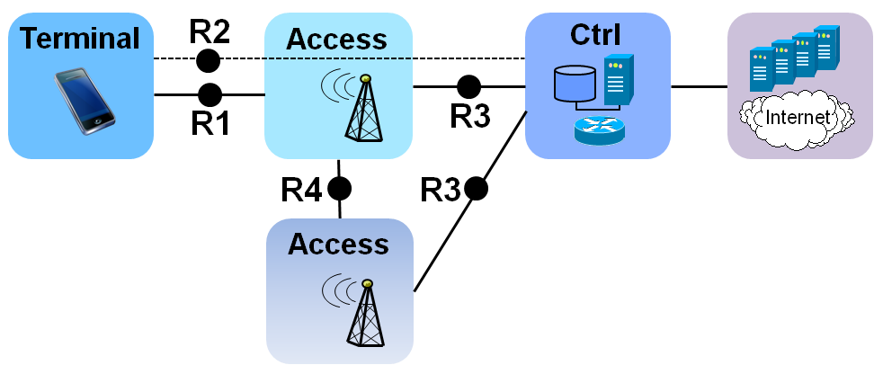
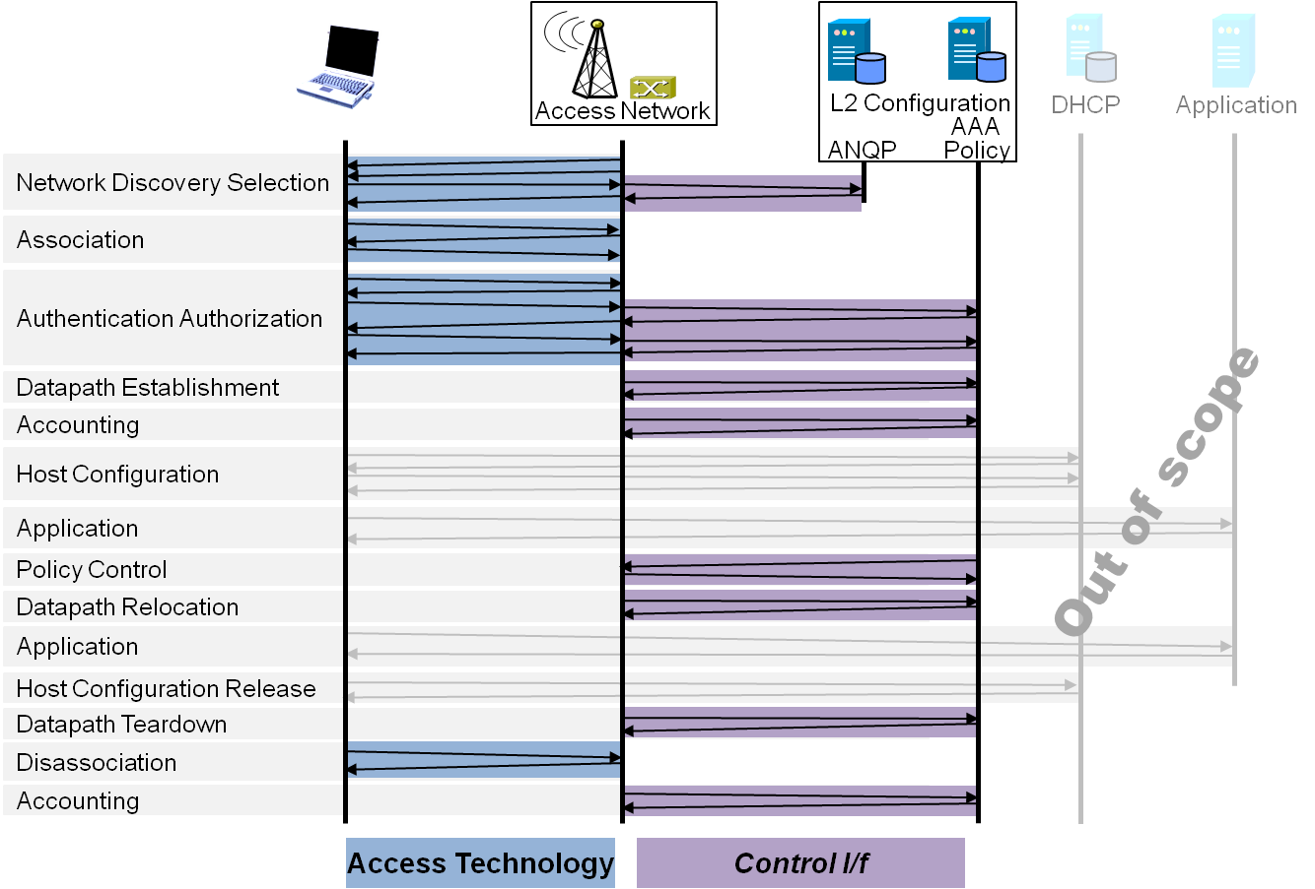
P802.1CF Draft ToC
Introduction and Scope
Abbreviations, Acronyms, Definitions, and Conventions
References
Entities and Identifiers
Network Reference Model
  Reference Points
  Reference Model with refinements
  Backhaul represenation
  Deployment scenarios
Functional Design and Decomposition
  Dynamic Spectrum Access
  Network Discovery and Selection
  Association and Disassociation
  Authentication and Trust Establishment
  Datapath establishment,
  relocation and teardown
  Authorization, QoS and policy control
  Accounting and monitoring
SDN Abstraction
  Terminal
  Access Network
Annex:
  Tenets (Informative)

Slide 16
Business#6
AOB
  Conference calls until Mar 2015
    December 16th, 10:00 AM ET
    February 10th, 10:00 AM ET
  Motions to the closing plenary
    Approval of the conference calls until Mar 2015
Adjourned at 11:49 AM

