Slide 1
Key Concepts of Data Path establishment, relocation, and teardown
Date: 2015-11-08
Authors:
Name | Affiliation | Phone | Email
Max Riegel | Nokia Networks | +49 173 293 8240 | maximilian.riegel@nokis.com
Notice: This document does not represent the agreed view of the IEEE 802.1 OmniRAN TG. It represents only the views of the participants listed in the ‘Authors:’ field above. It is offered as a basis for discussion. It is not binding on the contributor, who reserve the right to add, amend or withdraw material contained herein.
Copyright policy: The contributor is familiar with the IEEE-SA Copyright Policy <http://standards.ieee.org/IPR/copyrightpolicy.html>.
Patent policy: The contributor is familiar with the IEEE-SA Patent Policy and Procedures: <http://standards.ieee.org/guides/bylaws/sect6-7.html#6> and <http://standards.ieee.org/guides/opman/sect6.html#6.3>.
Abstract
The presentation provides a summary of the key concepts and facts for the specification of data path establishment, re-location and teardown. This update is aimed for introduction of a text contribution to P802.1CF on Data Path establishment, relocation, and teardown.

Slide 2
Key Concepts of
Datapath establishment, relocation, and teardown
Max Riegel
(Nokia Networks)

Slide 3
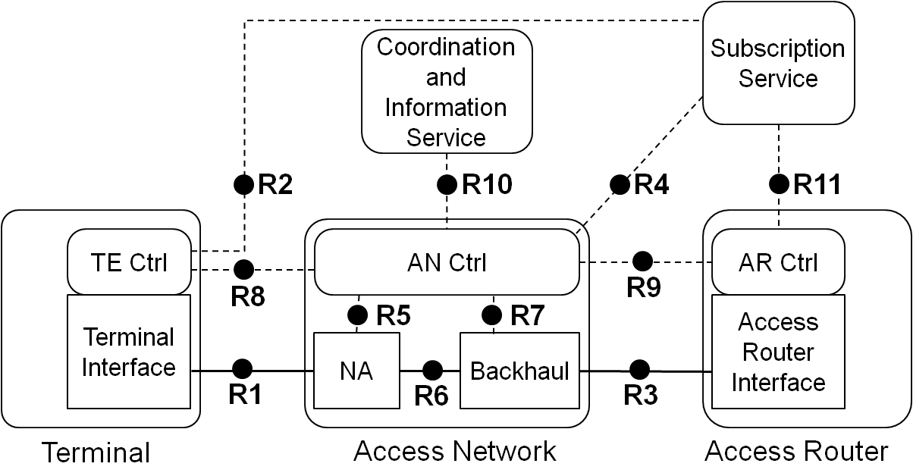
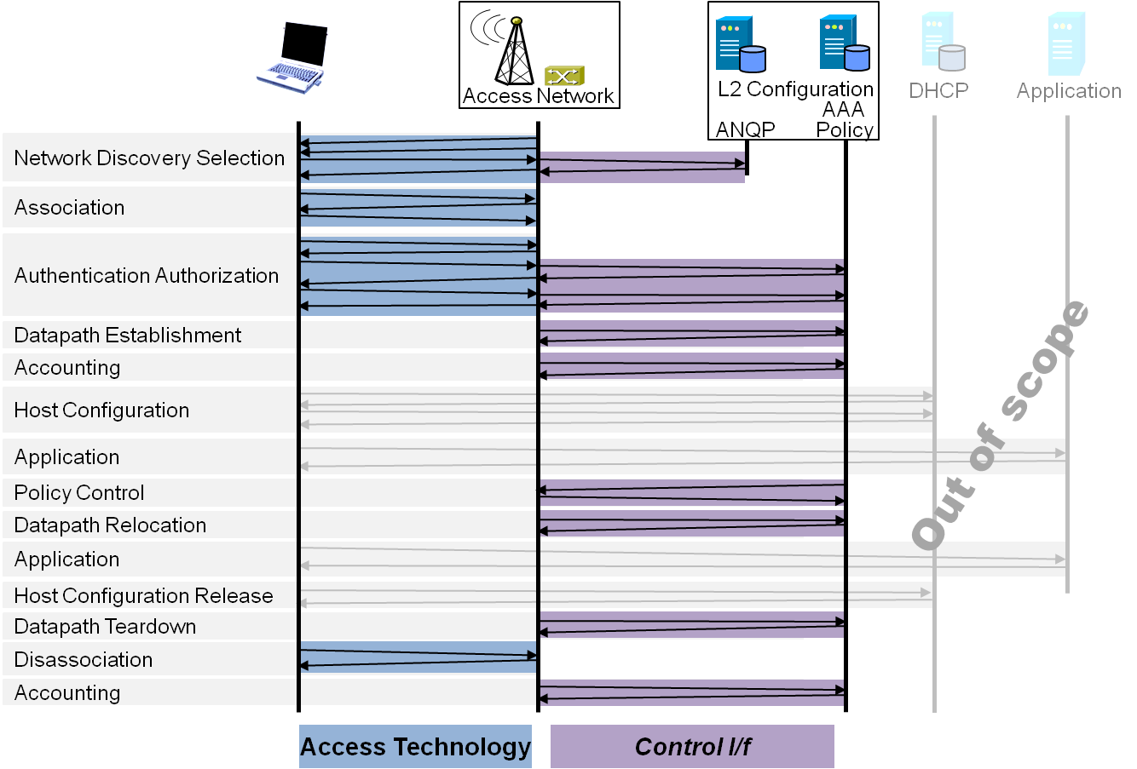
P802.1CF Draft ToC
Introduction and Scope
Abbreviations, Acronyms, Definitions, and Conventions
References
Identifiers
Network Reference Model
  Overview
  Reference Points
  Access Network Control Architecture
    Multiple deployment scenarios including backhaul
Functional Design and Decomposition
  Access Network Setup
  Network Discovery and Selection
  Association and Disassociation
  Authentication and Trust Establishment
  Data path establishment,
  relocation and teardown
  Authorization, QoS and policy control
  Accounting and monitoring
SDN Abstraction
Annex:
  Privacy Engineering
  Tenets (Informative)

Slide 4
Data Path Chapter ToC
Introduction
Terminology
Roles and identifiers
Use cases
Functional requirements
Data path specific attributes
Data path basic functions
NA attributes mappings to IEEE 802 technologies
IEEE 802 backhaul solutions

Slide 5
Introduction
Data path carries user payload between Terminal and Access Router
Forwarding is performed based of MAC addresses of user payload packets. It is a fully bridged access network solution supporting various link behaviors
  Point-to-point
  Point-to-multipoint (Tree)
  Multipoint-to-multipoint (LAN)
Data path is either pre-established during Access network setup and/or dynamically configured when terminal connects to access network. Data path can be modified on demand anytime during the terminal session.
TE
NA
BH
AR
IP
DLL
DLL
IP
DLL
DLL
PHY
DLL
DLL
PHY
DLL
DLL
PHY
PHY
PHY
PHY
PHY
PHY

Slide 6
Terminology
TE Terminal
AN Access Network
NA Node of Attachment
BH Backhaul
SS Subscription Service
AR Access Router
CIS Coordination and Information
Service

Slide 7
Roles and Identifiers
Terminal (TE)
  Terminal Interface (TEI)
    TE-ID
    TEI-ID
    Supportive Information
Access Network (AN)
    Access Network Identifier (AN-ID)
    Supportive Information
  Node of Attachment (NA)
    NA-ID
    R1-Port ID
    R6-Port ID
    Supportive Information
  Backhaul
    BH-ID
    R6-Port ID
    R3-Port ID
    Supportive Information
Access Router
    Access Router Identifier (AR-ID)
    R3-PortID
    Supportive Information
Subscription Service
  ‘AAA and policy control’
    Subscription Service Identifier (SS-ID)
    Supportive Information

Slide 8
P802.1CF Network Reference Model
Subscription
Service
Coordination and Information
Service
R2
R10
R4
R11
TE Ctrl
AN Ctrl
AR Ctrl
R8
R9
Terminal
Interface
R5
R7
Access Router
Interface
NA
Backhaul
R1
R6
R3
Terminal
Access Network
Access Router
NA = Node of Attachment {AP, BS}

Slide 9


Use cases
Single, plain wireless access network
  LAN Service link behavior is provided to
    Simplify access router
    Provide direct terminal-to-terminal communication
  Mobility support is inherently provided by bridged infrastructure
    Without impacting IP connectivity terminals can move from one access point to another access point.

Slide 10

Use cases
Shared wireless access network
  Point-to-point link behavior is required to
    Enforce all traffic passing through the related AR
    Isolate terminal communication in a shared infrastructure
  Mobility support is required in the bridged infrastructure
    Without impacting IP connectivity, i.e. IP session has to be maintained while moving
  Point-to-point link state signaling required towards SS

Slide 11
Use Cases
Further Considerations
An access network may
be shared by multiple
ARs
VLANs may be used
to differentiate services
  E.g. setting up dedicated
  VLANs for data, guest and voice terminals
C-VIDs may be used as service differentiators in the access network.
Terminals being either end-stations or bridges eventually deploying (C-)VLAN with C-VLAN tag carrying up to terminals
Access network may be spotty and being spread across large areas
SS1
AR1
SS2
AR2

Slide 12
Use Cases
Backhaul composed of multiple segments
Terminal
NA
ETH Operator
##A##
AR+SS
R1
ETH Operator
##A##
R3
Internet
R6
ETH Backbone
Operator
Terminal
NA
AR+SS
R1
R6
R3
Internet
Terminal
NA
ETH Operator
##B##
ETH Operator
##C##
AR+SS
R1
R6
R3
Internet
Terminal
NA
AR+SS
R6
R3
R1
Backhaul provided by ETH Service Provider
Internet

Slide 13
Use Cases
Further backhaul characteristics
Transport of the user plane between NA and AR
Consists of bridges and links between bridges
Mix of wired or wireless medium possible within a backhaul
Isolation of user plane within transport medium through VLANs
  User plane is ‘tunneled’ through
  Backhaul does not modify payload
Multiple operational domains possible within backhaul
  Bridges and links may belong to multiple operators.
  However a single brigde device has a single owner

Slide 14
Use Cases
3GPP Trusted WLAN Access to EPC TS 23.402
Support for non-seamless WLAN
offload (NSWO) or single PDN
connection into EPC
Definition of a
  WLAN Access Network,
  Trusted WLAN AAA Proxy
  Trusted WLAN Access Gateway
Requiring a point-to-point link
between UE and Trusted WLAN
Access Gateway across WLAN
Access Network
Requiring also link state signaling of WLAN Access Network towards Trusted WLAN Access Gateway
Very similar requirements exist also in other access networks carrying Ethernet frames between terminal and access router
  E.g. WiMAX

Slide 15
Functional requirements
Data path SHOULD be configurable as either point-to-point or multipoint-to-multipoint or rooted-multipoint (point-to-multipoint) behavior
Successful completion of data path establishment SHOULD be indicated.
Relocation of data path within the access network SHOULD be supported.
Data path should be configurable to support the transport of C-VIDs between terminal and access router
Data path should protect integrity of user payload
Data path should support encrypted transport of user payload
Data path should allow for differentiated services based on C-VIDs and priority bits
Data path should support wired and wireless links in the access and backhaul.

Slide 16
Datapath specific attributes
Node of Attachment
  R1 MAC and PHY configuration parameters
  R1 performance and QoS parameters
    E.g. supported service classes (Throughput up/down, delay, jitter)
  R6 configuration parameters
  VLAN configuration and mapping
Backhaul (remark: check MEF for further attributes)
  R6 configuration parameters
  R3 configuration parameters
  Service specification
  Service mapping table
Subscription Service
  User specific service specification
Access Router
  R3 configuration parameters
  Network Interface performance
    E.g. supported service classes (throughput up/down, delay, jitter)

Slide 17
Data path basic functions
Data path establishment
  Retrieve user specific configuration information from Subscription Service
  Configure terminal interface R1
  Configure forwarding and interfaces R1 and R6 in NA
  Configure link performance and interfaces R6 and R3 in Backhaul
  Initiate configuration of R3 in AR
  Signal completion of access link establishment
Data path relocation
  Reconfigure terminal interface R1 to new NA
  Configure forwarding and interfaces R1 and R6 in new NA
  Relocate interface R6 in Backhaul towards new NA
  Signal completion of access link relocation
Data path tear down
  Teardown interface in Terminal
  Teardown forwarding function and interfaces in NA
  Teardown interface in AR
  Remove resource allocations in Backhaul
  Signal completion of teardown

Slide 18
Data path basic functions
Subscription
Service
Terminal
Access Network
ANQP
AAA
Policy
Configuration
DHCP
Application
Scanning
Network Selection
Association
Authentication
Authorization
Data path establishment
Accounting
Host Configuration
Application
Policy Control
Data path relocation
Application
Host Config Release
Disassociation
Data path teardown
Accounting

Slide 19
NA attributes mapping to IEEE 802 technologies
 |  | 802.3 | 802.11 | 802.16 | 802.22
R1 Config | QoS Parms
 | Forwarding
 | Filtering
 | Security
R6 Config
VLAN Config
R3 Config
NA configuration is performed from information delivered by the Subscription Service as part of authorization

Slide 20
IEEE 802 backhaul solutions
MAC-in-MAC (Provider Backbone Bridging)
NA effectively representing ‘BEB’
Link identified by B-SA + I-SID
  B-SA uniquely correlated to terminal MAC address
    Would it work using terminal MAC as B-SA (C-SA = B-SA)?
  B-DA represents access router peer
  I-SID for further study;
Mobility support by learning B-bridges
Protocol for dynamic configuration of PBBN
Open: Link state signaling?
Security assessment

Slide 21
IEEE 802 backhaul solutions
MACsec
MACsec establishes single hop across multiple bridges
MACsec peers are R6d at the NA and R3d at the CNS
Control protocol by 802.1X
  EAP based establishment of security association
    How to tie with EAP based access authentication
  Well defined link state management
Protocol for mobility support required
  Wouldn’t be a kind of 802.11r applicable to MAC sec ptp links?
Scalability and performance issues
  MACsec Ys well distributed on NA side, however the entity at the CNS may have to handle a huge number of sessions.

Slide 22
IEEE 802 backhaul solutions
SDN
T.b.d., e.g. https://mentor.ieee.org/omniran/dcn/14/omniran-14-0040-00-CF00-ethernet-connection-service.pdf
  Proposal of Paul Bottorff (May 2014)

Slide 23
Conclusion
The slides present the logical structure and the essential content of the proposed text on data path.
Any additional recommendations ?

