Slide 1
Discussion on NRM Control Reference Points Information and Parameters
Date: 2015-01-15
Authors:
Name | Affiliation | Phone | Email
Antonio de la Oliva | University Carlos III of Madrid |  | aoliva@it.uc3m.es
Juan Carlos Zuniga | InterDigital |  | j.c.zuniga@ieee.org
Luis Miguel Contreras | Telefonica |  | luismiguel.contrerasmurillo@telefonica.com
Notice: This document does not represent the agreed view of the OmniRAN EC SG. It represents only the views of the participants listed in the ‘Authors:’ field above. It is offered as a basis for discussion. It is not binding on the contributor, who reserve the right to add, amend or withdraw material contained herein.
Copyright policy: The contributor is familiar with the IEEE-SA Copyright Policy <http://standards.ieee.org/IPR/copyrightpolicy.html>.
Patent policy: The contributor is familiar with the IEEE-SA Patent Policy and Procedures: <http://standards.ieee.org/guides/bylaws/sect6-7.html#6> and <http://standards.ieee.org/guides/opman/sect6.html#6.3>.
Abstract
This presentation discusses about the information and parameters identified for the different control reference points in the OMNIRAN NRM (DCN 2014-83-00).

Slide 2
Agreed OMNIRAN NRM
R1: represents the PHY and MAC layer functions between terminal and access network. These are completely covered by the IEEE 802 specifications.
R2: represents a control interface between terminal and the subscription service, e.g. for authentication.
R3: represents the reference points for the communication between the access network and the core network, up to the interface between L2 and L3 in the first L3 router.
  R3d: represents the IEEE 802 data path interface between access network and the first hop router of the Core Network Service.
  R3c: represents a control interface between the access network controller and core network controller.
  R3s: represents a control interface communicating subscription-specific information elements between the access network controller and the subscription service.
R6d: User-plane interface carrying user data between the node of attachment and the backhaul.
R6c: Control-only interface for the configuration of the node of attachment. It includes information elements for the configuration of the interface to the backhaul, the interface to the access link and data forwarding functions.
R7c: This interface is used to control and configure the user plane within the backhaul. The backhaul interconnects the NAs with the CNS
R8c: represents a control interface between the Access Network Controller and the Terminal Controller.
R9c: represents a control interface between the Access Network Controller and the CIS.

Slide 3
Some details on R6c information
Interface connecting NAs with controller
Three different categories of configuration parameters:
  Semi-static management parameters: Port configuration, link speed, queue parameters
  Dynamic parameters: Tx power, MCS, QoS characteristics, flow identification, measurements
  Control of complex MAC dependent actions: Enable multicast support, move a user to other AP, QoS configuration exchange, power saving

Slide 4
R6c: Where are all this parameters?
Example on 802.11:
  Static parameters can be used like the ones present in MIB of MLME and PLME
  Dynamic parameters need to be defined and possibly MLME/PLME APIs should be opened to configure these parameters dynamically

Slide 5
R6c: Example of parameters
Parameter | Description/Units
Interface Max Capacity | kb/s
Current Max Capacity | Current maximum usable capacity of the link. kb/s
Interface Min Capacity | kb/s
Throughput | Current throughput of the link
Transmission Power | dBm
Port speed | Modulation and Coding Schema (MCS) per STA, switch port speed
Traffic shaper characteristics | IEEE 802.1 compatible description of traffic shaper characteristics to be configured
Beam-forming patterns
It would be interesting to get feedback from OMNIRAN tenants (e.g., ONF) to identify if there are more parameters worth specifying

Slide 6
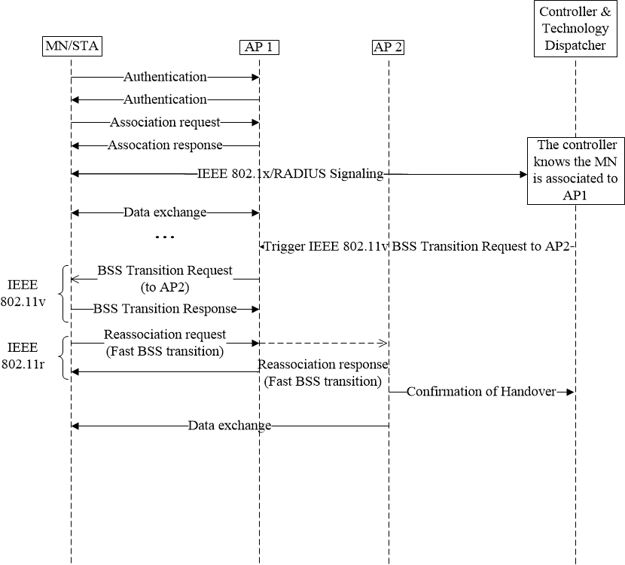
R6c: Control of MAC dependent interactions
Example on IEEE 802.11
  The controller is able to trigger mobility of users
  API to MLME enables de controller to trigger complex operations (e.g., MLME-BTM.request)

Slide 7
R6c: Example of potential MAC operations
WMN primitives
11k reporting
QoS configuration
Key configuration
11aa GCR
11ak links to be included as stable in a wireless switch

Slide 8
R6c: Related protocols
We need to revisit how to control and manage IEEE 802 equipment.
Current trend is to use a mix of OF-Config + OF + YANG description of parameters
  Requires the identification of parameters to be dynamically/statically controlled
  Requires to open selected SAPs in 802 technologies to enable real time control of parameters

Slide 9
R3c: Orchestration between controllers
This reference point serves as interface between controllers at the CNS and AN.
Defines an interface for controlling the AN behavior.
  Example: Flow identification for QoS, VLAN tagging

Slide 10
R9c: Interface to CIS
Currently we have identified 3 CIS in the IEEE scope:
  Spectrum database
  MIIS
  ANQP server
Two different interactions are needed:
  Management of the information on each database
    GET/SET API
  Control of the interaction Terminal to CIS
    Reference point as concatenation of R1+R6c (controller as Man in the middle, acting based on terminal query)

