Slide 1
P802.1CF NRM Refinements
Date: 2015-02-10
Authors:
Name | Affiliation | Phone | Email
Max Riegel | Nokia Networks | +49 173 293 8240 | maximilian.riegel@nsn.com
Notice: This document does not represent the agreed view of the IEEE 802.1 OmniRAN TG. It represents only the views of the participants listed in the ‘Authors:’ field above. It is offered as a basis for discussion. It is not binding on the contributor, who reserve the right to add, amend or withdraw material contained herein.
Copyright policy: The contributor is familiar with the IEEE-SA Copyright Policy <http://standards.ieee.org/IPR/copyrightpolicy.html>.
Patent policy: The contributor is familiar with the IEEE-SA Patent Policy and Procedures: <http://standards.ieee.org/guides/bylaws/sect6-7.html#6> and <http://standards.ieee.org/guides/opman/sect6.html#6.3>.
Abstract
Document ‘omniran-14-0083-00-00TG-p802-1cf-network-reference-model.docx’ specifies the Network Reference Model of P802.1CF. This document provides further refinements to the NRM figures considered in ‘omniran-15-0003-01-CF00’ to enhance clarity and completeness of the NRM representation.

Slide 2
P802.1CF NRM Refinements
2015-02-10
Max Riegel
(Nokia Networks)

Slide 3
Terminology
SS: Subscription Service
CIS: Coordination and Information Service
AN: Access Network
ANC: Access Network Controller
NA: Node of Attachment
CN: Core Network
CNI: Core Network Interface
CNC: Core Network Controller
TE: Terminal
TEI: Terminal Interface
TEC: Terminal Controller

Slide 4
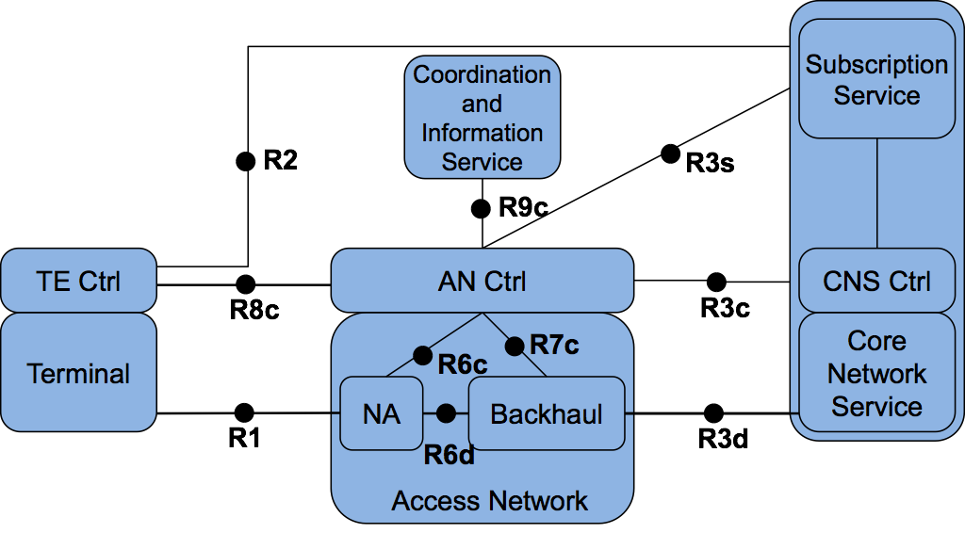
From omniran-14-0083-00-00TG-p802-1cf-network-reference-model.docx
Detailed Network Reference Model
Figure 4: Network Reference Model exposing Access Network details

Slide 5
From omniran-15-0003-01-CF00-nrm-ambiguities:
ATL F2F discussion result
Subscription
Service
Coordination and Information
Service
R2
R9c
R3s
TE Ctrl
AN Ctrl
CN Ctrl
R8c
R3c
Terminal
Interface
R6c
R7c
Core
Network
Interface
NA
Backhaul
R1
R6d
R3d
Terminal
Access Network
Core Network

Slide 6
ATL F2F discussion results
Access Network denotes complete network entity including control
Terminal represents complete entity including data path interface, control and other functions out of scope
  Endpoint of data path denoted ‘Terminal Interface’
  Control rephrased to ‘Terminal Controller’
Core Network represents complete entity including data path interface, control and other function out of scope of P802.1CF
  Endpoint of data path denoted ‘Core Network Interface’
  Control rephrased to ‘Core Network Controller’
Dotted line between Subscription Service and CNC to indicate, that existence of such interface is assumed but details are out of scope.

Slide 7
What’s still open…
More clear definition of ‘Terminal Interface’ and ‘Core Network Interface’ required
Why do we not split R1 into R1d and R1c to make it more aligned to R3
  By this split, R8c might become superfluous
Why embedding Subscription Service into Core Network?
  There is good reason to separate these entities with bringing the interface between Subscription Service and Core Network Interface into scope.

Slide 8
Proposed revision of the NRM
Subscription
Service
Coordination and Information
Service
R2c
R9c
R4c
R5c
TE Ctrl
AN Ctrl
CN Ctrl
R8c/1c
R3c
Terminal
Interface
R6c
R7c
Core
Network
Interface
NA
Backhaul
R1d
R6d
R3d
Terminal
Access Network
Core Network

Slide 9
Additional considerations
Discussions have shown that further information is required to show scope and applicability of NRM
  How NRM is related to ‘real’ networks?
    Operators expressed that applicability is limited due to missing IP layer functionality
  What benefits is the NRM providing with its focus on PHY and LINK layer?
  What are the endpoints of communication and reference points in the bigger picture?
The next slide may provide some figures for explaining the scope and applicability.

Slide 10

Functional Mapping
End-to-end network topology figure
Subscription
Service
Information
Service
Terminal
Access Network
Backhaul
Core Network
NRM for the L2 part of the network access
Subscription
Service
Terminal
R2
R4
Access Network
Core Network
R1
R3
NRM entities in the protocol layer architecture
Application
Application
Transport
Transport
Network
Network
Network
Network
Data Link
DL
DL
DL
DL
DL
DL
Data Link
Data Link
Data Link
Physical
Phy
Phy
Phy
Phy
Phy
Phy
Physical
Physical
Physical
Medium
Medium
Medium
Medium
Medium
Terminal
Interface
Node of
Attachment
Backhaul
Core Network
Interface
Scope of P802.1CF

Slide 11
NRM benefits for SDN
Generic architecture model for Ethernet access networks defining entities and interfaces, providing the base for
  Identity and attribute information of entities
  Functional behavior and message exchanges
However P802.1CF will not …
  define higher layer protocols for conveying information between SDN controller and access network nodes
  specify higher layer protocols for the exchange of control information between network entities
  make pre-assumptions about the network layer protocol

