Slide 1
IEEE 802.1 OmniRAN TG
February 23rd , 2016 Conference Call
2016-02-23
Max Riegel, Nokia
(TG Chair)

Slide 2
Conference Call
Tuesday, February 23rd , 2016 at 10:00-11:00am ET
Join WebEx meeting:
  https://nokiameetings.webex.com/nokiameetings/j.php?MTID=macc6bd1761579f1492673af6e7a0567b
    Meeting number: 952 537 563
    Meeting password:qn8WRQ23
Join by phone
  +498938037488 Germany
  Access code: 952 537 563
  Global call-in numbers
    https://nokiameetings.webex.com/nokiameetings/globalcallin.php?serviceType=MC&ED=426409707&tollFree=0

Slide 3
Instructions for the chair
The IEEE-SA strongly recommends that at each WG meeting the chair or a designee:
  Show slides #1 through #4 of this presentation
  Advise the WG attendees that:
    The IEEE’s patent policy is described in Clause 6 of the IEEE-SA Standards Board Bylaws;
    Early identification of patent claims which may be essential for the use of standards under development is strongly encouraged;
    There may be Essential Patent Claims of which the IEEE is not aware. Additionally, neither the IEEE, the WG, nor the WG chair can ensure the accuracy or completeness of any assurance or whether any such assurance is, in fact, of a Patent Claim that is essential for the use of the standard under development.
  Instruct the WG Secretary to record in the minutes of the relevant WG meeting:
    That the foregoing information was provided and that slides 1 through 4 (and this slide 0, if applicable) were shown;
    That the chair or designee provided an opportunity for participants to identify patent claim(s)/patent application claim(s) and/or the holder of patent claim(s)/patent application claim(s) of which the participant is personally aware and that may be essential for the use of that standard
    Any responses that were given, specifically the patent claim(s)/patent application claim(s) and/or the holder of the patent claim(s)/patent application claim(s) that were identified (if any) and by whom.
  The WG Chair shall ensure that a request is made to any identified holders of potential essential patent claim(s) to complete and submit a Letter of Assurance.
  It is recommended that the WG chair review the guidance in IEEE-SA Standards Board Operations Manual 6.3.5 and in FAQs 14 and 15 on inclusion of potential Essential Patent Claims by incorporation or by reference.
  Note: WG includes Working Groups, Task Groups, and other standards-developing committees with a PAR approved by the IEEE-SA Standards Board.

Slide 4
Participants, Patents, and Duty to Inform
All participants in this meeting have certain obligations under the IEEE-SA Patent Policy.
  Participants [Note: Quoted text excerpted from IEEE-SA Standards Board Bylaws subclause 6.2]:
    “Shall inform the IEEE (or cause the IEEE to be informed)” of the identity of each “holder of any potential Essential Patent Claims of which they are personally aware” if the claims are owned or controlled by the participant or the entity the participant is from, employed by, or otherwise represents
    “Should inform the IEEE (or cause the IEEE to be informed)” of the identity of “any other holders of potential Essential Patent Claims” (that is, third parties that are not affiliated with the participant, with the participant’s employer, or with anyone else that the participant is from or otherwise represents)
  The above does not apply if the patent claim is already the subject of an Accepted Letter of Assurance that applies to the proposed standard(s) under consideration by this group
  Early identification of holders of potential Essential Patent Claims is strongly encouraged
  No duty to perform a patent search

Slide 5
Patent Related Links
All participants should be familiar with their obligations under the IEEE-SA Policies & Procedures for standards development.
Patent Policy is stated in these sources:
  IEEE-SA Standards Boards Bylaws
  http://standards.ieee.org/develop/policies/bylaws/sect6-7.html#6
  IEEE-SA Standards Board Operations Manual
  http://standards.ieee.org/develop/policies/opman/sect6.html#6.3
  Material about the patent policy is available at
  http://standards.ieee.org/about/sasb/patcom/materials.html
If you have questions, contact the IEEE-SA Standards Board Patent Committee Administrator at patcom@ieee.org or visit http://standards.ieee.org/about/sasb/patcom/index.html
This slide set is available at https://development.standards.ieee.org/myproject/Public/mytools/mob/slideset.ppt

Slide 6
Call for Potentially Essential Patents
If anyone in this meeting is personally aware of the holder of any patent claims that are potentially essential to implementation of the proposed standard(s) under consideration by this group and that are not already the subject of an Accepted Letter of Assurance:
  Either speak up now or
  Provide the chair of this group with the identity of the holder(s) of any and all such claims as soon as possible or
  Cause an LOA to be submitted

Slide 7
Other Guidelines for IEEE WG Meetings
All IEEE-SA standards meetings shall be conducted in compliance with all applicable laws, including antitrust and competition laws.
  Don’t discuss the interpretation, validity, or essentiality of patents/patent claims.
  Don’t discuss specific license rates, terms, or conditions.
    Relative costs, including licensing costs of essential patent claims, of different technical approaches may be discussed in standards development meetings.
      Technical considerations remain primary focus
  Don’t discuss or engage in the fixing of product prices, allocation of customers, or division of sales markets.
  Don’t discuss the status or substance of ongoing or threatened litigation.
  Don’t be silent if inappropriate topics are discussed … do formally object.
---------------------------------------------------------------
See IEEE-SA Standards Board Operations Manual, clause 5.3.10 and “Promoting Competition and Innovation: What You Need to Know about the IEEE Standards Association's Antitrust and Competition Policy” for more details.

Slide 8
Resources – URLs
Link to IEEE Disclosure of Affiliation
  http://standards.ieee.org/faqs/affiliationFAQ.html
Links to IEEE Antitrust Guidelines
  http://standards.ieee.org/resources/antitrust-guidelines.pdf
Link to IEEE Code of Ethics
  http://www.ieee.org/web/membership/ethics/code_ethics.html
Link to IEEE Patent Policy
  http://standards.ieee.org/board/pat/pat-slideset.ppt

Slide 9
Agenda proposal
Agenda bashing
Review of minutes
Reports
P802.1CF contributions
Review of 802.1CF editor’s draft
Wi-Fi as component of 5G within the scope of P802.1CF
Agenda for the upcoming F2F meeting
AOB

Slide 10
Business#1
Call Meeting to Order
  Meeting called to order by chair at 10:07 AM ET
Minutes taker:
  Walter volunteered to take notes
Roll Call
Name | Affiliation |  | Name | Affiliation
Max Riegel | Nokia Networks
Walter Pienciak | IEEE SA
Wang Hao | Fujitsu
Juan Carlos Zuniga | Interdigital
Yonggang Fang | ZTE
Antonio de la Oliva | UC3M
Dan Romascanu | Avaya

Slide 11
Call for Potentially Essential Patents
If anyone in this meeting is personally aware of the holder of any patent claims that are potentially essential to implementation of the proposed standard(s) under consideration by this group and that are not already the subject of an Accepted Letter of Assurance:
  Either speak up now or
  Provide the chair of this group with the identity of the holder(s) of any and all such claims as soon as possible or
  Cause an LOA to be submitted
Nothing brought up.

Slide 12
Agenda
Review of minutes
  https://mentor.ieee.org/omniran/dcn/16/omniran-16-0010-00-00TG-jan-2016-f2f-meeting-minutes.docx
Reports
  January 2016 EC workshop
  other
P802.1CF contributions
  Access network Setup
  Authentication and trust establishment
    https://mentor.ieee.org/omniran/dcn/16/omniran-16-0013-00-CF00-chapt-7-4-authentication-functional-description.docx
  Data path establishment, relocation and teardown
  Fault diagnostics and maintenance
    https://mentor.ieee.org/omniran/dcn/16/omniran-16-0012-00-CF00-ethernet-oam-survey-and-introducing-nms.pptx
  other contributions
Review of 802.1CF editor’s draft
  Status update
Wi-Fi as component of 5G within the scope of P802.1CF
Agenda for the upcoming F2F meeting
AOB

Slide 13
Business #2
Review of minutes
  https://mentor.ieee.org/omniran/dcn/16/omniran-16-0010-00-00TG-jan-2016-f2f-meeting-minutes.docx
Reports
  January EC F2F workshop
    Outcome see next slide
P802.1CF contributions
  Authentication and trust establishment
    https://mentor.ieee.org/omniran/dcn/16/omniran-16-0013-00-CF00-chapt-7-4-authentication-functional-description.docx
    Work in progress, requires further text and illustrations
    Text proposal will be completed until Macau F2F for review and discussions.

Slide 14
IEEE 802 participation in 5G/IMT-2020
On the Matter of 5G and IMT-2020, the EC tentatively agreed (subject to ballot confirmation) to form an EC standing committee:
Scope:
To provide a report on the following items to the EC:
Costs and benefits of creating an IEEE 5G specification
Costs and benefits of providing a proposal for IMT-2020, considering possible models of a proposal:
  as a single technology,
  as a set of technologies,
  or as one or more technologies within a proposal from external bodies (e.g., 3GPP)
During its lifetime, to act as the communication point with other IEEE organizations on this topic.
Organization:
The committee is chartered for 6 months (i.e., due July 2016 at the 802 plenary) as an EC SC (type 2). Any 802 WG voting member may participate as a voting member of the committee.
The EC chair Paul Nikolich assigned Glenn Parsons as chair of the committee. Sessions of the committee will likely take place on Monday evening and Tuesday evening.

Slide 15
Business #3
P802.1CF contributions
  Fault diagnostics and maintenance
    https://mentor.ieee.org/omniran/dcn/16/omniran-16-0012-00-CF00-ethernet-oam-survey-and-introducing-nms.pptx
    Highly appreciated presentation; discussion will continue in Macau F2F
    Concerns raised how co-location of NMS with SS would work out together with network slicing and NFV.
    Wang Hao explained that NMS across multiple operators is not covered by specifications. Only the requirements for the interface between NMS and EMS are usually specified.
  Other contributions
    None
Review of 802.1CF editor’s draft
  Status update
    Next revision will be created after Macau F2F
    Already many chapters populated with specification text (see next slide)
    Still a few chapters require initial contributions

Slide 16
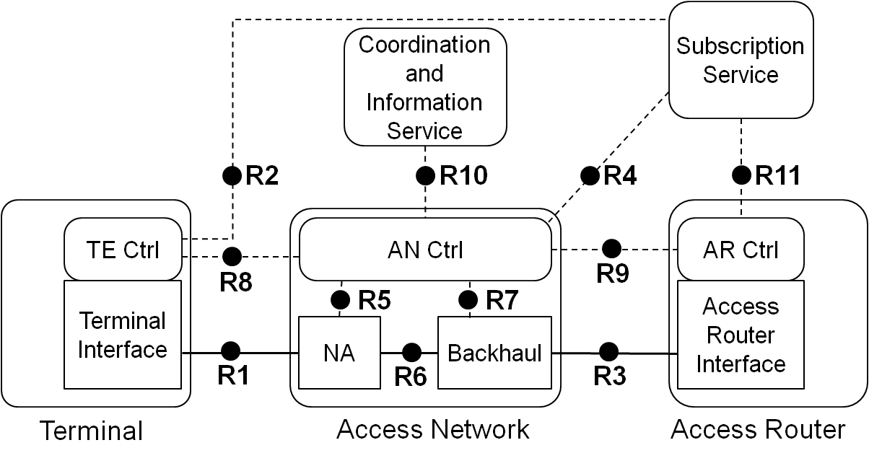
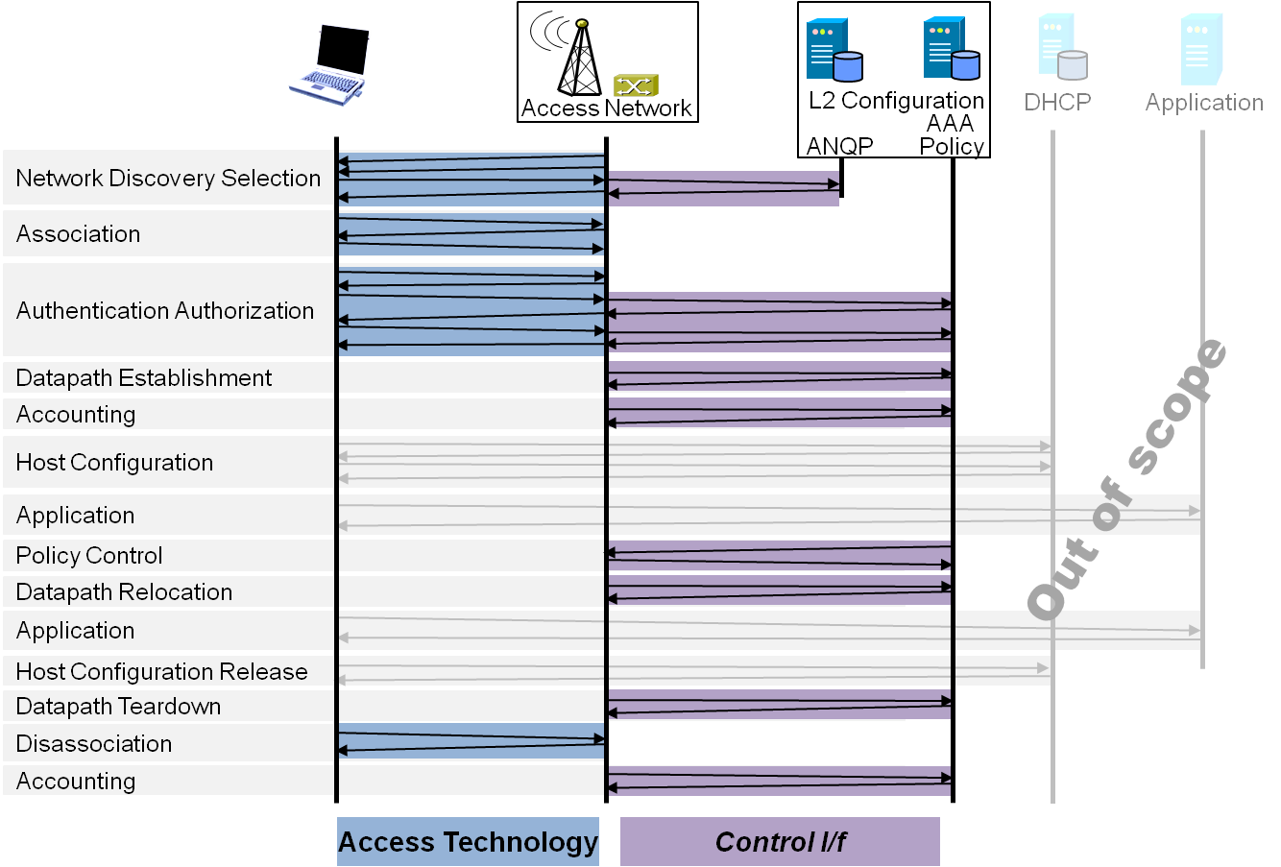
P802.1CF Draft ToC
Overview
References, definitions, acronyms and abbreviations
Conformance
Network Reference Model
  Basic concepts and terminology
  Overview of NRM
  Basic, enhanced and comprehensive NRM
  Deployment scenarios
Functional Design and Decomposition
  Access Network Setup
  Network Discovery and Selection
  Association and Disassociation
  Authentication and Trust Establishment
  Data path establishment,
  relocation and teardown
  Authorization, QoS and policy control
  Monitoring and statistics
  Fault diagnostics and maintenance
SDN Abstraction
Annex:
  PICS pro-forma
  Privacy Engineering
  Applicability to non-IEEE 802 PHY layer technologies
  Bibliography

Slide 17
Business #4
Wi-Fi as component of 5G within the scope of P802.1CF
  Nothing more to share. Discussion will continue in EC SC
Agenda for the upcoming F2F meeting
  Agenda proposal and session graphics on next two slides
  Special session on access network virtualization
    No demand for further agenda items raised.
AOB
  OmniRAN will meet at the 802.1 interim in Budapest in May 2016
    If key stakeholder can come to Budapest, the SDN chapter will be one of the major topics
Meeting adjourned by chair at 11:20AM ET

Slide 18
March 2016 Agenda Graphics
 | Mon 3/14 | Tue 3/15 | Wed 3/16 | Thu 3/17 | Fri 3/18
08:00 10:00 | 802 WGs Opening | 802.11 WNG | 802.11 ARC |  | 802.11 Closing
10:30 12:30 |  |  | 802.11/802.15 Mid-week Plenaries | OmniRAN closing
13:30 15:30
16:00 18:00 | OmniRAN opening

Slide 19
Agenda proposal for March 2016 F2F
Review of minutes
Reports
New P802.1CF contributions
  Fault diagnostics and maintenance
  Functional design and decomposition
  Deployment scenarios
Representing access network virtualization in P802.1CF
  Models, approaches
  Network reference model amendments
Review of 802.1CF editor’s draft
  Comment resolution
Wi-Fi as component of 5G within the scope of P802.1CF
Project planning
Status report to IEEE 802 WGs
AOB

