Slide 1
Ethernet OAM Survey and Introducing Network Management Service
Date: [2016-03-14]
Authors:
Name | Affiliation | Phone | Email
Hao Wang | Fujitsu R&D Center | +86-10-59691000 | wangh@cn.fujitsu.com
Su Yi | Fujitsu R&D Center | +86-10-59691000 | yisu@cn.fujitsu.com
Xiaojing Fan | Fujitsu R&D Center | +86-10-59691000 | fanxiaojing@cn.fujitsu.com
Ryuichi Matsukura | Fujitsu/Fujitsu Laboratory | +81-44-754-2667 | r.matsukura@jp.fujitsu.com
Notice: This document does not represent the agreed view of the OmniRAN EC SG. It represents only the views of the participants listed in the ‘Authors:’ field above. It is offered as a basis for discussion. It is not binding on the contributor, who reserve the right to add, amend or withdraw material contained herein.
Copyright policy: The contributor is familiar with the IEEE-SA Copyright Policy <http://standards.ieee.org/IPR/copyrightpolicy.html>.
Patent policy: The contributor is familiar with the IEEE-SA Patent Policy and Procedures: <http://standards.ieee.org/guides/bylaws/sect6-7.html#6> and <http://standards.ieee.org/guides/opman/sect6.html#6.3>.
Abstract
This presentation surveys on IEEE 802.3ah and 802.1ag, and discusses about the need for introducing a network management service into OmniRAN.

Slide 2
Ethernet OAM Survey and Introducing Network Management Service
2016-03-14
Hao Wang
Fujitsu R&D Center

Slide 3



OAM Concept
Operation, Administration, Maintenance & Provision
  Fault analysis, performance monitoring, security management, configuration & service provision
OAM covers both N-S and W-E interfaces
Management Plane (NM,EM)
N
OAM&P
Network Plane (Network Elements)
S
W
E

Slide 4





Specification Landscape
Standard Organization | Specification
 | IEEE 802.3ah ‘link OAM’ [E<>W] IEEE 802.1ag ‘CFM’ [E<>W]
 | WMF-T31-119-R016v01 ‘NMS to EMS Interface’ [N<>S]
 | Y.1731 ‘Ethernet OAM’ [E<>W]
 | 3GPP TS 32.111-1 ‘3G Fault Management Requirements’ [N<>S]
 | ‘Ethernet Local Management Interface (E-LMI) [E<>W]

Slide 5
Ethernet OAM Layering
Ethernet OAM is layered
  Service layer OAM measures and represents the status of the services as seen by the customer
  Network layer OAM monitors path between two non-adjacent devices
  Transport layer OAM ensures that two directly connected peers maintain bidirectional communication
Each layer supports its own OAM mechanisms
  Not intend to compete but to be complimentary
Protocol building blocks for Ethernet OAM
Service Layer
E-LMI
Network Layer
802.1ag/Y.1731
W
E
Transport Layer
802.3ah

Slide 6
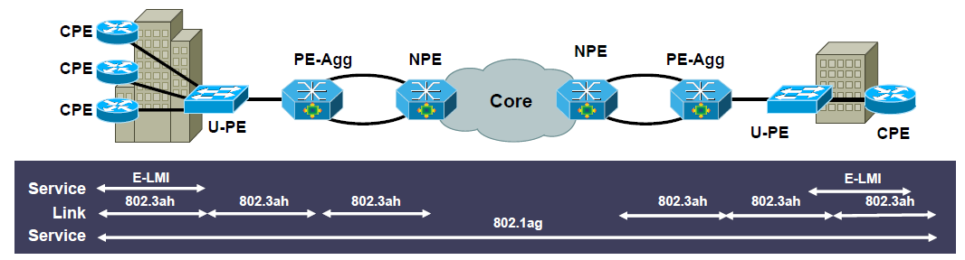
Carrier Ethernet OAM
Carrier Ethernet Capabilities | Benefits
IEEE 802.1ag Fault management per services/VLAN | End-to-end service manageability
IEEE 802.3ah Link protection and monitoring | First mile physical connectivity verification
MEF 16 E-LMI for customer premise equipment | Pro-active service status and availability

Slide 7




Link OAM: 802.3ah
Ethernet First Mile (EFM) OAM
Supports point-to-point (single) link OAM
Monitors and supports troubleshooting individual links
Standards-based for Ethernet networks
  Interoperates in a multivendor environment
Uses standard Ethernet frames, called OAMPDUs
  OAMPDU is sourced and terminated at both ends of a link, not relayed by bridges
  Types:
    Information OAMPDU
    Event Notification OAMPDU
    Variable Request OAMPDU
    Variable Response OAMPDU
    Loopback Control OAMPDU
    Organization Specific OAMPDU
802.3ah
OAM
802.3ah
OAM

Slide 8
802.3ah Frame Format
Ethernet OAM uses standard Ethernet frames, called OAMPDUs
OAMPDU uses IEEE Slow Protocol’s MAC address (01-80-c2-00-00-02) and Ether-Type (88-09) but has a unique subtype (03)
MAC header
MAC client DATA
Destination Address | Source Address | Ether-Type | Sub-type | Flags | Code | Data/Pad | FCS
6 octets | 6 octets | 2 octets | 1 octet | 2 octets | 1 octet | 42~1496 octets | 4 octets
01-80-C2-00-00-02
(slow protocol address)
03
Status bits
To identify specific OAMPDU
Format depends on “Code”
88-09
(slow protocol type)

Slide 9
802.3ah OAM Functions
Discovery
  The first phase of Ethernet OAM
  Identify the devices in the network along with their OAM capabilities
Remote failure indication
  A mechanism for and OAM entity to convey slow degradation of Ethernet link to its peer via specific flags in the OAMPDU
Link monitoring
  Detect and indicate link faults under a variety of conditions
Remote loopback
  Help the administrator ensure the quality of links during installation when troubleshooting
Polling of MIB variables
  A read-only access to remote MIB variables limited to a specific MIB branch and leaf

Slide 10

Service OAM: 802.1ag
Connectivity Fault Management (CFM)
Service Provider
Facilitates
  Path discovery
  Fault detection
  Fault verification and isolation
  Fault notification
  Fault recovery
Supports
  Continuity Check (CC) Message
  LinkTrace (LT) message
  Loopback (LB) message
Customer
Network
Operator A
Network
Operator B
Network
Customer
Network
Customer
location 1
Customer
location 2
Customer MA
ME
MD level 5
(7, 6, or 5)
Service Provider MA
ME
MD level 3
(4 or 3)
MEP
Operator A MA
Operator B MA
MIP
ME
ME
MD level 1
(2, 1, or 0)
MD (Maintenance Domain)
  The part of a network for which faults in Layer 2 connectivity can be managed
MEP (Maintenance End Point)
  A Maintenance Point (MP) at the edge of a domain that actively sources CFM messages
MIP (Maintenance Intermediate Point)
  A maintenance point internal to a domain that only responds when triggered by certain CFM messages
MA (Maintenance Association)
  A set of MEPs established to verify the integrity of a single service instance (a VLAN or a VPLS)
ME (Maintenance Entity)
  A point-to-point relationship between two MEPs within a single MA

Slide 11
802.1ag Functions
Continuity Check Message (CCM)
  A periodic hello message multicast by an MEP within the maintenance domain
Periodic CCM (multicast)
MEP
Periodic CCM
MEP
LinkTrace Message (LTM)
  A multicast message used by a source MEP to trace the
  path to other MEPs and MIPs in the same domain
  All reachable MIPs and MEPs respond back with a Link Trace Unicast Reply (LTR)
  The originating MEP can then determine the MAC addresses of all MIPs and MEPs belonging to the same Maintenance Domain
MEP
LTM (multicast)
LTR (Unicast)
MEP
MIP
LTR (Unicast)
Loopback Message (LBM)
  Used to verify the connectivity between a MEP and a peer
  MEP or MIP
  A loopback message is initiated by a MEP with a destination MAC address set to the desired destination MEP or MIP (Unicast)
  The receiving MIP or MEP responds to the Loopback message
  with a Loopback Reply (LBR) (Unicast)
  A loopback message helps a MEP identify the precise location
  of a fault along a given path
LBM (Unicast)
MEP
LBR
MEP

Slide 12
802.1ag Frame Format over Different Media
MAC header
MAC client DATA
Type/Length media (802.3):
Destination Address | Source Address | Ether-Type | Data | FCS
6 octets | 6 octets | 2 octets | Variable length | 4 octets
LLC media (802.11):
SNAP header
89-02
802.11 MAC header | SNAP “AA” | SNAP “AA” | UI “03” | RFC1042 OUI “00” “00” “00” | Type | Data | FCS
| DSAP | SSAP | CTL | Protocol identifier |
SNAP: Subnetwork Access Protocol
DSAP: Destination Service Access Point
SSAP: Source Service Access Point
UI: Unnumbered Information
Example:
1 – CCM
2 – LBR, 3 – LBM
4 – LTR, 5 – LRM
Octets
 | 0 |  | 1 | 2 | 3
0 | MD Level | Version | OpCode | Flags | First TLV Offset
4 | Varies with value of OpCode
…
Last |  |  |  |  | End TLV (0)
Common CFM header
Octets

Slide 13
Comparing 802.3ah and 802.1ag
IEEE 802.3ah EFM Link OAM | IEEE 802.1ag CFM Service OAM
Operates on Physical Link Only, Cannot Pass through a Bridge | May Be Per-Service or Per-Wire; Passes End-to-End through Bridges
Discovery, Statistics Enquiry, Keep alive, Loopback (Mirror) Mode | Connectivity Verification, Traceroute, Ping, Alarm Indication/Suppression
Single Instantiation per physical link | Multiple instances operating at multiple levels simultaneously.
Created by One Committee (IEEE 802.3) | Joint Effort by IEEE 802.1, ITU-T
Standard Approved by IEEE 802 | IEEE P802.1ag (Published December 17, 2007), ITU SG 13/3

Slide 14
OAM Interworking
Scenario: 802.3ah to 802.1ag
Link layer defects detected by 802.3ah (remote failure indication)
Defects relayed to 802.1ag on same device
802.1ag notifies remote devices of localized fault by transmitting CC
Customer
Service Provider
Customer
Eth Access
MPLS Core
MPLS Access
CC
MEP
Service OAM
MIP
802.3ah to 802.1ag interworking
Remote failure indication
Link OAM
802.3ah
802.3ah
802.3ah
802.3ah

Slide 15
Introducing Network Management Service

Slide 16
Network Management Service (NMS)
NMS performs management functions through the interface to the EM (Element Manager) across multiple Network Elements (NE)
  It is a network management application, and can be as simple as a command generator
  Focus on managing the functions related to the interaction between multiple network elements
  Perform functions for distribution of network resources: configuration, control and supervision of the network
  These functions can achieve fault diagnostics and maintenance (FDM), configuration management, performance management, security management, and so on
Benefits:
  Simplify configuration, monitoring, and troubleshooting
  Security benefit (less people log on NE)
  Effective in cross-domain scenarios (no need for experts with different domain technologies)

Slide 17
802.3ah OAM Client
OAM client responsibilities – integral role in establishing and managing OAM on a link
  Enable and configure the OAM sublayer entity
  Link events are signaled between peer OAM client entities
OAM client
MAC client
MAC client
OAM client
OAM sublayer
OAM sublayer
MAC control (optional)
MAC control (optional)
MAC
MAC
PHY
PHY

Slide 18
NMS Fits in a Common Structure
802.3ah
802.1ag
OmniRAN
NMS (SS)
NMS
NMS
Ex. SNMP manager
Itf-N
Itf-N
R2, R4, R11
Element Manager (EM)
EM
Controller
Ex. SNMP manager& agent
Ex. SNMP interface
R5, R7
OAM client
OAM client
Ex. SNMP agent
Ex. SNMP agent
Interface
802.3 OAM service interface
Layer management interface (LMI)
MAC/PHY interface
MAC/PHY interface
MAC/PHY interface
MAC/PHY interface
OAMPDU
CFM message

Slide 19
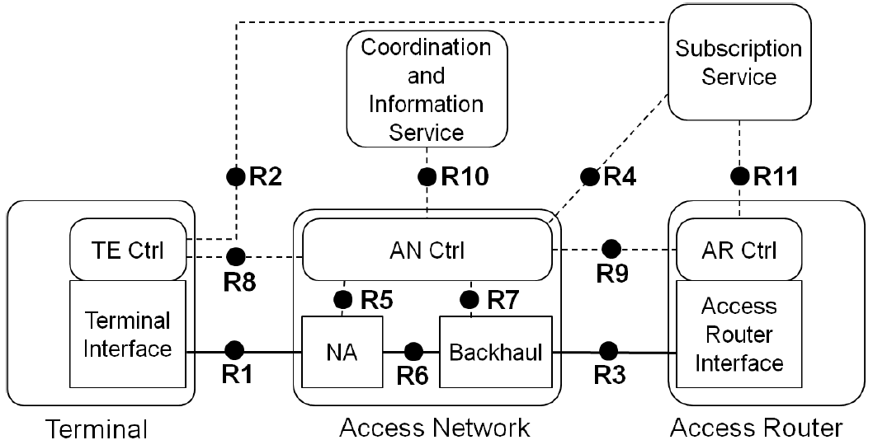
Propose Change of NRM
Extend Subscription Service (SS) to a general management entity (NMS), which provides security management (AAA capability)
  NMS includes more functions than SS
  NMS requirements for FDM will be specified in FDM chapter
  R2, R4, and R11 will carry more information as a result
NMS
(SS)
R2, R4, R11 for OAM [N<>S]
R1, R6, R3 for OAM [W<>E]
R5, R7 for EM-NE interface [N<>S]

Slide 20
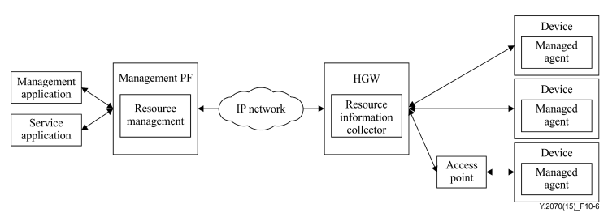
Annex: ITU-T Y.2070
Management Architecture of Home Network
Home network is complex: different types of technologies co-exist, complicated topology composed of various resources, difficult to maintain for end users
Managed agent on the device executes configuring and gathering the home environment information by the instruction
Resource management function in the management PF
Resource information collector function: gets status, performance and configuration data
Interfaces for remote administrators such as call centers and customer support centers

Slide 21
Annex:
Mapping Y.2070 Architecture to NRM
Introducing NMS essentially extends the availability of network reference model of OmniRAN
Management PF
NMS (SS)
Resource management
Home gateway (HGW)
Resource information collector
IP Network
End device
AP

Slide 22
References
IEEE 802.1ag-2007 "Local and metropolitan area networks – Virtual Bridged Local Area Networks, Amendment 5: Connectivity Fault Management"
IEEE 802.3ah-2004 "Local and metropolitan area networks – Specific requirements, Part 3: Carrier Sense Multiple Access with Collision Detection (CSMA/CD) Access Method and Physical Layer Specifications, Amendment: Media Access Control Parameters, Physical Layers, and Management Parameters for Subscriber Access Networks"
3GPP TS 32.111-1 "Telecommunication management; Fault Management; Part 1: 3G Fault Management Requirements" (v12.2.0)
WMF-T31-119-R016v01 "WiMAX Forum Network Requirements; WiMAX Network Management: NMS to EMS Interface"
ITU-T Y.2070 "Next Generation Networks – Frameworks and functional architecture models, Requirements and architecture of the home energy management system and home network services" 01/2015
TR-1053 "Customer support functions for home network service platform" (Edition 1.0)
TR-1057 "Customer support guideline for home network service" (Edition 1.0)
Ethernet OAM Tutorial, APRICOT 2007
Carrier Ethernet Operations, Administration and Maintenance, APNIC 35 Conference 2013
http://www.ieee802.org/802_tutorials/04-July/802.1ag%20-%20CFM%20Tutorial%20-%20Part%201%20v2.ppt
Practical use of Ethernet OAM, SwiNOG 22, 2011

Slide 23
Questions, Comments
Fault Diagnosis and Maintenance

