Slide 1
omniRAN Network Function Virtualization
Date: 2016-03
Authors:
Name | Affiliation | Phone | Email
Yonggang Fang | ZTETX Inc |  | yfang@ztetx.com
Zhendong Luo | CATR |  | luozhendong@catr.cn
Xia Shen | CATR |  | shenxia@catr.cn
Notice: This document represents only the views of the participants listed in the ‘Authors:’ field above. It is offered as a basis for discussion. It is not binding on contributors, who reserve the right to add, amend or withdraw material contained herein.
Copyright policy: The contributor is familiar with the IEEE-SA Copyright Policy <http://standards.ieee.org/IPR/copyrightpolicy.html>.
Patent policy: The contributor is familiar with the IEEE-SA Patent Policy and Procedures: <http://standards.ieee.org/guides/bylaws/sect6-7.html#6> and <http://standards.ieee.org/guides/opman/sect6.html#6.3>.
Abstract
This contribution discusses the network function virtualization for omniRAN.

Slide 2
Background
Why omniRAN needs NFV
  NFV provides the unified software defined platform for network functions virtualization to encapsulate the hardware difference.
  Manage a large number of APs and STAs efficiently and effectively
    Broadband access in dense area such as public venues
    Massive Internet of Things with a large number of APs.
  Consolidate management of multiple local WLANs offered by single service provider
  Allow multiple service providers to share RAN and use same platform to manage different hardware resources.
  Optimize the network according to the traffic load and service requirement dynamically

Slide 3
omniRAN Network Reference Model
IEEE 802 Access Network
Service Provider NW
NFV based Network Management System
Coordination and Information
Service
R2
R10
R4
R11
TE Ctrl
AN Ctrl
AR Ctrl
R8
R9
Terminal
Interface
R5
R7
Access Router
Interface
NA
Backhaul
R1
R6
R3
Terminal
Access Network
Access Router

Slide 4
omniRAN Network Reference Model
Functional Entities and Interfaces
  Node of Attachment
    Wireless interfaces:
      support multi-band, multi-mode 802.11 protocol to communicate with wireless devices
      may integrate with other radio technologies
  Backhaul Interfaces
    Ethernet based backhaul: for wired connection to other entities
    802.11 based backhaul: for connection to other entities wireless
  AN Controller
    Provide the management and control function of omniRAN
      Network configuration and instantiation
      User data plane establishment
      Fault management and diagnosis

Slide 5
omniRAN Network Reference Model
Functionalities
  Management Plane Functionalities
    Network configuration and instantiation
    Authenticating, controlling and managing IEEE 802.11 AN
    Fault diagnosis management
    accounting management,
  Control Plane Functionalities:
    service management,
    user traffic connection setup, mobility management,
    etc.
  Data Plane Functionalities:
    carrying, sequencing, tunneling, forwarding the user data traffic between the Core network, AN

Slide 6
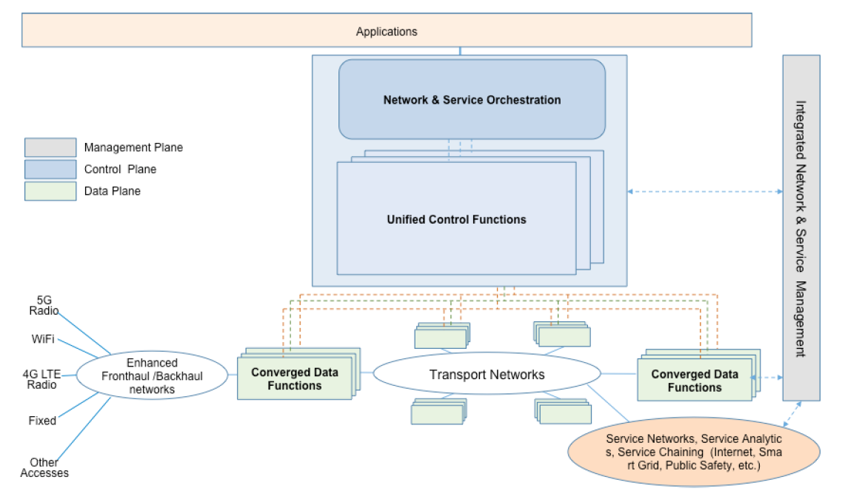
omniRAN Protocols
NFV in ITU-T FG IMT-2020
  FG IMT-2020 identifies the work areas for analyzing the standard gap.
  The network architecture used for the FG IMT-2020 analysis is as follows.
    The converged data functions on the left refers to “RAN”
    The converged data function on the right refers to the “Core network”

Slide 7
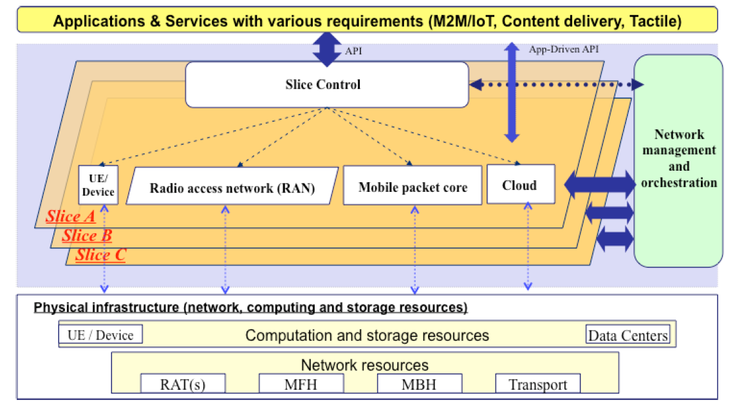
omniRAN Protocols
NFV in ITU-T FG IMT-2020
  The virtualized network functions in the slice are across over entire networks from UE, RAN, Mobile Core and Cloud.
  The NFVI encapsulates the physical infrastructure
NFVI

Slide 8
NFV for omniRAN
NFV
  Services management plane
    CP function
    UP function
    AN configuration and instantiation
    TE authentication and data path establishment
  Resource plane
    AN resource
    TE resource
CP
function
UP
function
TE
Config
AN
Config
Network Function Virtualization
TE
resource
AN
resource
Cloud node
resource
TE Ctrl
AN Ctrl
AR Ctrl
R8
R9
Terminal
Interface
R5
R7
Access Router
Interface
Operator Network
NA
Backhaul
R1
R6
R3
Terminal
Access Network
Access Router

Slide 9
NFV for omniRAN
NFV for omniRAN in Operator Network Slicing
Operator Network Slice
TE
Config
AN
Config
CP
function
UP
function
Network
Management &
Orchestration
TE Ctrl
AN Ctrl
AR Ctrl
R8
R9
R5
R7
Terminal
Interface
Access Router
Interface
NA
Backhaul
R1
R6
R3
Terminal
Access Network
Access Router
TE
resource
AN
resource
Cloud node
resource

Slide 10
omniRAN Protocols
Protocol Stacks
  Network Functions:
    BSSM-F: BSS Management Function
    FDM-F: Fault Diagnosis Management Function
    DPM-F: Data Path Management Function
    SSM-F: Subscription Service Management Function
  NFV Management and Orchestration (NFV-MANO)
    Manage and control the VNF in multiple levels.
    For IEEE802.11 MAC/PHT, it can manage through IEEE802 layer management
FDM-F
BSSM-F
DPM-F
SSM-F
NFV Management and Orchestration
VNF Layer
LLC
LLC
LLC
LLC
LLC
NFVI Layer
802.11 MAC
802.11 MAC
802.3 MAC
802.3 MAC
802.3 MAC
802.3 MAC
802.3 MAC
802.11
PHY
802.11
PHY
802.3
PHY
802.3
PHY
802.3
PHY
802.3
PHY
802.3
PHY
TE
NA
ANC
BH
AR

Slide 11
Summary
Proposal
  Introducing the NFV for omniRAN to provide the unifed software based network function platform
  The NFV can include
    the network management, configuration and instantiation function
    User plane data path management function
    Fault and diagnosis management function
  The virtualized network function could be used to manage
    Multiple different ANs from single operator or
    RANs shared by multiple different service providers

Slide 12
References
References
  IEEE802-1cf-d0-0
  NGMN 5G White Paper: https://mentor.ieee.org/802.11/dcn/15/11-15-0547-00-0wng-ngmn-5g-white-paper-overview.pptx
  omniran-16-0012-00-CF00-ethernet-oam-survey-and-introducing-nms

