Slide 1
P802.1CF architectural considerations for EM and NM
Date: 2016-03-17
Authors:
Name | Affiliation | Phone | Email
Max Riegel | Nokia | +49 173 293 8240 | maximilian.riegel@nokis.com
Notice: This document does not represent the agreed view of the IEEE 802.1 OmniRAN TG. It represents only the views of the participants listed in the ‘Authors:’ field above. It is offered as a basis for discussion. It is not binding on the contributor, who reserve the right to add, amend or withdraw material contained herein.
Copyright policy: The contributor is familiar with the IEEE-SA Copyright Policy <http://standards.ieee.org/IPR/copyrightpolicy.html>.
Patent policy: The contributor is familiar with the IEEE-SA Patent Policy and Procedures: <http://standards.ieee.org/guides/bylaws/sect6-7.html#6> and <http://standards.ieee.org/guides/opman/sect6.html#6.3>.
Abstract
The presentation provides considerations for the architectural arrangement of EM and NM within P802.1CF architecture

Slide 2
P802.1CF architectural considerations for EM and NM
Max Riegel
(Nokia)

Slide 3
Problem description
OmniRAN currently investigates the representation of Network Management within its P802.1CF architecture.
Various options have been introduced by https://mentor.ieee.org/omniran/dcn/16/omniran-16-0019-01-CF00-measurement-and-management-in-ieee-802-11.pptx and https://mentor.ieee.org/omniran/dcn/16/omniran-16-0012-01-CF00-ethernet-oam-survey-and-introducing-nms.pptx without a conclusive proposal for the architectural arrangements.
To mature consensus on the architectural concepts, Network Management should be considered from various perspectives including operational models, network virtualization and modern software-driven implementation aspects.

Slide 4
NRM Overview
CIS Coordination and Information Service
SS Subscription Service
TEC Terminal Control
TEI Terminal Interface
ANC Access Network Control
NA Node of Attachment
BH Backhaul
ARC Access Router Control
ARI Access Router Interface
SS
CIS
R2
R10
R4
R11
TEC
ANC
ARC
R8
R9
TEI
R5
R7
ARI
NA
BH
R1
R6
R3
Terminal
Access Network
Access Router
The NRM defines a generic architecture of IEEE 802 access network
It provides the set of functions and their relationships of an IEEE 802 access network.
The NRM does not specify the operational composition of access network functions with interconnected functions on the network side.

Slide 5


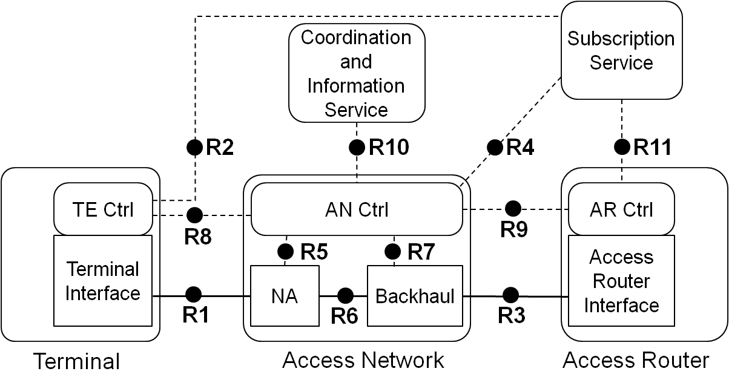
Operational assumption for authentication and trust establishment
User
Service Provider
Subscription

Slide 6
Generic case of Access Network operation
User
Service Provider
Subscription
Access Network Operator
IP Network
Operator
Focus of P802.1CF

Slide 7

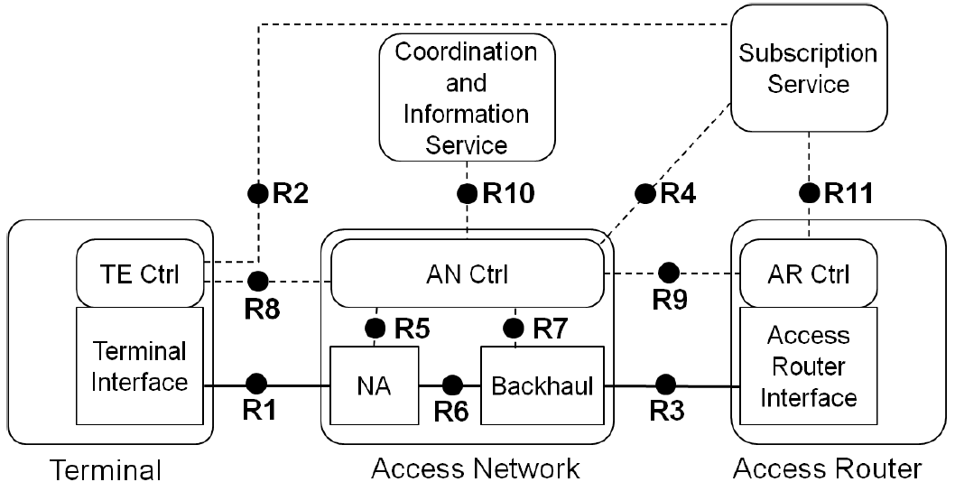
NMS vs. ‘Management Function Set’
Deployment Case (III)
OmniRAN
NMS
(SS)
NMS
Management plane
ItfN
R2, R4,
R11
Controller
(EM)
EM
N<>S
R5, R7
Interface
(NE)
Network plane
R1, R6,
R3
E<>W
Slide from: https://mentor.ieee.org/omniran/dcn/16/omniran-16-0019-01-CF00-measurement-and-management-in-ieee-802-11.pptx

Slide 8
Location of NM: Option 1
Access Network Operator
CIS
BSS
OSS
R10
NM
NMfkts
SS
ANC
R2
R4
R11
EM
EM
EM
TEC
ARC
R8
R9
TEI
R5
R7
ARI
NA
BH
R1
R6
R3
Terminal
Access Network
Access Router

Slide 9
Location of AN NM showing relation to NM of a connected IP Service Provider
Access Network Operator
IP Service Provider
CIS
BSS
BSS
OSS
OSS
R10
NM
NM
NMfkts
SS
EM
ANC
R2
R4
R11
EM
EM
EM
TEC
ARC
EM
R8
R9
TEI
R5
R7
ARI
NA
BH
R1
R6
R3
Terminal
Access Network
Access Router

Slide 10
Location of NM: Option 2
Access Network Operator
CIS
BSS
R10
OSS
SS
ANC
NM
NMfkts
R2
R4
R11
EM
EM
EM
TEC
ARC
R8
R9
TEI
R5
R7
ARI
NA
BH
R1
R6
R3
Terminal
Access Network
Access Router

Slide 11
Conclusion
NMS belongs into the operational domain of the Access Network Operator
Element management is part of Access Network Control
Multiple options possible for location of Network Management
  It seems more logical to locate NM into the OSS of the AN operator with communication towards the EM happening by EM function calls
    Like done by RESTful interfaces today.
Proposing addition of NM function to NRM

Slide 12
Revised NRM
CIS Coordination and Information Service
NM Network Management
SS Subscription Service
TEC Terminal Control
TEI Terminal Interface
ANC Access Network Control
NA Node of Attachment
BH Backhaul
ARC Access Router Control
ARI Access Router Interface
SS
CIS
NM
R2
R10
R11
R4
R12
TEC
ANC
ARC
R8
R9
TEI
R5
R7
ARI
NA
BH
R1
R6
R3
Terminal
Access Network
Access Router
The NRM defines a generic architecture of IEEE 802 access network
It provides the set of functions and their relationships of an IEEE 802 access network.
The NRM does not specify the operational composition of access network functions with interconnected functions on the network side.

