Slide 1
Key Concepts of Association and Disassociation
Date: 2016-05-26
Authors:
Name | Affiliation | Phone | Email
Max Riegel | Nokia | +49 173 293 8240 | maximilian.riegel@nokia.com
Notice: This document does not represent the agreed view of the IEEE 802.1 OmniRAN TG. It represents only the views of the participants listed in the ‘Authors:’ field above. It is offered as a basis for discussion. It is not binding on the contributor, who reserve the right to add, amend or withdraw material contained herein.
Copyright policy: The contributor is familiar with the IEEE-SA Copyright Policy <http://standards.ieee.org/IPR/copyrightpolicy.html>.
Patent policy: The contributor is familiar with the IEEE-SA Patent Policy and Procedures: <http://standards.ieee.org/guides/bylaws/sect6-7.html#6> and <http://standards.ieee.org/guides/opman/sect6.html#6.3>.
Abstract
The presentation provides an introduction into the association and disassociation functions, and presents initial thoughts on the content of the related chapter 7.3 of the specification.

Slide 2
Key Concepts of
Association and Disassociation
Max Riegel
(Nokia)

Slide 3
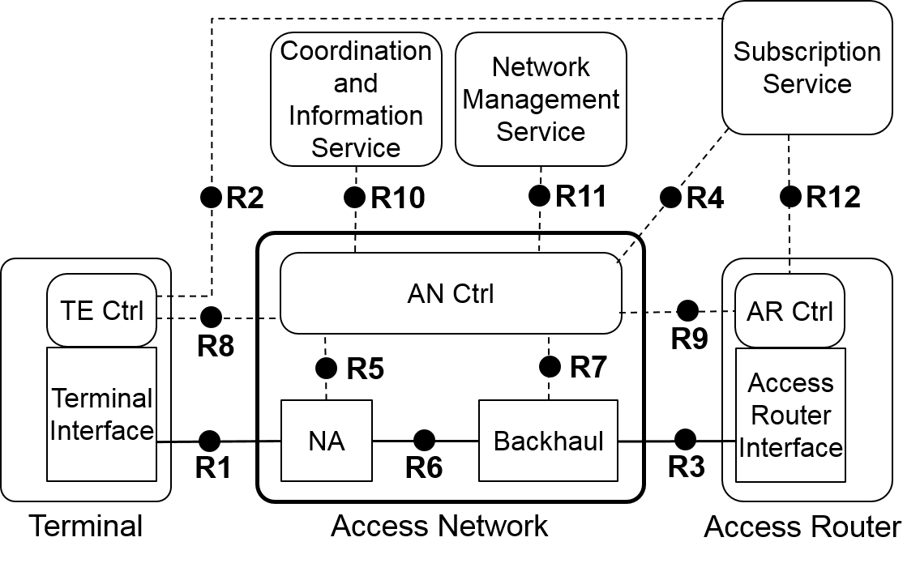
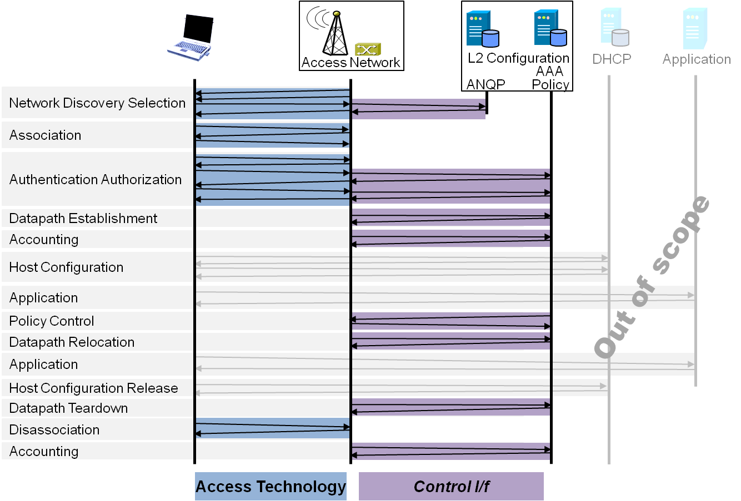
P802.1CF Draft ToC
Overview
References, definitions, acronyms and abbreviations
Conformance
Network Reference Model
  Basic concepts and terminology
  Overview of NRM
  Basic, enhanced and comprehensive NRM
  Deployment scenarios
Functional Design and Decomposition
  Access Network Setup
  Network Discovery and Selection
  Association and Disassociation
  Authentication and Trust Establishment
  Data path establishment,
  relocation and teardown
  Authorization, QoS and policy control
  Monitoring and statistics
  Fault diagnostics and maintenance
SDN Abstraction
Annex:
  Privacy Engineering
  Applicability to non-IEEE 802 PHY layer technologies
  Bibliography

Slide 4
Functional design and decomposition
Chapter ToC
Introduction
Roles and identifiers
Use cases
Functional requirements
Specific attributes
Basic functions
Detailed procedures
Mapping to IEEE 802 technologies

Slide 5
1. Introduction
Association
  Part of the MAC service
  Establishment of MAC layer connection
    Register with peer MAC entity
    Arbitration of PHY and MAC parameters
      Capability exchanges
    Instantiation of MAC state values
  Usually followed by authentication phase
Disassociation
  Orderly teardown of MAC layer connection
    Release of resources allocated to particular terminal
References in IEEE 802.3 (Arbitration, Chap 37), IEEE 802.11 (6.3.7-6.3.9), IEEE 802.16 (Registration, 6.3.9.9.), IEEE 802.15.4 (5.1.3)
  Description will mainly follow 802.11 and 802.3

Slide 6
2. Roles and identifiers
TEI
  Originating entity of sending ASSOCIATE.request
TEC
  Provides target attributes for connection set-up to TEI
NA
  Entity, the TEI seeks to associate with
ANC
  Provides capabilities and constraints for associations to NA
  May forward session context to target NA in case of handover and REASSOCIATE
  Informs SS about the termination of a session after disassociation

Slide 7
3. Use cases
MAC layer connection set-up of TE to NA as part of network entry
  TE registers with target NA after scanning and selection of most appropriate NA
MAC layer connection relocation from serving NA to target NA
  TE seeks for handover to other NA and informs target NA as well as serving NA about relocation of connection.
  Various options for speeding up relocation process by pre-establishment of session context or by transfer of session context from serving to target NA
MAC layer connection teardown due to various reasons to clean up session table in TE and NA and release allocated resources
  TE or NA informs peer about upcoming drop of the connection for various reason. Disassociate message allows for timely release of resources and cleaning up connection states.
    Without DISASSOCOATE message, connection would be removed after time-out

Slide 8
4. Functional requirements
Should allow for capabilities discovery
Should support extensible parameter sets for capabilities
Should allow for orderly capabilities negotiation
Should support prioritized lists of capabilities sets
Should support MAC addresses for identifying the peer entities
Should support that TEs are changing their MAC addresses from session to session
Should support extensible list of reason codes for acknowledgements messages
Should support dynamic selection of subsequent authentication procedure
Should support orderly teardown of MAC connections
May support fast relocation procedures by dedicated REASSOCIATE message and session context transfer
Should support vendor specific extensions of the attribute sets

Slide 9
5. Specific attributes
Protocol configuration
  E.g. Time-out values, attribute sets, protocol-version, fast-handover support
Link Capability Information
  E.g. Supported PHY and MAC modes, supported channels
Preferred and requested link capabilities
  E.g. broadcast modes, minimum/maximum MCS, power-save
Security and QoS capabilities
  E.g. authentication and encryption modes, QoS models
Support of particular services
  E.g. emergency services, regulatory requirements
Result codes
  E.g. success, time-out, loss-of-carrier

Slide 10
6. Basic functions
Preassociation
  ???
Association
  {-request, -response, -indication, -confirm}
Reassociation
  {-request, -response, -indication, -confirm}
Disassociation
  {-request, -indication, -confirm}

Slide 11
7. Detailed procedures
Successful connection setup with negotiation of connection parameters
Failing connection setup due to mismatch of capabilities
Orderly session teardown initiated by TE
Session termination enforced by NA
Session relocation without support of fast transition schemes
Session relocation with support of fast transition schemes

Slide 12
8. Mapping to IEEE 802 technologies
References to related sections in IEEE 802.3, 802.11, 802.16, 802.22
Capabilities comparison between IEEE technologies regarding support of functions

Slide 13
Conclusion
The slides present the basic concepts for writing the text for the Chapter 7.3 Association and Disassociation. It is intended to align the descriptions mainly to 802.3 and 802.11 specifications with providing some information on related 802.16/802.22 procedures
Any comments or recommendations ?

