Slide 1
Key concepts of authorization, QoS, and policy control
Date: 2016-07-25
Authors:
Name | Affiliation | Phone | Email
Max Riegel | Nokia | +491732938240 | maximilian.riegel@nokia.com
Notice: This document does not represent the agreed view of the IEEE 802.1 OmniRAN TG. It represents only the views of the participants listed in the ‘Authors:’ field above. It is offered as a basis for discussion. It is not binding on the contributor, who reserve the right to add, amend or withdraw material contained herein.
Copyright policy: The contributor is familiar with the IEEE-SA Copyright Policy <http://standards.ieee.org/IPR/copyrightpolicy.html>.
Patent policy: The contributor is familiar with the IEEE-SA Patent Policy and Procedures: <http://standards.ieee.org/guides/bylaws/sect6-7.html#6> and <http://standards.ieee.org/guides/opman/sect6.html#6.3>.
Abstract
The presentation provides initial thoughts on the content of the section 7.6 Authorization, QoS, and policy control. The presentation is mainly aimed for describing the basic architecture and basic functions without going deeper into advanced topics, just to create initial text for the functional description within P802.1CF. It is expected that more details and more advanced functions will be added during the task group ballot phase.

Slide 2
Key Concepts of
Authorization, QoS, and policy control
Max Riegel
(Nokia)

Slide 3
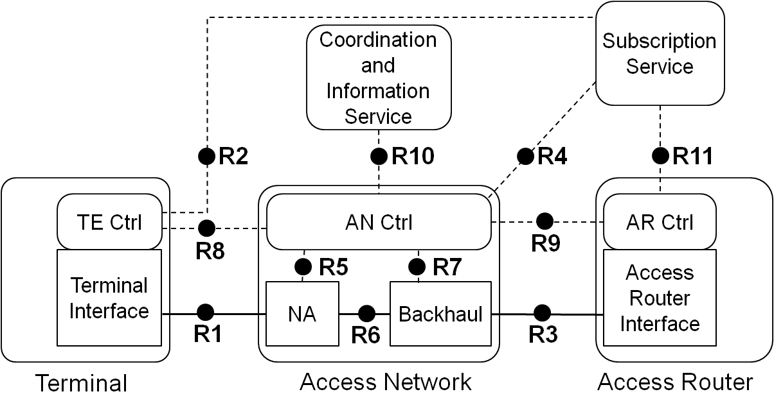
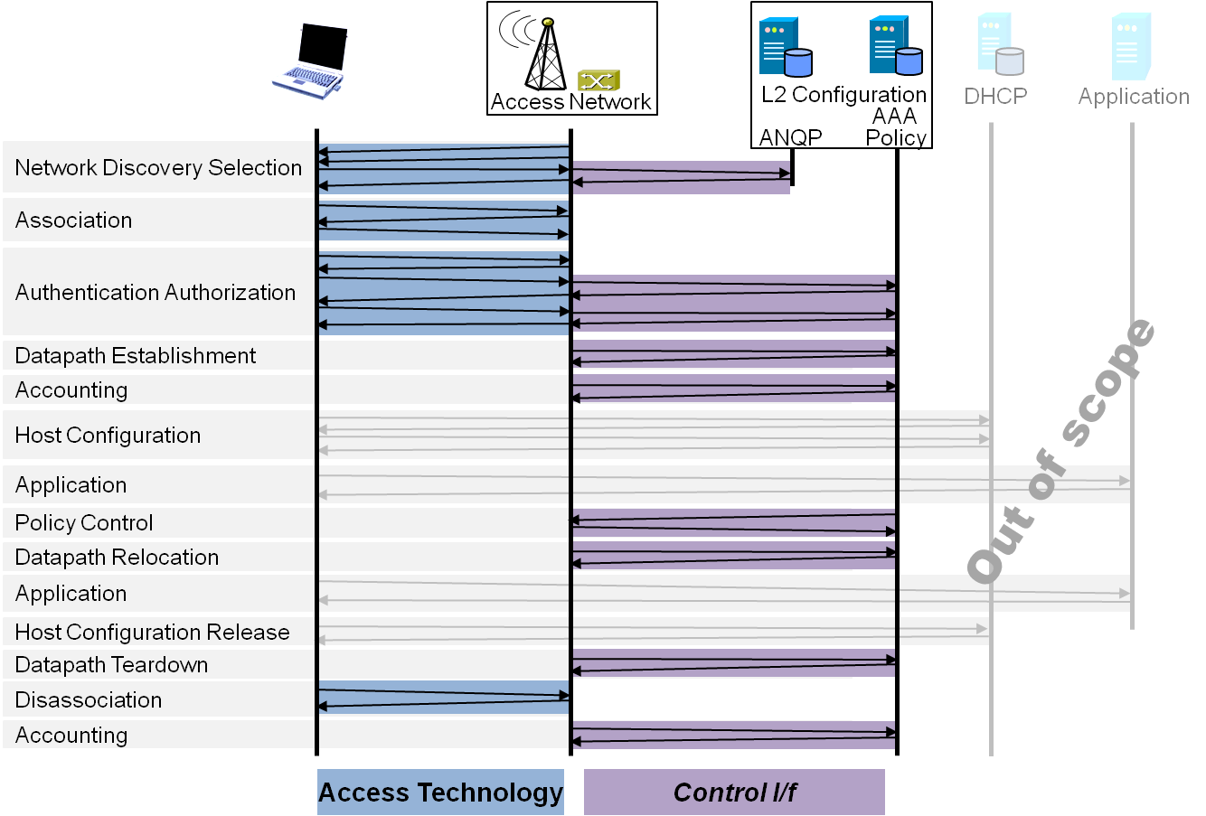
P802.1CF Draft ToC
Overview
References, definitions, acronyms and abbreviations
Conformance
Network Reference Model
  Basic concepts and terminology
  Overview of NRM
  Basic, enhanced and comprehensive NRM
  Deployment scenarios
Functional Design and Decomposition
  Access Network Setup
  Network Discovery and Selection
  Association and Disassociation
  Authentication and Trust Establishment
  Data path establishment,
  relocation and teardown
  Authorization, QoS and policy control
  Monitoring and statistics
  Fault diagnostics and maintenance
SDN Abstraction
Annex:
  PICS proforma
  Privacy Engineering
  Applicability to non-IEEE 802 PHY layer technologies
  Bibliography

Slide 4
Functional design and decomposition
Chapter ToC
Introduction
Roles and identifiers
Use cases
Functional requirements
Specific attributes
Basic functions
Detailed procedures
Mapping to IEEE 802 technologies

Slide 5
Scope and purpose
Only initial thoughts brought up
  Basic architecture and functions
  Further refinements expected during TG balloting phase
Topic is closely related to data path establishment, relocation and tear-down
  Authorization essentially provides the QoS parameters for configuration of data path
Main purpose of presentation is to provide some initial text for chapter to show more complete content for initial TG ballot

Slide 6
1. Introduction
Several aspects to be covered
  QoS model supported by IEEE 802
    Both, diffserv as well as intserv
  Repository of QoS/policy parameters
    Access network assumes that parameters are stored and provided by Subscription Service
  Signaling to forward configuration parameters into networks elements
    Policy repository, policy decision, policy enforcement
P802.1CF has to show how these aspects map to IEEE 802 access network

Slide 7
IEEE 802 QoS models
Mainly defined by 802.1Q bridging behavior
  Diffserv: 802.1p -> 802.1Q
  Intserv: rfc2815 + e.g. 802.1Qat resource reservation protocol
IEEE 802.3 recently introduced mechanisms to allow even stricter intserv model (interspersed express traffic aka 802.3br)
IEEE 802.11 supports mainly diffserv (802.11e aka WMM)
  Intserv is challenging for unlicensed spectrum access
IEEE 802.16 knows about 5 different data delivery services covering both intserv and diffserv
IEEE 802.22 follows 802.16

Slide 8
QoS architecture
Repository of QoS control/policy information is part of Subscription Service
  Policy parameters belong to subscription
  Subscription service provides QoS parameters as part of authorization
    … and might have possibilities to change parameters during ongoing session
Generic policy control architecture
Policy decision point
Policy data base
Policy enforcement
point
Policy enforcement point
Policy enforcement point

Slide 9
Policy control in NRM
SS
CIS
NMS
Policy Data Base
R2
R10
R11
R4
R12
ANC
TEC
Policy Decision Point
ARC
R8
R9
TEI
R5
R7
ARI
NA
BH
PEP
PEP
R1
R6
R3
TE
AN
AR

Slide 10
Service flow
Service flow is the basic means of policy control
  Uniquely identified by an ID
  User datagrams can be assigned to service flows
  Operational states
    Provisioned: Subscription specific service flow parameters provided by subscription service
    Permitted: Requested service flow parameters fit to allowed range
    Active: service flow is established in network elements
Service flows can be static or dynamic
  Static flows keep same behavior throughout a session
  Dynamic flows change behavior during a session

Slide 11
2. Roles and identifiers
Service Flow
  Identifies a traffic forwarding class with defined QoS parameters
Subscription
  Comprises policy information (permitted QoS parametes)
SS
  Repository of policies
  Provides policies and initiate policy changes
ANC
  Operates the policy decision point
NA, BH
  Policy enforcement points
TEI, ARI
  Communicate with ANC about policy changes

Slide 12
3. Use cases
QoS policy provisioning between Subscription Service and AN Control
Default service flow creation, modification and deletion
Subscription service initiated service flow creation, modification, and deletion
Access router initiated service flow creation, modification, and deletion
Terminal initiated service flow creation, modification, and deletion

Slide 13
4. Functional requirements
Should support subscriber specific QoS parameters
Should allow for both intserv and diffserv QoS models
Should support static and dynamic service flows
Should allow Subscription Service to change active service flows
Should allow for dynamic service flow creation on request from terminal or access router
Should create static service flows based on the authorization information delivered in the admission accept message
Should be able to handle any number of terminals, any number of access routers and any number of subscription services.
Should support the resource reservation protocols specified by IEEE 802

Slide 14
5. Specific attributes
Service flow parameters
  Datagram filter
  Priority
  Bandwidth
  Delay
  Jitter
Policy rules
  Traffic specification
  Priority
  Usage limits (time, volume)

Slide 15
6. Basic functions
Provisioning of authorization information to policy decision point at session begin
Change of authorization during session
Provisioning of QoS parameters to policy enforcement points
Request of service flow by terminal
Request of service flow by access router

Slide 16
7. Detailed procedures
Pre-provisioned service flow establishment
Service flow initialization by terminal
Service flow initialization by access router
Service flow modification by terminal
Service flow termination by terminal
Change of authorization by subscription service

Slide 17
8. Mapping to IEEE 802 technologies
Services and service models supported by the IEEE 802 technologies

Slide 18
Conclusion
The slides present an initial functional description of the authorization and policy control process.
More sophisticated models could be added later, e.g. adopting the Policy and charging control architecture of 3GPP TS 23.203
Any comments or recommendations ?

