Slide 1
IEEE 802.1 OmniRAN TG
Special session on WP-5A/ RLAN approach for 5G SC
2016-07-26
Max Riegel, Nokia
(TG Chair)

Slide 2
July 2016 Special session on WP-5A/ RLAN approach for 5G SC
Venue:
  Manchester Grand Hyatt
    1 Market Place
    San Diego, CA USA
    Information Tel: +1 619-232-1234
Meeting room:
  Mon, Tue, Wed, Thu: Hillcrest C
Sessions:
  Mon, Mar 25th, 16:00-18:00
  Tue, July 26th, 13:30-15:30 special session on 5G
  Tue, Mar 26th, 16:00-18:00
  Wed, Mar 27th, 16:00-18:00
  Thu, Mar 28th, 10:30-12:30

Slide 3
Guidelines for IEEE-SA Meetings
All IEEE-SA standards meetings shall be conducted in compliance with all applicable laws, including antitrust and competition laws.
Don’t discuss the interpretation, validity, or essentiality of patents/patent claims.
Don’t discuss specific license rates, terms, or conditions.
  Relative costs, including licensing costs of essential patent claims, of different technical approaches may be discussed in standards development meetings.
    Technical considerations remain primary focus
Don’t discuss or engage in the fixing of product prices, allocation of customers, or division of sales markets.
Don’t discuss the status or substance of ongoing or threatened litigation.
Don’t be silent if inappropriate topics are discussed… do formally object.
---------------------------------------------------------------
If you have questions, contact the IEEE-SA Standards Board Patent Committee Administrator at patcom@ieee.org or visit http://standards.ieee.org/about/sasb/patcom/index.html
See IEEE-SA Standards Board Operations Manual, clause 5.3.10 and “Promoting Competition and Innovation: What You Need to Know about the IEEE Standards Association's Antitrust and Competition Policy” for more details.
This slide set is available
at https://development.standards.ieee.org/myproject/Public/mytools/mob/preparslides.ppt

Slide 4
Agenda proposal for special session on WP-5A/ RLAN approach for 5G SC
Introduction (Max)
IEEE 802 as a component of 5G (Yonggang)
  https://mentor.ieee.org/802-ec/dcn/16/ec-16-0078-01-5GSG-ieee-802-as-a-component-of-5g.pptx
Introduction and thoughts on Action A: IEEE “5G” specification (Roger)
  https://mentor.ieee.org/802-ec/dcn/16/ec-16-0094-07-5GSG-proposed-draft-report-ieee-802-ec-5g-imt-2020-sc.pptx
Views on related regulatory activities (Rich)
Discussion on potential (standardization) activities in IEEE 802 (all)
Conclusion
AoB

Slide 5
Introduction
Question came up during Budapest 5G SC meeting:
  “What kind of (network standardization) efforts would be needed to follow alternative path for 5G with focus on WP5A/RLAN approach?”
    Not striving for IMT-2020 application but positioning IEEE 802 as a complementary solution
There was no answer as all considerations so far were made on efforts for IMT-2020 application.
Question became even more important due to Action A in 5G SC report.
  Potential efforts for Action A have been raised several times during 5G SC discussions on Monday EVE meeting.
Let’s find a way forward to create an idea about the standardization efforts in IEEE 802!

Slide 6
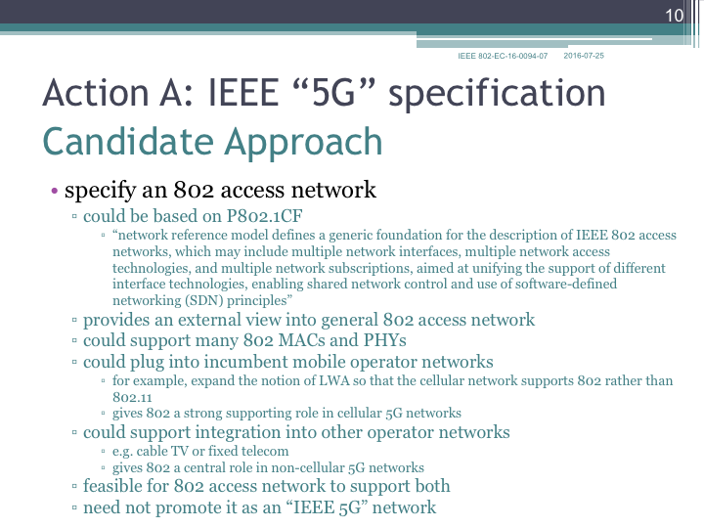

Slide 7
Conclusions

