Slide 1
IEEE 802.1 OmniRAN TG
Sept 2016 F2F Meeting
Warsaw, Poland
2016-09-12
Max Riegel, Nokia
(TG Chair)

Slide 2
Sept 2016 F2F Meeting
Venue:
  Warsaw Marriot Hotel
    Al. Jerozolimskie 65/79
    Warsaw 00-697 Poland
    Tel: +48 22 630 63 06
    http://arinex.com.au/ieee2016/
Meeting room:
  Tue, Wed, Thu: ODRA, Level 3
Sessions:
  Tue, Sept 13th, 16:00-18:00
  Wed, Sept 14th, 13:30-15:30
  Wed, Sept 14th, 16:00-18:00 - special session on ‘Action A’
  Thu, Sept 15th, 10:30-12:30
  Thu, Sept 15th, 13:30-15:30
  Thu, Sept 15th, 16:00-18:00

Slide 3
Agenda proposal for Sept 2016 F2F
Review of minutes
Reports
Contributions to Industry Connections activity (5G SC Action A)
Result of TG ballot of P802.1CF-D0.2
  Comments’ database
Input from York F2F Ad-hoc
Comments’ resolution on P802.1CF-D0.2
New P802.1CF contributions
Plan for creation of P802.1CF-D0.3 draft
  Completion of comments’ resolution
  Plan and timeline for creation of D0.3
Project planning
  External review of P802.1CF-D0.3
Status report to IEEE 802 WGs
AOB

Slide 4
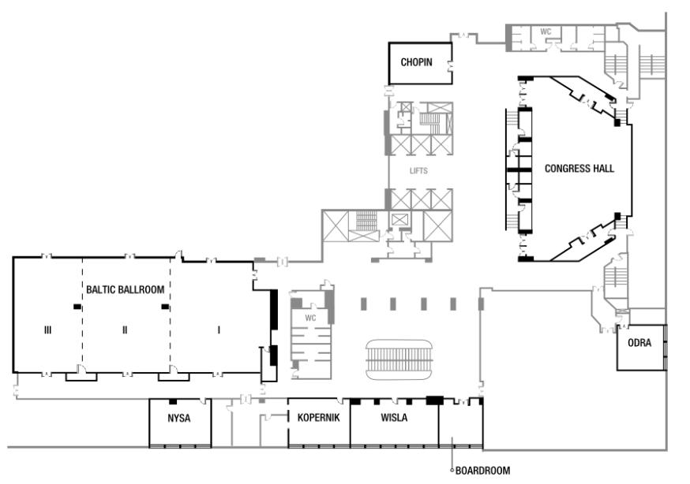
Meeting Room ODRA at Level 3

Slide 5
WiFi in hotel rooms
- if you booked your accommodation through the meeting portal, then you have complimentary Wi-Fi in your hotel room at the Marriott.
The hotel system displays a per day cost for the “High Speed internet””, however this will not be charged by the hotel, and the front desk should have confirmed that at check in.
Any questions, please see the hotel front desk or the registration desk.

Slide 6
Meals
- Breakfast is included in your room rate if you booked via the Marriott Hotel link
- Morning and Afternoon tea will be served in the foyer areas on level 2 and 3
- Lunch will be available from 1200 – 1330 and will be served from the hotel restaurant: Lilla Weneda

Slide 7
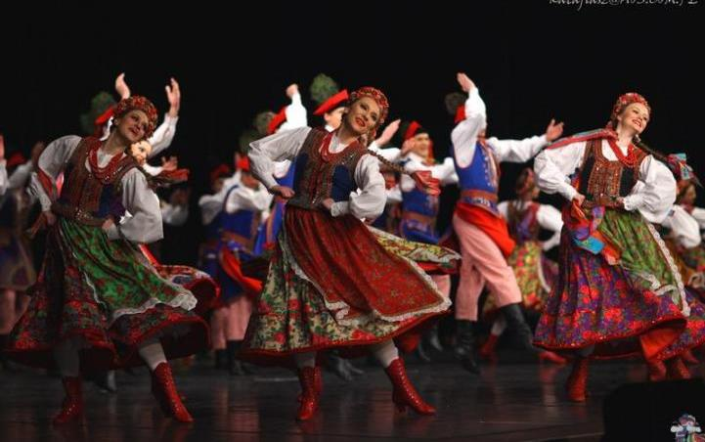
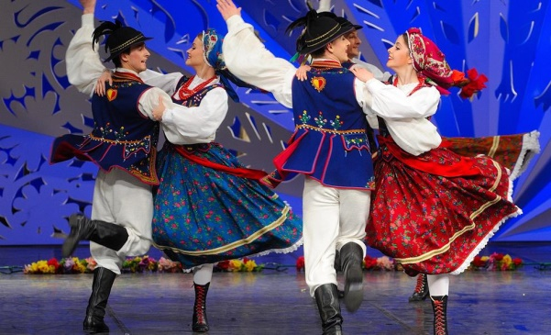
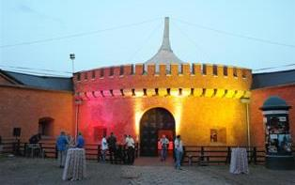
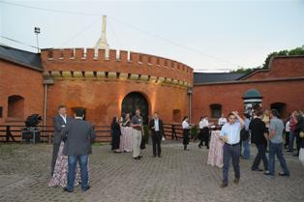
Wednesday Social
Dinner in the Fortress
The Wednesday Social is included in your meeting fee for all attendees
Stand up dinner within the old Fortress, including local Folk Dance performances
Coach pick up: 6pm, Marriott Foyer. ( approx 10 min by coach)
Timings: dinner from 630pm, Cultural performances from 730pm, return buses from 830pm onwards
The Fortress is approx 10 min walking distance from the Old Town for those of you would like to continue there after dinner.
For catering and transport purposes, if you can not attend, please let the registration desk know. Any questions please see Sara or Daniel on the registration desk.

Slide 8
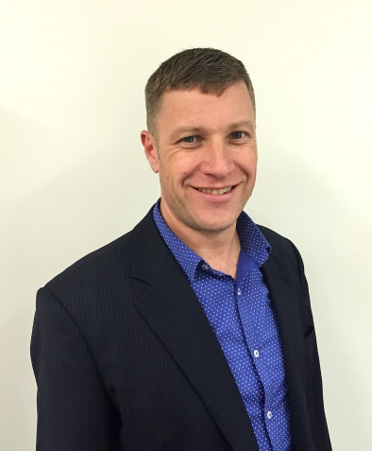
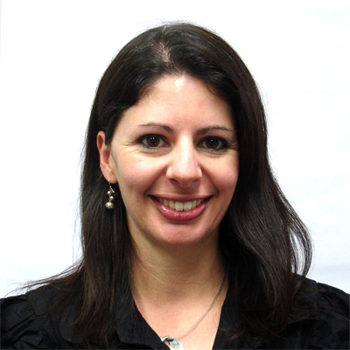
Any Questions
- Please see Daniel or Sara on the registration desk!

Slide 9
Sept 2016 Agenda Graphics
 | Mon 09/12 | Tue 09/13 | Wed 09/14 | Thu 09/15 | Fri 09/16
08:00 10:00 |  | 802.11 WNG | 802.11 ARC |  | 802.11 Closing
 | OmniRAN F2F Ad-hoc York
10:30 12:30 |  | 802.11ARC | 802.11/802.15 Mid-week Plenaries
13:30 15:30
16:00 18:00 |  | OmniRAN Opening | OmniRAN special session on Industry Connections activity | OmniRAN Closing
 |  | 802.11 AANI SC

Slide 10
Participants, Patents, and Duty to Inform
All participants in this meeting have certain obligations under the IEEE-SA Patent Policy.
  Participants [Note: Quoted text excerpted from IEEE-SA Standards Board Bylaws subclause 6.2]:
    “Shall inform the IEEE (or cause the IEEE to be informed)” of the identity of each “holder of any potential Essential Patent Claims of which they are personally aware” if the claims are owned or controlled by the participant or the entity the participant is from, employed by, or otherwise represents
    “Should inform the IEEE (or cause the IEEE to be informed)” of the identity of “any other holders of potential Essential Patent Claims” (that is, third parties that are not affiliated with the participant, with the participant’s employer, or with anyone else that the participant is from or otherwise represents)
  The above does not apply if the patent claim is already the subject of an Accepted Letter of Assurance that applies to the proposed standard(s) under consideration by this group
  Early identification of holders of potential Essential Patent Claims is strongly encouraged
  No duty to perform a patent search

Slide 11
Patent Related Links
All participants should be familiar with their obligations under the IEEE-SA Policies & Procedures for standards development.
Patent Policy is stated in these sources:
  IEEE-SA Standards Boards Bylaws
  http://standards.ieee.org/develop/policies/bylaws/sect6-7.html#6
  IEEE-SA Standards Board Operations Manual
  http://standards.ieee.org/develop/policies/opman/sect6.html#6.3
  Material about the patent policy is available at
  http://standards.ieee.org/about/sasb/patcom/materials.html
If you have questions, contact the IEEE-SA Standards Board Patent Committee Administrator at patcom@ieee.org or visit http://standards.ieee.org/about/sasb/patcom/index.html
This slide set is available at https://development.standards.ieee.org/myproject/Public/mytools/mob/slideset.ppt

Slide 12
Call for Potentially Essential Patents
If anyone in this meeting is personally aware of the holder of any patent claims that are potentially essential to implementation of the proposed standard(s) under consideration by this group and that are not already the subject of an Accepted Letter of Assurance:
  Either speak up now or
  Provide the chair of this group with the identity of the holder(s) of any and all such claims as soon as possible or
  Cause an LOA to be submitted

Slide 13
Other Guidelines for IEEE WG Meetings
All IEEE-SA standards meetings shall be conducted in compliance with all applicable laws, including antitrust and competition laws.
  Don’t discuss the interpretation, validity, or essentiality of patents/patent claims.
  Don’t discuss specific license rates, terms, or conditions.
    Relative costs, including licensing costs of essential patent claims, of different technical approaches may be discussed in standards development meetings.
      Technical considerations remain primary focus
  Don’t discuss or engage in the fixing of product prices, allocation of customers, or division of sales markets.
  Don’t discuss the status or substance of ongoing or threatened litigation.
  Don’t be silent if inappropriate topics are discussed … do formally object.
---------------------------------------------------------------
See IEEE-SA Standards Board Operations Manual, clause 5.3.10 and “Promoting Competition and Innovation: What You Need to Know about the IEEE Standards Association's Antitrust and Competition Policy” for more details.

Slide 14
Resources – URLs
Link to IEEE Disclosure of Affiliation
  http://standards.ieee.org/faqs/affiliationFAQ.html
Links to IEEE Antitrust Guidelines
  http://standards.ieee.org/resources/antitrust-guidelines.pdf
Link to IEEE Code of Ethics
  http://www.ieee.org/web/membership/ethics/code_ethics.html
Link to IEEE Patent Policy
  http://standards.ieee.org/board/pat/pat-slideset.ppt

Slide 15
Business #1
Call Meeting to Order
  Chair called meeting to order at 16:03
Minutes taker:
  Walter is taking notes.
Roll Call
Name | Affiliation |  | Name | Affiliation
Max Riegel | Nokia Bell Labs |  | Liang Jin | Spirent Comm.
Walter Pienciak | IEEE |  | Xingxin Zhang | Huawei
Wang Hao | Fujitsu |  | Hakan Persson | Ericsson
Yonggang Fang | ZTETX
Hyeong Ho Lee | ETRI
Subir Das | ACS
Krzysztof Grochla | IITiS

Slide 16
Call for Potentially Essential Patents
If anyone in this meeting is personally aware of the holder of any patent claims that are potentially essential to implementation of the proposed standard(s) under consideration by this group and that are not already the subject of an Accepted Letter of Assurance:
  Either speak up now or
  Provide the chair of this group with the identity of the holder(s) of any and all such claims as soon as possible or
  Cause an LOA to be submitted
No declarations made.

Slide 17
Agenda for Sept 2016 F2F
Review of minutes
Reports
Contributions to Industry Connections activity (5G SC Action A)
Result of TG ballot of P802.1CF-D0.2
  Comments’ database
Input from York F2F Ad-hoc
Comments’ resolution on P802.1CF-D0.2
New P802.1CF contributions
Plan for creation of P802.1CF-D0.3 draft
  Completion of comments’ resolution
  Plan and timeline for creation of D0.3
Project planning
  External review of P802.1CF-D0.3
Status report to IEEE 802 WGs
AOB

Slide 18
Schedules over the week
Tue, Sept 13th, 16:00-18:00
  Review of minutes
  Reports
  Contributions to Industry Connections activity (5G SC Action A)
  Result of TG ballot of P802.1CF-D0.2
    Comments’ database
  Input from York F2F Ad-hoc
  Comments’ resolution on P802.1CF-D0.2
Wed, Sept 14th, 13:30-15:30
  Comments’ resolution on P802.1CF-D0.2
Thu, Sept 15th, 10:30-12:30
  Comments’ resolution on P802.1CF-D0.2
Thu, Sept 15th, 13:30-15:30
  Comments’ resolution on P802.1CF-D0.2
  New P802.1CF contributions
  Plan for creation of P802.1CF-D0.3 draft
    Completion of comments’ resolution
    Plan and timeline for creation of D0.3
  Project planning
    External review of P802.1CF-D0.3
  Status report to IEEE 802 WGs
  AOB

Slide 19
Business #2
Review of minutes
  https://mentor.ieee.org/omniran/dcn/16/omniran-16-0055-00-00TG-july-2016-f2f-minutes.docx
    No comments raised.
Reports
  Initial TG ballot on P802.1CF-D0.2
  Sharing of P802.1CF with IETF
  York Ad-hoc results
  Presentation to 802.15.3d on Ethernet convergence
    https://mentor.ieee.org/802.15/dcn/16/15-16-0640-00-003d-ethernet-convergence.pptx

Slide 20
York Ad-hoc results
Comments’ discussion w/ Norm Finn
  Discussion about meaning and usage of ‘end station’ and ‘end system’
  Agreement to emphasize in 6.1.7 that access router is ‘end station’ of access network, as it does not forward frames on Layer 2
  Explain in specification that ‘end system’ is where the applications reside
Discussion about Ethernet convergence for 802.15.3d
  Agreement reached that proposing to tunnel Ethernet frames over the ptp 802.15.3 link would be the best approach
  Slides for presentation to 802.15.3d updated after discussion
Discussion about the intentions for the OmniRAN special session in Warsaw on ‘Industry Connections activity’
  Agreed to initiate a brainstorming session to create and collect ideas on the potential new operators domains, on the potential offerings of IEEE 802 to these operators, and on the necessary actions to establish such new operator domains by IEEE 802
  WebEX session will be set-up and announced on the 5G SC list to enable remote attendance

Slide 21
Business #3
Contributions to Industry Connections activity (5G SC Action A)
  Special session on Wed, Sep 14, 1600-1800
    Brainstorming session to progress thinking and ideas for industry connections activity
    WebEX for remote attendance
Result of TG ballot of P802.1CF-D0.2
  Comments’ database
Input from York F2F Ad-hoc
  Clarifications on Norman Finn’s comments

Slide 22
TG ballot results of P802.1CF/D0.2
Responses can be on web archive of ballot list: http://www.ieee802.org/1/private/email2/thrd1.html
Somewhat weak response (20 responses total)
  4 Approve
  3 Disapprove
  13 Abstain
    8 lack of expertise
    5 lack of time
Total of 58 comments
  33 editorial
  25 technical
https://mentor.ieee.org/omniran/dcn/16/omniran-16-0059-00-00TG-p802-1cf-d0-2-collected-comments.xls

Slide 23
Business #4
Comments’ resolution on P802.1CF-D0.2
  Done. Result of resolution uploaded under https://mentor.ieee.org/omniran/dcn/16/omniran-16-0059-01-00TG-p802-1cf-d0-2-collected-comments.xls
  One open comment to closed in the next conference call.
New P802.1CF contributions
  None.

Slide 24
Business #5
Plan for creation of P802.1CF-D0.3 draft
  Completion of comments’ resolution
    To be done in conference call on Sept 27th
  Plan and timeline for creation of D0.3
    15 days recirculation closing Nov 3rd
    Announcement of recirculation on Oct 17th
    Decision on input for D0.3 on Sept 27th
    Max will provide introductory section to chapter 7 (overview of functional description)
    More would be needed for 6.9 Deployment Scenarios, but time to create content is too short.

Slide 25
Business #6
Project planning
  External review of P802.1CF-D0.3
    Plan to present P802.1CF in intarea meeting at next IETF (Nov 14-17, Seoul, Korea)
      Who will present?
    TTC Japan; Introduction done by Fujitsu
      Request for access to specification
    Other groups?
      For further discussion
Status report to IEEE 802 WGs
  Proposal presented and agreed
  https://mentor.ieee.org/omniran/dcn/16/omniran-16-0062-00-00TG-sep-2016-report-to-802-wgs.pptx
AOB
  None
Adjourned at 15:50

