Slide 1
IEEE 802.1 OmniRAN TG
Special session on 5G SC Action A (Industry Connections activity)
2016-09-14
Max Riegel, Nokia Bell Labs
(TG Chair)

Slide 2
Guidelines for IEEE-SA Meetings
All IEEE-SA standards meetings shall be conducted in compliance with all applicable laws, including antitrust and competition laws.
Don’t discuss the interpretation, validity, or essentiality of patents/patent claims.
Don’t discuss specific license rates, terms, or conditions.
  Relative costs, including licensing costs of essential patent claims, of different technical approaches may be discussed in standards development meetings.
    Technical considerations remain primary focus
Don’t discuss or engage in the fixing of product prices, allocation of customers, or division of sales markets.
Don’t discuss the status or substance of ongoing or threatened litigation.
Don’t be silent if inappropriate topics are discussed… do formally object.
---------------------------------------------------------------
If you have questions, contact the IEEE-SA Standards Board Patent Committee Administrator at patcom@ieee.org or visit http://standards.ieee.org/about/sasb/patcom/index.html
See IEEE-SA Standards Board Operations Manual, clause 5.3.10 and “Promoting Competition and Innovation: What You Need to Know about the IEEE Standards Association's Antitrust and Competition Policy” for more details.
This slide set is available
at https://development.standards.ieee.org/myproject/Public/mytools/mob/preparslides.ppt

Slide 3
Agenda proposal
Introduction
5G SC Conclusions
Recap of OmniRAN discussions in San Diego
IEEE SA Industry Connections activity
  Industry Connections Activity Initiation Document (ICAID)
Discussion topics for the meeting
  What does IEEE 802 like to achieve?
  What can IEEE 802 offer/deliver?
  What would be the means/steps to move forward?
Conclusion
AoB

Slide 4
Introduction
802.1 OmniRAN TG is tasked to hold sessions in preparation of an Industry Connections activity resulting out of 5G SC Action A.
Many options have been raised, but it seems that we are far from having conclusions on the particular approach.
The session is aimed to openly exchange views and ideas.
  Do not hesitate to provide all your thoughts.

Slide 5
5G SC Action A conclusion
802.1 OmniRAN TG – 5G SC Action A

Slide 6
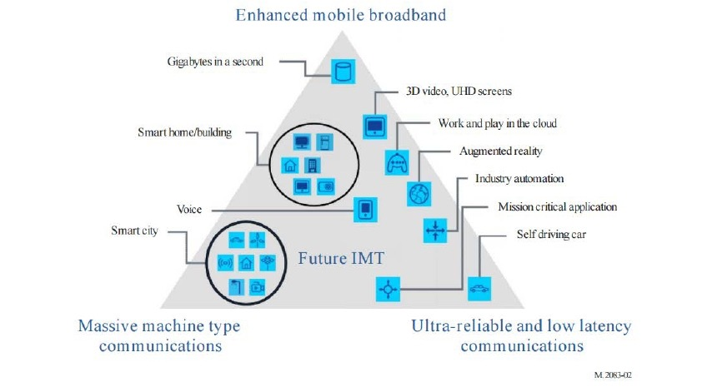
IMT-2020 (per ITU-R M.2083)
6

Slide 7
Cost benefit analysis of options/actions
7

Slide 8
8
Action A: IEEE “5G” specification
Candidate Approach
• specify an 802 access network
  could be based on P802.1CF
    “network reference model defines a generic foundation for the description of IEEE 802 access networks, which may include multiple network interfaces, multiple network access technologies, and multiple network subscriptions, aimed at unifying the support of different interface technologies, enabling shared network control and use of software-defined networking (SDN) principles”
  provides an external view into general 802 access network
  could support many 802 MACs and PHYs
  could plug into incumbent mobile operator networks
    for example, expand the notion of LWA so that the cellular network supports 802 rather than 802.11
    gives 802 a strong supporting role in cellular 5G networks
  could support integration into other operator networks
    e.g. cable TV or fixed telecom
    gives 802 a central role in non-cellular 5G networks
  feasible for 802 access network to support both
  need not promote it as an “IEEE 5G” network

Slide 9
9
P802.1CF Interface option to 5G
Source: IEEE 802-EC-16-0083-00-5GSG

Slide 10
Action A: Routes to success
802 Access Network
10
engage with 3GPP to specify interface details
  could support many 802 MACs and PHYs
engage with other parties to specify interface details
  build partnership with other operator communities
support internationalization
  standardize within partner communities
  standardize in JTC1
  standardize in ITU-R (WP 5A) in support of spectrum needs
    WP 5A: “Land mobile service excluding IMT”
    refer to WP 5A’s “Guide to the use of ITU-R texts relating to the land mobile service, including wireless access in the fixed service”
  could standardize in ITU-R IMT-2020 (see Action B)

Slide 11
Action A: Possible partners
802 Access Network
11
IEEE
  Communications Society standards activities; e.g. IEEE 1904 Access Networks Working Group
3GPP
ITU-R (WP 5A; WP 5D)
IETF, Broadband Forum, CableLabs, MEF, ETSI BRAN, Open Networking Foundation, Wi-Fi Alliance, ZigBee Alliance, Ethernet Alliance, WiMAX Forum, CPRI, …

Slide 12
12
Action A – IEEE 802 Access Network
Objective
Adoption of IEEE 802 Access Network specification in multiple disparate operator networks.
Strength | Weakness | Opportunity | Threat
1. Builds on traditional 802 presentation of interface to support many networks | 1. Could require compromises in the support of any specific network | 1. Can be applied in both 3GPP networks and in alternative networks | 1. Coordination efforts required– may not be accepted
2. Enhances interoperation with identified end-to-end networks | 2. Requires liaison activity to coordinate interface requirements. | 2. Offers an advantage for end-to-end networks to use 802 | 2. Specifications may come too late or under-perform
3. Could be leveraged to promote spectrum for non-IMT systems; e.g. WAS | 3. May require development of uses cases and requirements | 3. Increases value of the entire range of 802 MAC/PHYs; could support spectrum expansion | 3. Non-802 technologies may be used at the specified interface
Description
Specify an IEEE 802 Access Network, incorporating IEEE 802 MAC/PHYs and supporting standards, with a unified interface to end-to-end networks. Promote standardization of the integration of the IEEE 802 Access Network into end-to-end networks.
Cost | Benefit
IEEE 802 needs to develop Access Network spec; 802 MAC/PHYs may need to develop new amendments; external ecosystems need to be developed | Makes IEEE 802 the central player in heterogeneous access and in access networks for 5G of all forms; IEEE has no responsibility to specify end-to-end

Slide 13
OmniRAN San Diego conclusions
802.1 OmniRAN TG – 5G SC Action A

Slide 14
OmniRAN San Diego Conclusions
There are limited possibilities to establish IEEE 802 as complementary 5G technology in ITU WP-5A
  ”5G” is a marketing term not used by ITU-R
IEEE 802 is already prominently represented in M.1450 maintained by WP-5A
  Could potentially be even more enhanced
  IEEE 802.18 is already active, but might require more input
There are plenty of options to establish an IEEE 802 “5G” specification
  But we are currently missing the objectives for such an effort
We need a customer for the IEEE 802 “5G” specification
  Like 3GPP has strong relationship with mobile operators on 5G/IMT-2020
We have to work on industry relations for IEEE 802 “5G”
  Ideas and proposals wanted!
BTW: Standardization effort for Action A is not the issue.

Slide 15
IEEE Industry Connections activity
802.1 OmniRAN TG – 5G SC Action A

Slide 16
IEEE SA Industry Connections activity
Aimed for technical group discussions (far) ahead of starting PAR discussions.
  http://standards.ieee.org/develop/indconn/
  Can be individual or entity based.
  Works under dedicated P&Ps
  Confidentiality, lighter IPR regime ???
IEEE SA offers special procedural support
  ICAID (Industry Connections Activity Initiation Document) request form for approval
    http://standards.ieee.org/develop/indconn/icaid_form.doc
Further resources:
  http://standards.ieee.org/about/sasb/iccom/resources.html

Slide 17
Discussions
802.1 OmniRAN TG – 5G SC Action A

Slide 18
  What does IEEE 802 like to achieve?

Slide 19
  What can IEEE 802 offer/deliver?

Slide 20
  What would be the means/steps to move forward?

Slide 21
Conclusion and next steps
802.1 OmniRAN TG – 5G SC Action A

Slide 22
Conclusion and next steps

