Slide 1
omniRAN Virtual Access Network Instantiation
Date: 2016-09-27
Authors:
Name | Affiliation | Phone | Email
Yonggang Fang | ZTETX Inc |  | yfang@ztetx.com
Notice: This document represents only the views of the participants listed in the ‘Authors:’ field above. It is offered as a basis for discussion. It is not binding on contributors, who reserve the right to add, amend or withdraw material contained herein.
Copyright policy: The contributor is familiar with the IEEE-SA Copyright Policy <http://standards.ieee.org/IPR/copyrightpolicy.html>.
Patent policy: The contributor is familiar with the IEEE-SA Patent Policy and Procedures: <http://standards.ieee.org/guides/bylaws/sect6-7.html#6> and <http://standards.ieee.org/guides/opman/sect6.html#6.3>.
Abstract
This contribution provides an overview of virtual access network creation for P802.1CF specification of Recommended Practice for Network Reference Model ad Functional Description of IEEE 802 Access Network.

Slide 2
Background
Why needs an instantiation
  omniRAN defines a virtual access network in the NRM, which is a kind of software defined access network.
  The functions of virtual AN are implemented through the virtualized network function modules which encapsulate physical functions and offer the common software interfaces to other functional modules of virtual access network.
  Unlike the real access network, the virtual access network may not be necessary to be created upon the power-up. Instead, it may be created upon needed by the orchestrator.
  The virtual access network can be updated or released at anytime.

Slide 3
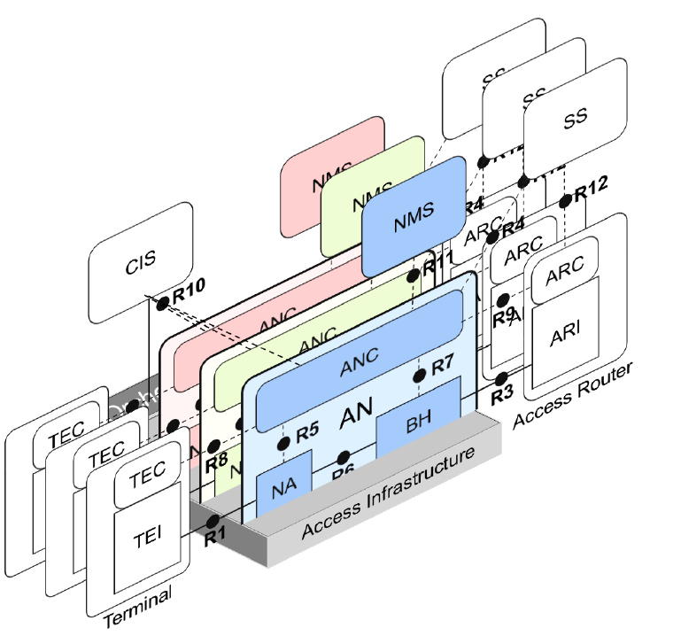
omniRAN Network Reference Model
Instance of Virtual AN
  A virtual AN is a kind of software defined access network associating with a service provider. Service providers expect to operate the virtual access network in the same way as the real dedicated access network.
  The virtual AN is represented by the instance which is created dynamically by the access network orchestrator, when there
  is a need to establish a virtual access network for a
  service provider.
  In the virtual AN instance,
    the reference points becomes the
  VNF interfaces. For example,
  R5 is the VNF interface between
  V-ANC and V-NA
    Functions of AN are represented
    by (abstracted) virtual network
    functions

Slide 4
Virtual AN Instantiation Procedure
Virtual AN Creation Procedure
  Creation : create a virtual AN instance, discovering and Joining the service provider network.
  Initiation: Configuration of virtual AN instance
Orchestrator
V-NA
V-BH
V-ANC
V-NMS
1. Creation Request
2. Discovery Request
3. Discovery Response
4. Join Request
5. Join Response
6. Creation Response
7. Initiation Request
8. Initiation Response
9. Initiation Request
10. Initiation Response

Slide 5
Virtual AN Instantiation Procedure
Virtual AN Instantiation Procedure
  Creation
    Upon the request, or default configuration, the AN orchestrator creates a virtual AN instance associated with a service provider, including the virtual ANC instance, virtual NA instance(s), virtual BH instance(s); and a virtual NMS instance.
  Initialization of virtual AN
    The instance of V-NMS establishes a communication with the designated service provider interface to retrieve the AN configuration information.
    The instance of V-ANC communicates with V-NMS to get the configuration information of the service provider of V-AN through VNF interface (R11) between V-ANC and V-NMS
    The V-ANC configures
      V-NA(s) through the VNF interface (R5):
        operating information: SSID, virtual BSSID, TBTT, channel info, capability, etc.
        Communication port: virtual R6
        Forwarding table: such as for SDN
        Authentication information
      V-BH(s) through the VNF interface (R7)
        Communication ports: virtual R6 and R3
        Forwarding tables: such as for SDN
        Authentication information

Slide 6
References
References
  IEEE802-1cf-d2
  omniran-16-0017-02-CF00-omniRAN-NFV
  omniran-16-0036-01-CF00-an-setup-procedure-2

