Slide 1
IEEE 802.1 OmniRAN TG
Conference call on 5G SC Action A (Industry Connections activity)
2016-11-17
Max Riegel, Nokia
(TG Chair)

Slide 2
Guidelines for IEEE-SA Meetings
All IEEE-SA standards meetings shall be conducted in compliance with all applicable laws, including antitrust and competition laws.
Don’t discuss the interpretation, validity, or essentiality of patents/patent claims.
Don’t discuss specific license rates, terms, or conditions.
  Relative costs, including licensing costs of essential patent claims, of different technical approaches may be discussed in standards development meetings.
    Technical considerations remain primary focus
Don’t discuss or engage in the fixing of product prices, allocation of customers, or division of sales markets.
Don’t discuss the status or substance of ongoing or threatened litigation.
Don’t be silent if inappropriate topics are discussed… do formally object.
---------------------------------------------------------------
If you have questions, contact the IEEE-SA Standards Board Patent Committee Administrator at patcom@ieee.org or visit http://standards.ieee.org/about/sasb/patcom/index.html
See IEEE-SA Standards Board Operations Manual, clause 5.3.10 and “Promoting Competition and Innovation: What You Need to Know about the IEEE Standards Association's Antitrust and Competition Policy” for more details.
This slide set is available
at https://development.standards.ieee.org/myproject/Public/mytools/mob/preparslides.ppt

Slide 3
Agenda proposal
Introduction
IEEE SA Industry Connections
Industry Connections Activity Initiation Document (ICAID)
Plan for Jan ’17 Atlanta meeting
AoB

Slide 4
Motion at 802.1 Nov ’16 closing plenary
Authorize OmniRAN TG to create an ICAID proposal addressing the 5G SC Action A and authorize the 802.1 chair to pre-circulate the ICAID proposal to the EC for consideration.
  Moved: Max Riegel
  Second: John Messenger
  Vote: 22, 0, 1

Slide 5
5G SC Action A

Slide 6
6
Action A: IEEE “5G” specification
Candidate Approach
• specify an 802 access network
  could be based on P802.1CF
    “network reference model defines a generic foundation for the description of IEEE 802 access networks, which may include multiple network interfaces, multiple network access technologies, and multiple network subscriptions, aimed at unifying the support of different interface technologies, enabling shared network control and use of software-defined networking (SDN) principles”
  provides an external view into general 802 access network
  could support many 802 MACs and PHYs
  could plug into incumbent mobile operator networks
    for example, expand the notion of LWA so that the cellular network supports 802 rather than 802.11
    gives 802 a strong supporting role in cellular 5G networks
  could support integration into other operator networks
    e.g. cable TV or fixed telecom
    gives 802 a central role in non-cellular 5G networks
  feasible for 802 access network to support both
  need not promote it as an “IEEE 5G” network

Slide 7
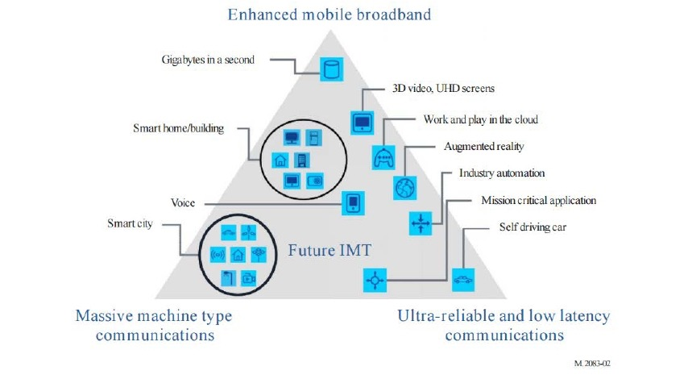
IMT-2020 (per ITU-R M.2083)
7

Slide 8
Scope of Action A
“IEEE next generation communication infrastructure specifications that support enhanced broadband, massive machine type communication and ultra-reliable and low latency communications not belonging to mobile networks”
Could be called ‘IEEE ngci’ ?

Slide 9
Who could be the ‘customers’?
Other operators of public communication networks than mobile network operators
  MSO
  FNO
  Hotspot operators
‘Verticals’ represented in IEEE standards like
  Smart Grid
    http://standards.ieee.org/develop/msp/smartgrid.pdf
  Cloud Computing
    http://standards.ieee.org/develop/msp/cloudcomputing.pdf
  Internet of Things (including Green Community Networks)
    http://standards.ieee.org/develop/msp/iot.pdf
  Intelligent Transportation Systems
    http://standards.ieee.org/develop/msp/its.pdf
  eHealth
    http://standards.ieee.org/develop/msp/ehealth.pdf
  Smart Cities
    http://standards.ieee.org/develop/msp/smartcities.pdf

Slide 10
What would we like to achieve?
Strengthen the IEEE 802 ecosystem by unifying technical approaches among various deployment domains.
More direct involvement of customers in the evolution of IEEE 802 technologies
Faster adoption of emerging trends into IEEE 802 standards by better understanding of market evolution
...?

Slide 11
What do we miss?
What are the requirements and commonalities among the various deployment domains of IEEE 802 technologies?
Who are the leading customers?
… ?

Slide 12
IEEE SA
Industry Connections

Slide 13
IEEE SA Industry Connections activity
Aimed for technical group discussions (far) ahead of starting PAR discussions.
  http://standards.ieee.org/develop/indconn/
  ICAID (Industry Connections Activity Initiation Document) request form for approval
    http://standards.ieee.org/develop/indconn/icaid_form.doc
Presentation by John:
  Use of Industry Connections in IEEE 802
    https://mentor.ieee.org/omniran/dcn/16/omniran-16-0083-00-5gaa-use-of-industry-connections-in-ieee-802.pptx
Further resources:
  http://standards.ieee.org/about/sasb/iccom/resources.html

Slide 14
DRAFt ICAID

Slide 15
Draft ICAID
Initial draft text based on input from John and edited by Max available by
  https://mentor.ieee.org/omniran/dcn/16/omniran-16-0084-00-5gaa-draft-icaid-for-5g-sc-action-a.doc
Revision with comments from John:
  https://mentor.ieee.org/omniran/dcn/16/omniran-16-0084-01-5gaa-draft-icaid-for-5g-sc-action-a.doc

Slide 16
Way forward

Slide 17
Next steps
?
Next F2F meeting: Atlanta, Jan 2017
  Session on Wed, PM2

Slide 18
AoB
??

