Slide 1
IEEE 802.1 OmniRAN TG
Special session on 5G SC Action A (Industry Connections activity)
2017-03-15
Max Riegel, Nokia Bell Labs
(TG Chair)

Slide 2
Guidelines for IEEE-SA Meetings
All IEEE-SA standards meetings shall be conducted in compliance with all applicable laws, including antitrust and competition laws.
Don’t discuss the interpretation, validity, or essentiality of patents/patent claims.
Don’t discuss specific license rates, terms, or conditions.
  Relative costs, including licensing costs of essential patent claims, of different technical approaches may be discussed in standards development meetings.
    Technical considerations remain primary focus
Don’t discuss or engage in the fixing of product prices, allocation of customers, or division of sales markets.
Don’t discuss the status or substance of ongoing or threatened litigation.
Don’t be silent if inappropriate topics are discussed… do formally object.
---------------------------------------------------------------
If you have questions, contact the IEEE-SA Standards Board Patent Committee Administrator at patcom@ieee.org or visit http://standards.ieee.org/about/sasb/patcom/index.html
See IEEE-SA Standards Board Operations Manual, clause 5.3.10 and “Promoting Competition and Innovation: What You Need to Know about the IEEE Standards Association's Antitrust and Competition Policy” for more details.
This slide set is available
at https://development.standards.ieee.org/myproject/Public/mytools/mob/preparslides.ppt

Slide 3
Agenda proposal
Introduction
Review of minutes
Introduction into scope and goals of ICAID
Review of Industry Connections Activity
Initiation Document (ICAID)
Operation of the IC activity
  Addressing the Verticals represented in IEEE SA
  Initial steps
AoB

Slide 4
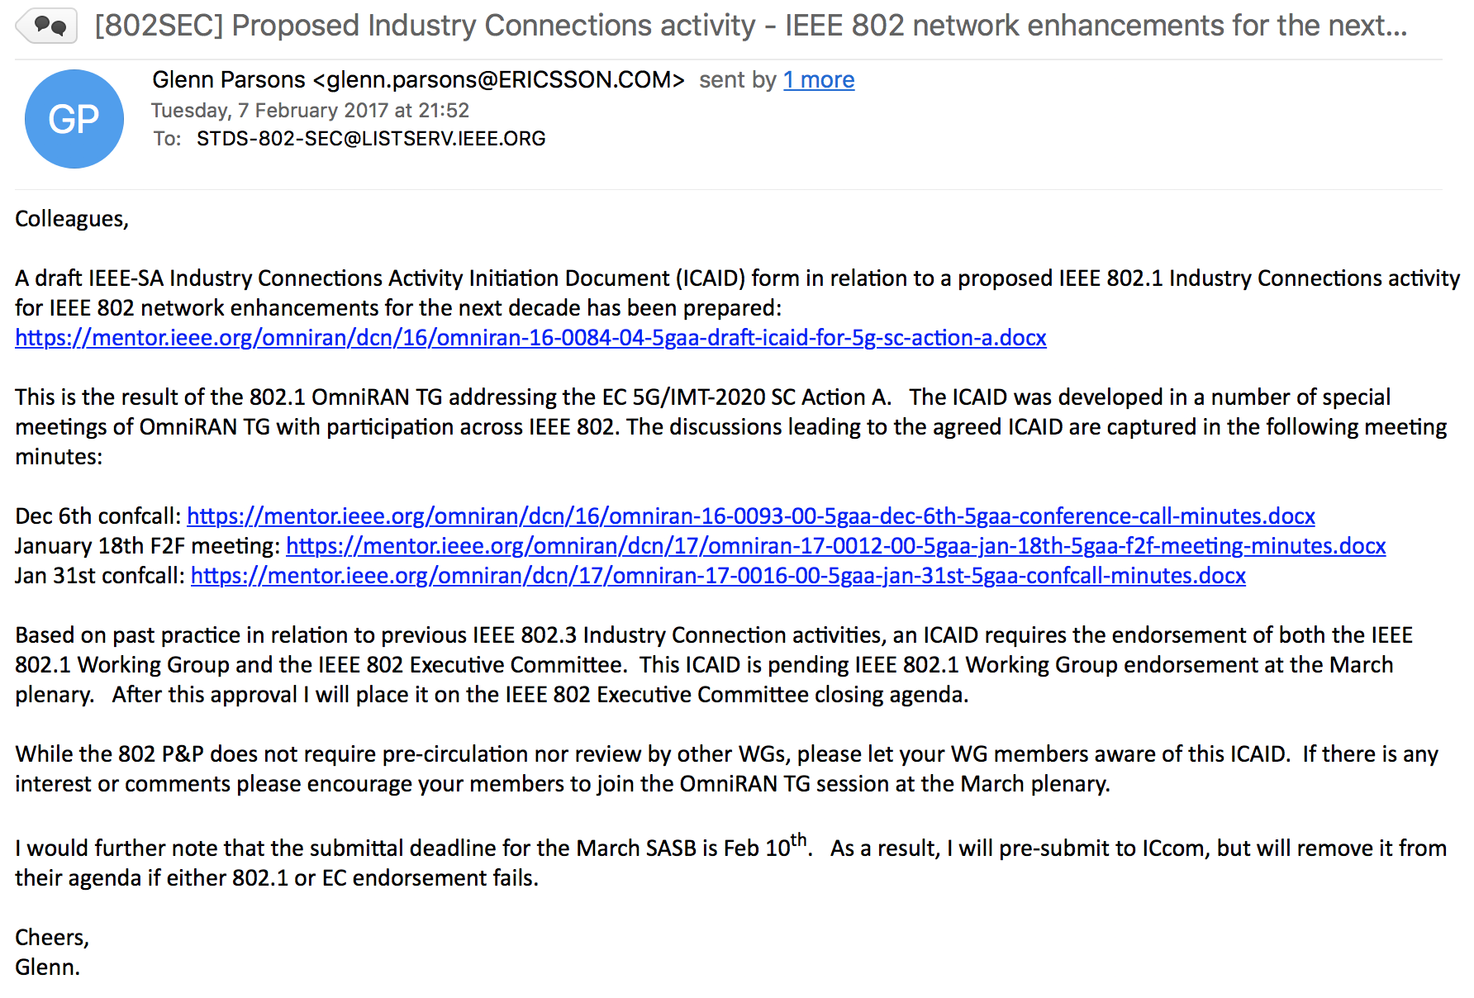

Slide 5
Minutes
For reference:
  Dec 6th ConfCall
    https://mentor.ieee.org/omniran/dcn/16/omniran-16-0093-00-5gaa-dec-6th-5gaa-conference-call-minutes.docx
For review:
  Jan 18th, F2F meeting
    https://mentor.ieee.org/omniran/dcn/17/omniran-17-0012-00-5gaa-jan-18th-5gaa-f2f-meeting-minutes.docx
  Jan 31st ConfCall
    https://mentor.ieee.org/omniran/dcn/17/omniran-17-0016-00-5gaa-jan-31st-5gaa-confcall-minutes.docx

Slide 6
SCOPE and AIM
IEEE 802.1 ICAID

Slide 7
5G SC Conclusion
Action A: Establish a kind of IEEE “5G” for the non-mobile environment
  Organized by 802.1 WG (Industry Connections project)
Action B3: Ensure IEEE 802.11 is becoming well integrated in the incumbent mobile operator 5G universe
  Organized by 802.11 WG (Liaison with 3GPP)
Spectrum issues handled by 802.18
Joint 802.1/802.11 meetings as necessary for coordination of actions A & B3

Slide 8
Mentor DCN: EC-16-0119-01-5GSG
8
Action A: IEEE “5G” specification
Candidate Approach
• specify an 802 access network
  could be based on P802.1CF
    “network reference model defines a generic foundation for the description of IEEE 802 access networks, which may include multiple network interfaces, multiple network access technologies, and multiple network subscriptions, aimed at unifying the support of different interface technologies, enabling shared network control and use of software-defined networking (SDN) principles”
  provides an external view into general 802 access network
  could support many 802 MACs and PHYs
  could plug into incumbent mobile operator networks
    for example, expand the notion of LWA so that the cellular network supports 802 rather than 802.11
    gives 802 a strong supporting role in cellular 5G networks
  could support integration into other operator networks
    e.g. cable TV or fixed telecom
    gives 802 a central role in non-cellular 5G networks
  feasible for 802 access network to support both
  need not promote it as an “IEEE 5G” network

Slide 9
Scope and title of the Industry Connections activity
“IEEE next generation communication infrastructure specifications that support enhanced broadband, massive machine type communication and ultra-reliable and low latency communications not belonging to mobile networks”
Working title.
  IEEE 802 network enhancements for the next decade
    Some better marketing term would be desirable;-)

Slide 10



IEEE 802 networking is predominantly happen in non-IMT networks
IMT
‘Verticals’
Hotspot
Smart Grid
Cloud Computing
…
eHealth
Internet of Things
Smart Cities
2G
3G
IMT2000
4G
IMT2010
5G
IMT2020
xDSL
FTTH
Cable
Enterprise
LAN
Mobile Core
CSP Backbone
CSP Backbone
WAN
Internet

Slide 11
Network deployments aside of mobile networks
Other operators of public communication networks than mobile network operators
  MSO
  FNO
  Hotspot operators
‘Verticals’ represented in IEEE standards like
  Smart Grid
    http://standards.ieee.org/develop/msp/smartgrid.pdf
  Cloud Computing
    http://standards.ieee.org/develop/msp/cloudcomputing.pdf
  Internet of Things (including Green Community Networks)
    http://standards.ieee.org/develop/msp/iot.pdf
  Intelligent Transportation Systems
    http://standards.ieee.org/develop/msp/its.pdf
  eHealth
    http://standards.ieee.org/develop/msp/ehealth.pdf
  Smart Cities
    http://standards.ieee.org/develop/msp/smartcities.pdf

Slide 12
Aims of ‘5G SC Action A’
New deployments of IEEE 802 by better addressing deployment needs
  Unifying technical approaches among various deployment domains by better communications
  Development of further amendments to fulfill particular requirements.
Faster adoption of emerging trends to IEEE 802 standards by better understanding of market evolution.
  More direct involvement of “customers” in the evolution of IEEE 802 technologies

Slide 13
Industry Connections
IEEE 802.1 ICAID

Slide 14
Industry Connections (IC) Program
An efficient, economical, neutral environment for building consensus
  Supports incubation of new technologies, standards and services
  Help groups to solve shared problems and produce shared results
  Minimal effort, time and expense to begin collaborative work
  Respected, neutral, third-party home for activities and results
  Efficient path toward prestigious IEEE publication/standardization
  Flexible options for evolution, transition and conclusion of activities
Possible Outputs of IC Activities
  Proposals for standards
  White papers
  Peer-reviewed guides and position papers
  Workshops and other events
  Databases and registration services
  Software, tools and web services
  Other jointly developed results
Complements IEEE-SA “formal” standards activities

Slide 15
Study Groups vs.
Industry Connection Activity
Study Group (per IEEE 802 LMSC P&P)
  When a Sponsor is presented with a proposal concerning a standards development project, the Sponsor may form a Standards Study Group to examine the proposal to determine if there is a need for a standard to be developed.
  If the proposal merits formation of a project, the Study Group will draft a PAR for consideration by the Sponsor.
Industry Connections Activity
  An Industry Connections activity is initiated when a group of companies or individuals recognizes a need for collaboration and consensus within a technical area, and often before they fully understand what form that collaboration should take.
  Does not replace standards process, but may precede.

Slide 16
IEEE 802 network enhancements for the next decade
IEEE 802.1 ICAID

Slide 17
Steps during this week for final approval
Since February 7th, a few comments have been received on the ICAID proposal.
  There is no formal review process for ICAIDs
  OmniRAN TG will address comments and create final proposal in its Wednesday PM2 special session.
Proposed ICAID will be brought up for approval in the 802.1 closing plenary on Thursday.
  50% majority vote required
Proposed ICAID has to be confirmed by the closing EC plenary on Friday.
  50% majority vote required

Slide 18
Review of comments
ICAID as pre-submitted
  https://mentor.ieee.org/omniran/dcn/16/omniran-16-0084-04-5gaa-draft-icaid-for-5g-sc-action-a.docx
Received comments:
  Lei Wang
    https://mentor.ieee.org/omniran/dcn/17/omniran-17-0019-00-5gaa-comments-on-draft-icaid-for-5g-sc-action-a.docx
  Result of discussion with IEEE 802.3
    https://mentor.ieee.org/omniran/dcn/17/omniran-17-0031-00-5gaa-icaid-revision-proposal.docx
    BTW: There is an active IEEE 802.3 ICAID
      http://standards.ieee.org/about/sasb/iccom/IC15-005-02_New_Ethernet_Applications.pdf

Slide 19
Participation and Voting Model
Individual-Based
While operating as a subgroup under IEEE 802.1, any person attending a meeting may vote on all motions (including recommending approval of the deliverables).
A vote is carried by 75% of those present and voting Approve or Disapprove.

Slide 20
Motivation
The mobile industry is currently pursuing the development of the next generation mobile communication networks fulfilling the requirements for extreme mobile broadband, massive machine-type communication, and ultra-reliable and low latency communications as specified in ITU-R M.2083 for IMT-2020.
Many of the observed trends and use cases described in ITU-R M.2083 apply as well to communication infrastructures which do not belong to the IMT domain because they do not rely on high-velocity scenarios or on licensed radio spectrum. IEEE 802 technologies are mainly deployed in communication infrastructures outside of the IMT domain, and may require enhancements to address the emerging requirements of future communications.

Slide 21
Goal
The goal of this activity is to assess emerging requirements for IEEE 802-based wireless and higher-layer communication infrastructures outside of the IMT domain, identify commonalities, gaps, and trends not currently addressed by IEEE 802 standards and projects, and facilitate building industry consensus towards proposals to initiate new standards development efforts. Topics concerning enhanced cooperative functionality among existing IEEE standards in support of network integration will be encouraged.
Findings related to existing IEEE 802 standards and projects are forwarded to the responsible working groups for further considerations.

Slide 22
IEEE Sponsoring Committee
Sponsoring Committee Name: IEEE 802 LAN/MAN Standards Committee
Chair’s Name: Paul Nikolich
Chair’s Email Address: p.nikolich@ieee.org
Chair’s Phone: 857-205-0050
Working Group Chair: IEEE 802.1 Higher Layer LAN Protocols Working Group
Chair’s Name: Glenn Parsons
Chair’s Email Address: glenn.parsons@ericsson.com
Chair’s Phone: 613-963-8141

Slide 23
GOING FORWARD
IEEE 802.1 ICAID

Slide 24
After approval ...
Glenn Parsons has to decide how to operate the Industry Connection activity
  OmniRAN has prepared the ICAID proposal, however the topic is related to whole IEEE 802.1 and the other 802 WGs as well.
Involvement of all 802.1 TGs required, as well as close cooperation with stakeholders in the other IEEE 802 WGs
  BTW: OmniRAN could act as host for the special meetings of the IC activity.

Slide 25
Stretching out into ‘Verticals’
There are plenty of ‘vertical’ projects in IEEE SA
Adopt project classification established by IEEE SA
Research into projects to find out, which projects are requesting/defining a communication layer
Filter projects, which deploy or may deploy IEEE 802 technologies
Assess and categorize communication needs
  IC has to develop categorization scheme
Get in touch with most promising projects
  Inform about IC through liaison letter or (better) through presentation in one of their meetings
    Presentation material about IEEE 802 technologies?
Review results and plan further steps to establish a kind of roadmap for IEEE 802 technology evolution.

Slide 26
Doing the work
Can IEEE SA headquarter support?
  Pre-filter projects in respect to relevance for IEEE 802?
  Provide latest documentation of candidate projects
    It’s not always easy to find latest information about the projects
    How can we deal with entity based projects?
  Help to establish communications to the verticals?
    Hints on how to introduce the IC activity to the groups
Who are the staff liaisons for the verticals?
Doing the search
  Can we provide a list of criteria for relevant projects?
  Is there some search engine available?
Getting in contact
  Slide set for introduction of the IC activity
  Technology teaser of IEEE 802 evolution

Slide 27
Who is doing the work?
As usual, this project is contribution driven!
IEEE SA headquarter support is essential for initial steps
Volunteers needed for
  Analysis of IEEE SA projects
  Creation of communication material
  Participation in other group’s meetings
What would help to allow you to participate?
  Incentives for active participation

Slide 28
AoB
??

