Slide 1
Report on 802.15 TGs
Date: [2017-03-17]
Authors:
Name | Affiliation | Phone | Email
Hao Wang | Fujitsu R&D Center | +86-10-59691000 | wangh@cn.fujitsu.com
Su Yi | Fujitsu R&D Center | +86-10-59691000 | yisu@cn.fujitsu.com
Xiaojing Fan | Fujitsu R&D Center | +86-10-59691000 | fanxiaojing@cn.fujitsu.com
Ryuichi Matsukura | Fujitsu/Fujitsu Laboratory | +81-44-754-2667 | r.matsukura@jp.fujitsu.com
Notice: This document does not represent the agreed view of the IEEE 802.1 OmniRAN TG. It represents only the views of the participants listed in the ‘Authors:’ field above. It is offered as a basis for discussion. It is not binding on the contributor, who reserve the right to add, amend or withdraw material contained herein.
Copyright policy: The contributor is familiar with the IEEE-SA Copyright Policy <http://standards.ieee.org/IPR/copyrightpolicy.html>.
Patent policy: The contributor is familiar with the IEEE-SA Patent Policy and Procedures: <http://standards.ieee.org/guides/bylaws/sect6-7.html#6> and <http://standards.ieee.org/guides/opman/sect6.html#6.3>.
Abstract
This presentation reports the progress on 802.15.4s, 802.15-IG-DEP, 802.15.10, and 802.15.12.

Slide 2
Report on 802.15 TGs
2017-03-17
Hao Wang
Fujitsu R&D Center

Slide 3
Introduction
Report on the progress on the following 802.15 TGs
  15.4s Radio Resource Measurement
  15.10 Layer2 Routing
  15.12 Upper layer interface
  15 IG DEP

Slide 4
802.15.4s
Project type: Amendment to IEEE Standard 802.15.4-2011
  Standard for Low-Rate Wireless Networks: Amendment Enabling Spectrum Resource Measurement Capability
Scope: define MAC related functions to enable spectrum resource management (SRM)
  spectrum resource measurements and network performance metrics, such as packet error ratio, 4 delay, etc.
  information elements (IE) and data structures to capture these measurements
  procedures for collecting and exchanging spectrum resource measurement information with higher layers or other devices
Task group contacts (main contributors)
  Chair: Shoichi Kitazawa [Koden TI & Muroran IT]
  Vice-chair: Hidetoshi Yokota [Landis&Gyr]
Progress
  Current Draft 20
  Sponsor Ballot March 2017

Slide 5
802.15.4s - General Use Case
TG4s aims at building a standard to specify MAC framework for exchanging information on SRU.
Network manager
The Network Manager
controls PHY/MAC parameter based on spectrum resource usage (SRU).
Detecting spectrum resource usage and notifies to the management entity.
802.15.4
Coordinator
802.15.4
Coordinator
802.15.4
Coordinator
Radio resource contention will be occur
between different piconet

Slide 6
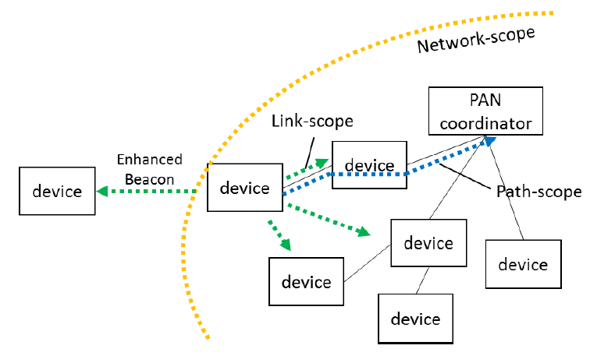
802.15.4s - Functional Overview
Scope-based forwarding control
  Scope-based Performance Metric
  How path-scope and network scope performance is calculated is outside the scope of the specification

Slide 7
802.15.4s - SRM Metrics
Energy Detection (ED)
Percentage of time of failed transmissions
Percentage of time of deferred transmissions
Retry Histogram
Channel Utilization
LQI
Received Channel Power Indicator (RCPI)
Received Signal Noise Indicator (RSNI)
RSSI
Noise Histogram
Average Access Delay

Slide 8
802.15 WNG: Overview Tutorial on IEEE 802.15.10
DCN: 15-17-0205-00-0010
Purpose: introduction to layer 2 routing
Presenters:
  Clint Powell (Powell Wireless Commsulting, LLC)
  Verotiana Rabarijaona (NICT)
  Charles Perkins (Futurewei)
  Noriyuki Sato (OKI)

Slide 9
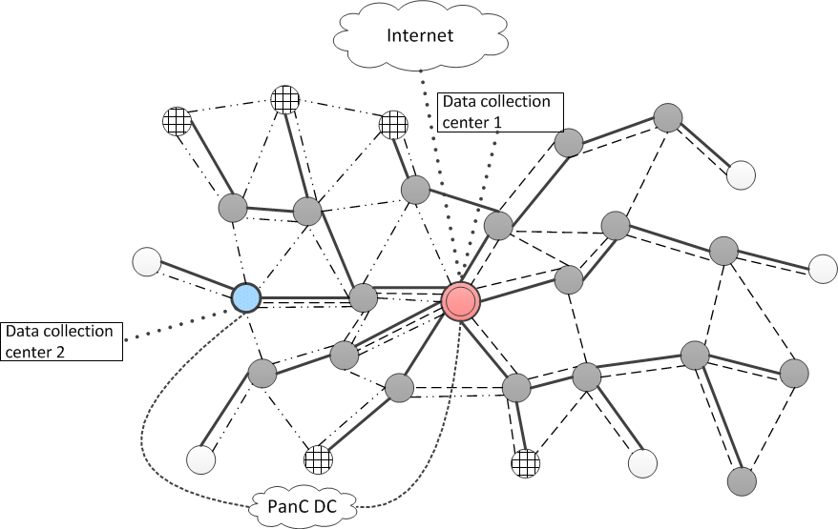
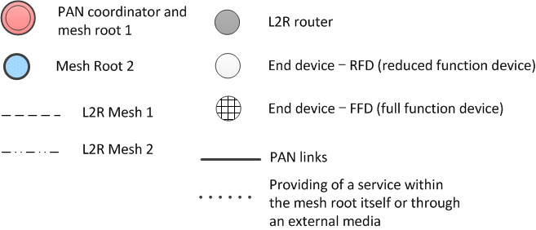
802.15.10 - Topologies
Multiple services in one mesh
* The definition of services are out of scope
Same service provided in different meshes
Optional direct connection to the PAN coordinator through an external network (3G, 4G, WiMAX...)
Used for short address assignment, credential verification...
Support for multiple meshes in one PAN

Slide 10
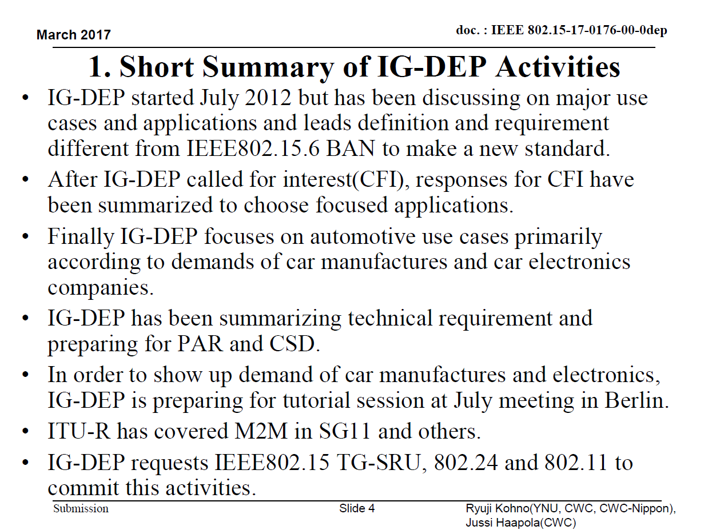
802.15 IG-DEP

Slide 11
802.15 IG-DEP - Focused Potential Applications
We have been discussing on focused potential applications according to demands in a world.
1.Automotive
  1.1Car Internal M2M
  1,2 Inter-vehicle M2M
  1.3 Remote Diagnosis in Factory
2. Medical Healthcare
  2.1 Wellness, Wellbeing
  2.2 Healthcare
  2.3 Professional Medicine
3. Social Public Service
  3.1 Life Line (Water/Gas/Electricity Supply)
  3.2 Public Safety
  3.3 Government System
4. Remote Infra Monitoring and Maintenance
  4.1 Remote Diagnosis of Infra(bridge/bldg/train)
  4.2 Remote Sensing and Controlling Mobile Robots
  4.3 Disaster Analysis and Prevention

Slide 12
802.15 IG-DEP - QoS Classes
QoS 1 Class: Highest Priority Level for Demand of Dependability
  1.1 Car Internal M2M
  1.3 Remote Diagnosis in Factory
  2.3 Professional Medicine
  3.2 Public Safety
QoS 2 Class: Meddle Priority Level for Demand of Dependability
  1,2 Inter-vehicle M2M
  2.2 Healthcare
  3.1 Life Line (Water/Gas/Electricity Supply)
  4.1 Remote Diagnosis of Infra(bridge/bldg./train)
QoS 3 Class: Low Priority Level for Demand of Dependability
  2.1 Wellness, Wellbeing
  3.3 Government System
  4.2 Remote Sensing and Controlling Mobile Robots
  4.3 Disaster Analysis and Prevention

Slide 13
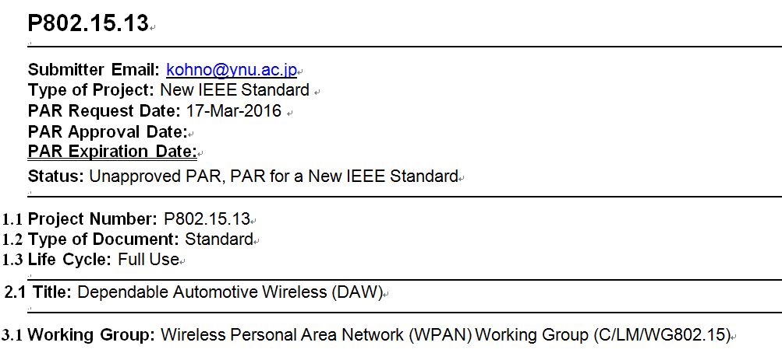
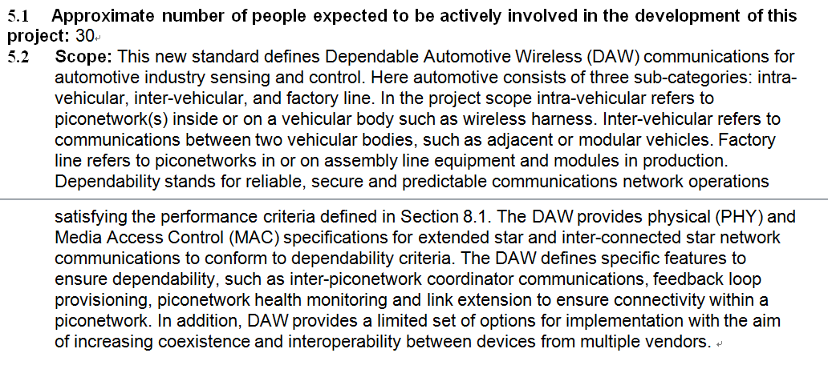
802.15 IG-DEP

Slide 14
P802.15.12 ULI
Title: Upper Layer Interface (ULI) for IEEE 802.15.4 Low-Rate Wireless Networks
Working Group: Wireless Personal Area Network (WPAN) Working Group (C/LM/WG802.15)
Scope: define an Upper Layer Interface (ULI) sublayer in L2, between L3 and the IEEE 802.15.4 MAC sublayer.
  provide data and management service access points (SAPs) for interface to the IEEE 802.15.4 MAC
  adapt L3 protocols and provide operational configuration including network and radio regulation requirements of the IEEE 802.15.4 MAC
  integrate optional upper Layer 2 functionalities focused on interfacing to the IEEE 802.15.4 MAC
  provide protocol differentiation, using mechanisms such as EtherType Protocol Differentiation (EPD) to support multiple, diverse higher layer protocols, and header compression.

Slide 15
PHY and DLL Functional Decomposition

Slide 16
Frame Composition

Slide 17
Questions, Comments
Thank YOU!

