Slide 1
Potential OmniRAN contribution to 802.1 Industry Connections Activity
Date: 2017-05-16
Authors:
Name | Affiliation | Phone | Email
Max Riegel | Nokia Bell Labs | +49 173 293 8240 | maximilian.riegel@nokis.com
Notice: This document does not represent the agreed view of the IEEE 802.1 OmniRAN TG. It represents only the views of the participants listed in the ‘Authors:’ field above. It is offered as a basis for discussion. It is not binding on the contributor, who reserve the right to add, amend or withdraw material contained herein.
Copyright policy: The contributor is familiar with the IEEE-SA Copyright Policy <http://standards.ieee.org/IPR/copyrightpolicy.html>.
Patent policy: The contributor is familiar with the IEEE-SA Patent Policy and Procedures: <http://standards.ieee.org/guides/bylaws/sect6-7.html#6> and <http://standards.ieee.org/guides/opman/sect6.html#6.3>.
Abstract
The presentation provides some initial thoughts about the participation of OmniRAN TG in the 802.1 Industry Connections Activity ‘IEEE 802 network enhancements for the next decade’

Slide 2
Potential OmniRAN contribution to
802.1 Industry Connections Activity
Max Riegel
(Nokia Bell Labs)

Slide 3
802.1 Industry Connections Activity
‘IEEE 802 network enhancements for the next decade’
The goal of this activity is to assess, outside of the IMT activity, emerging requirements for IEEE 802 wireless and higher-layer communication infrastructures, identify commonalities, gaps, and trends not currently addressed by IEEE 802 standards and projects, and facilitate building industry consensus towards proposals to initiate new standards development efforts.
Encouraged topics include enhancements of IEEE 802 communication networks and vertical networks as well as enhanced cooperative functionality among existing IEEE standards in support of network integration. Findings related to existing IEEE 802 standards and projects are forwarded to the responsible working groups for further considerations.

Slide 4
802.1 Industry Connections Activity
‘IEEE 802 network enhancements for the next decade’
Will start at the upcoming July ‘17 plenary
Aim of the activity by my own words:
  Attract increased participation in IEEE 802 standardization and further deployment of IEEE 802 technologies through serving ‘non-3GPP’ type of network deployments with ‘5G’-like networking capabilities.

Slide 5
‘5G’ Radio Requirements
Potential contributions to 802.1 ICA

Slide 6
IEEE 802 matches 5G radio requirements
5G Technology Directions
IEEE 802 technologies
Extreme broadband
  802.11ac, 802.11ad
  Upcoming: .11ax & .11ay
M2M
  802.11ah
  Various 802.15 radios
  802.11ba WUR
Critical communication
  802.11e
  802.11p
Extreme Broadband
High throughput, consistent QoE
5G Radio
Requirements
M2M
Low cost,
low battery consumption
Critical communication
Low latency,
high reliability

Slide 7
‘5G’ Network Requirements
Potential contributions to 802.1 ICA

Slide 8
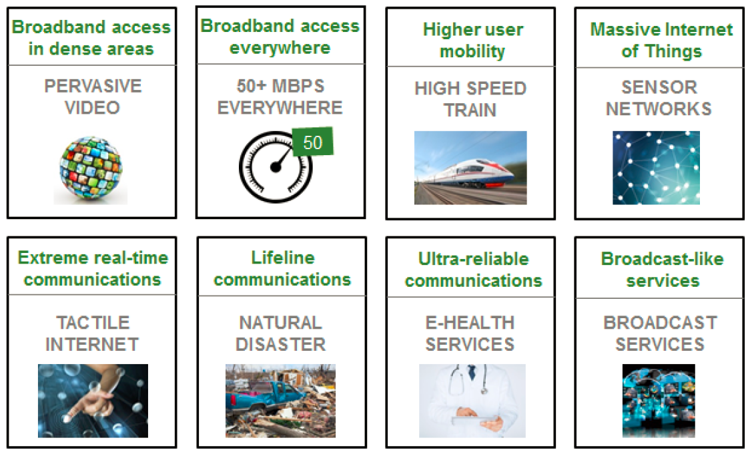
NGMN 5G Use Cases

Slide 9
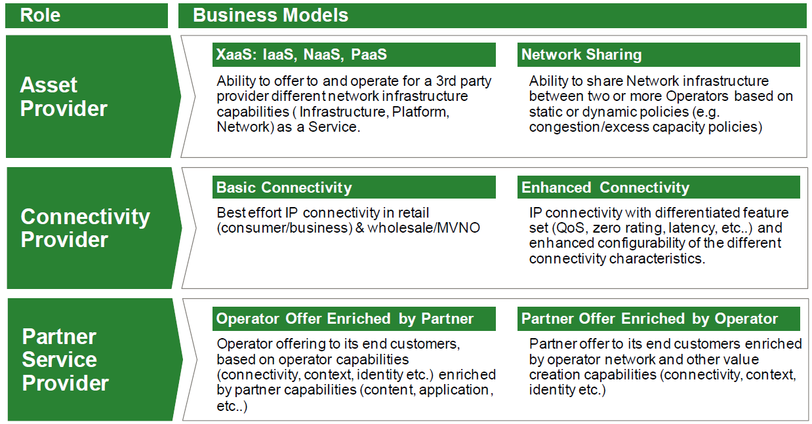
NGMN 5G Business Models

Slide 10



IEEE 802 Network Reference Model
Generic topology is aligned to common arrangement of an access infrastructure
The portion of the access infrastructure in scope of IEEE 802 is limited to the PHY and LINK layers between terminal and access router.
What seems to be a severe limitation (missing higher layer specifications) can actually be a huge benefit when dealing with various deployments.
NMS
Subscription
Service
Information
Server
Terminal
Access Network
Backhaul
Access Router
Application
Application
Transport
Transport
Network
Network
Network
Network
Data Link
DL
DL
DL
DL
DL
DL
Data Link
Data Link
Data Link
Physical
Phy
Phy
Phy
Phy
Phy
Phy
Physical
Physical
Physical
Medium
Medium
Medium
Medium
Medium
Terminal
Interface
Node of
Attachment
Backhaul
Access Router
Interface
Scope of specification

Slide 11
IEEE 802 access accommodates all the business arrangements considered in 5G
User
Access Network Operator
Service Provider
Subscription
Service
Coordination and Information
Service
Network
Management
Service
R2
R10
R11
R4
R12
AN Ctrl
TE Ctrl
AR Ctrl
R8
R9
Terminal
Interface
R5
R7
Access Router
Interface
NA
Backhaul
R1
R6
R3
Terminal
Access Network
Access Router
IP Provider

Slide 12
Network Slicing – the most prominent new ‘5G’ feature
Potential contributions to 802.1 ICA

Slide 13
5G Network Slicing
A “5G slice” provides a particular connection service with specific C- and U-plane functionality
  Collection of 5G network functions and specific RAT settings for a particular service
  Can span all domains of the network
Not all slices contain the same functions
  Can be only subset of today’s mobile networks
  Provides only the traffic treatment that is necessary for the particular use case.
Flexibility of slicing is a key enabler for value creation.
Third-party entities can be given permission to control certain aspects of slicing.

Slide 14
Description of Network Slicing Concept by NGMN Alliance
Network slicing concept consists of 3 layers:
  1) Service Instance Layer,
  2) Network Slice Instance Layer, and
  3) Resource layer.
Figure from NGMN whitepaper

Slide 15
Description of Network Slicing Concept by NGMN Alliance, cont.
The Service Instance Layer represents the services (end-user service or business services) which are to be supported. …
A network operator uses a Network Slice Blueprint to create a Network Slice Instance.
A Network Slice Instance provides the network characteristics which are required by a Service Instance.
A Network Slice Instance may also be shared across multiple Service Instances provided by the network operator.
The Network Slice Instance may be composed by none, one or more Sub-network Instances, which may be shared by another Network Slice Instance.
Similarly, the Sub-network Blueprint is used to create a Sub-network Instance to form a set of Network Functions, which run on the physical/logical resources.

Slide 16
NGMN 5G Network Slicing picture

Slide 17
3GPP-related Network Slicing Standardization
NGMN
  WS1 and NMWO.
3GPP SA1:
  SMARTER: TS 22.261 (approval 03.2017).
3GPP SA2:
  TR 23.799 Study Item, key issue#1 ‘Network Slicing’,
  TS: 23.501 and 23.502.
3GPP SA5 :
  TR 28.801 SI ‚Management & Orchestration of Network Slicing‘.
3GPP RAN:
  TR38.801 (RAN3), TR38.804 (RAN2)
Transport is not in the scope of 3GPP:
  3GPP SA5 seeks guidance on the cooperation with external bodies on Transport Network slicing management. This natural area for the IETF to work on.
IETF:
  Emerging NETslices discussions in order to establish new WG
ETSI-NFV
TM Forum:
  Customer Facing Service and Resource Facing Service.
ONF
  Technical Recommendation TR-526, entitled Applying SDN Architecture to 5G Slicing.

Slide 18
TR 23799 Key issue 1:
Support of network slicing
Network slicing enables the operator to create networks customised to provide optimized solutions for different market scenarios which demands diverse requirements, e.g. in the areas of functionality, performance and isolation.
Solutions for this key issue will study:
  Functionality and capabilities within 3GPP scope that enables the next generation system to support the Network Slicing and Network Slicing Roaming requirements defined in TR 22.864 [7] and in normative stage 1 specifications (when available), including but not limited to:
    How to achieve isolation/separation between network slice instances and which levels and types of isolation/separation will be required;
    How and what type of resource and network function sharing can be used between network slice instances;
  How to enable a UE to simultaneously obtain services from one or more specific network slice instances of one operator;
  What is within 3GPP scope with regards to Network Slicing (e.g. network slice creation/composition, modification, deletion);
  Which network functions may be included in a specific network slice instance, and which network functions are independent of network slices;
  The procedure(s) for selection of a particular Network Slice for a UE;
  How to support Network Slicing Roaming scenarios; and
  How to enable operators to use the network slicing concept to efficiently support multiple 3rd parties (e.g. enterprises, service providers, content providers, etc.) that require similar network characteristics.
The required definitions and terminology will be agreed upon during the work, e.g. adopting any terminology and definitions from SA WG1, NGMN etc. Additional input from e.g. NGMN or other industry organisations on Network Slicing will be considered.

Slide 19
3GPP TR 23799
Work Tasks for Network Slicing
ID | Work Task(s) | Work Task Description
NS_WT_#1 | Network Slice Instance Selection and Association | 1) Initial network slice instance selection to support UE's service establishment and re-selection to support UE mobility and other scenarios that are TBD, Note: More scenarios beyond the mobility need to be identified that may trigger network slice instance re-selection. 2) Network slice instance identification, 3) authorization for UE association with network slice instance Network provided and UE provided assistance information support for network slice instance selection.
NS_WT_#2 | Network Slicing Isolation | 1) Security isolation 2) Resource isolation 3) OAM support isolation (e.g. Usage and Fault isolation etc.) Note: Whether all items listed here are within the scope of SA WG2 is FFS.
NS_WT_#3 | Network Slicing Architecture | 1) Identifying impacted network functions and interfaces to support one or more network slice instances on top of a shared RAN and a shared infrastructure. 2) Identifying the common functions (if any) that need to be available in the core network and/or RAN to enable network slicing Identifying the approach to enable UE to associate with multiple slices simultaneously.
NS_WT_#4 | Network Slicing Roaming support | 1) Determination what visiting and home Network Function(s) are required to support roaming.
NS_WT_#5 | Network Slicing terminology & definitions | 1) If Network Slice Instance is agreed to apply E2E system, then, we should consider new terminology for Access slice instance and Core slice instances.

Slide 20
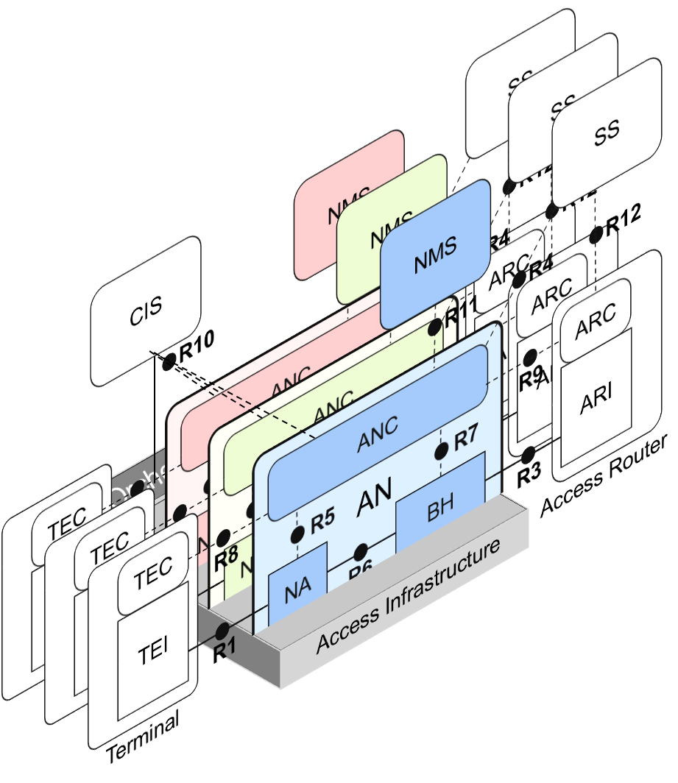
IEEE 802 well supports network slicing
802.1CF specification provides
model for network
virtualization
Covers architectural aspects of network slicing for IEEE 802 access network

Slide 21
Virtual network vs. virtualized network
P802.1CF-D0.4, section 6.7
Virtual networks define multiple instances of multipoint links, i.e., Layer 2 forwarding domains within an access network. A virtual network is denoted as VLAN and is identified within an access network through a VLAN-ID.
  For example, IEEE 802.1Q defines the methods to share a common Ethernet infrastructure for the establishment of multiple virtual LANs (VLANs), and IEEE 802.11 describes the implementation of multiple virtual APs, each exposing its own SSID and defining its own security environment on a single radio interface.
Virtualized access networks define instances of access network, each with its own ANC and NMS serving a number of network functions. Network functions in the access network are all elements carrying forward Ethernet data frames, i.e., NAs and BHs.
The model of a virtualized access network is defined by a template representing an abstract description of a particular design, which can be instantiated multiple times.
The CIS is the only network entity shared among multiple virtualized access networks to allow for access to and for adaptation of operational parameters.
NOTE: A virtualized access network may consist of multiple virtual networks; however, virtual networks can exist without network virtualization.

Slide 22
Conclusion and
Way forward
Potential contributions to 802.1 ICA

Slide 23
Conclusion
IEEE 802 can serve ‘5G’ requirements out of the box
  Reasonably well demonstrated for radio, hardly considered yet for networking aspects
To attract new and extended deployments, IEEE 802 should more prominently show its (existing!) networking capabilities compared to ‘5G’.

Slide 24
Proposed way forward
Create white paper / presentation of IEEE 802 networking capabilities compared to emerging discussions for ‘5G’
  Put particular focus on network slicing
P802.1CF provides the reference specification of IEEE 802 access network

