Slide 1
Layer-2 Network Virtualization
Date: 2017-07-10
Authors:
Name | Affiliation | Phone | Email
Max Riegel | Nokia Bell Labs |  | maximilian.riegel@nokia.com
Notice: This document does not represent the agreed view of the IEEE 802.1 OmniRAN TG. It represents only the views of the participants listed in the ‘Authors:’ field above. It is offered as a basis for discussion. It is not binding on the contributor, who reserve the right to add, amend or withdraw material contained herein.
Copyright policy: The contributor is familiar with the IEEE-SA Copyright Policy <http://standards.ieee.org/IPR/copyrightpolicy.html>.
Patent policy: The contributor is familiar with the IEEE-SA Patent Policy and Procedures: <http://standards.ieee.org/guides/bylaws/sect6-7.html#6> and <http://standards.ieee.org/guides/opman/sect6.html#6.3>.
Abstract
The presentation provides an introduction into the rationales and basic concepts for Layer-2 virtualized networks.

Slide 2
Layer-2 Network Virtualization
Max Riegel
(Nokia Bell Labs)
2017-07-10

Slide 3
Outline
Introduction
Multi-tenancy requirements
  Shopping mall
  Factory floor
Virtual networking
Virtualized networks
Standardization demand
P802.1CF
Way forward

Slide 4
Preface
Presentation provides idea of standardization demand
  Idea stems from observations of emerging networking demand in the enterprise market
Preliminary thoughts, no firm proposal
Further discussions required with potential stakeholders to create sharper picture.

Slide 5
Multi-Tenancy Networks
Shared use of common infrastructure for operational or economic reasons
Multiple operational domains
  A tenant pays for some exclusive rights to use a defined portion of the infrastructure
  Infrastructure is owned by a ‘landlord’
Growing importance in highly distributed economy
  Smaller, highly specialized entities operate pieces of a bigger process
  Independent business entities require independent networks, but share a common place

Slide 6
Example: Shopping Mall
Shopping malls assemble a variety
of (even) competing shops at
a common place.
Stores gain their competitiveness through offering the same goods at many places
  Common supply processes and correlation of customer insights
With ‘cloud’, ‘big data’ and ‘customer intelligence’ driving the evolution of the business, vendors require their own network
  Not only a networking service of the mall owner
    Responsiveness and flexibility to install new functions
    Exclusive access to communication meta-data

Slide 7
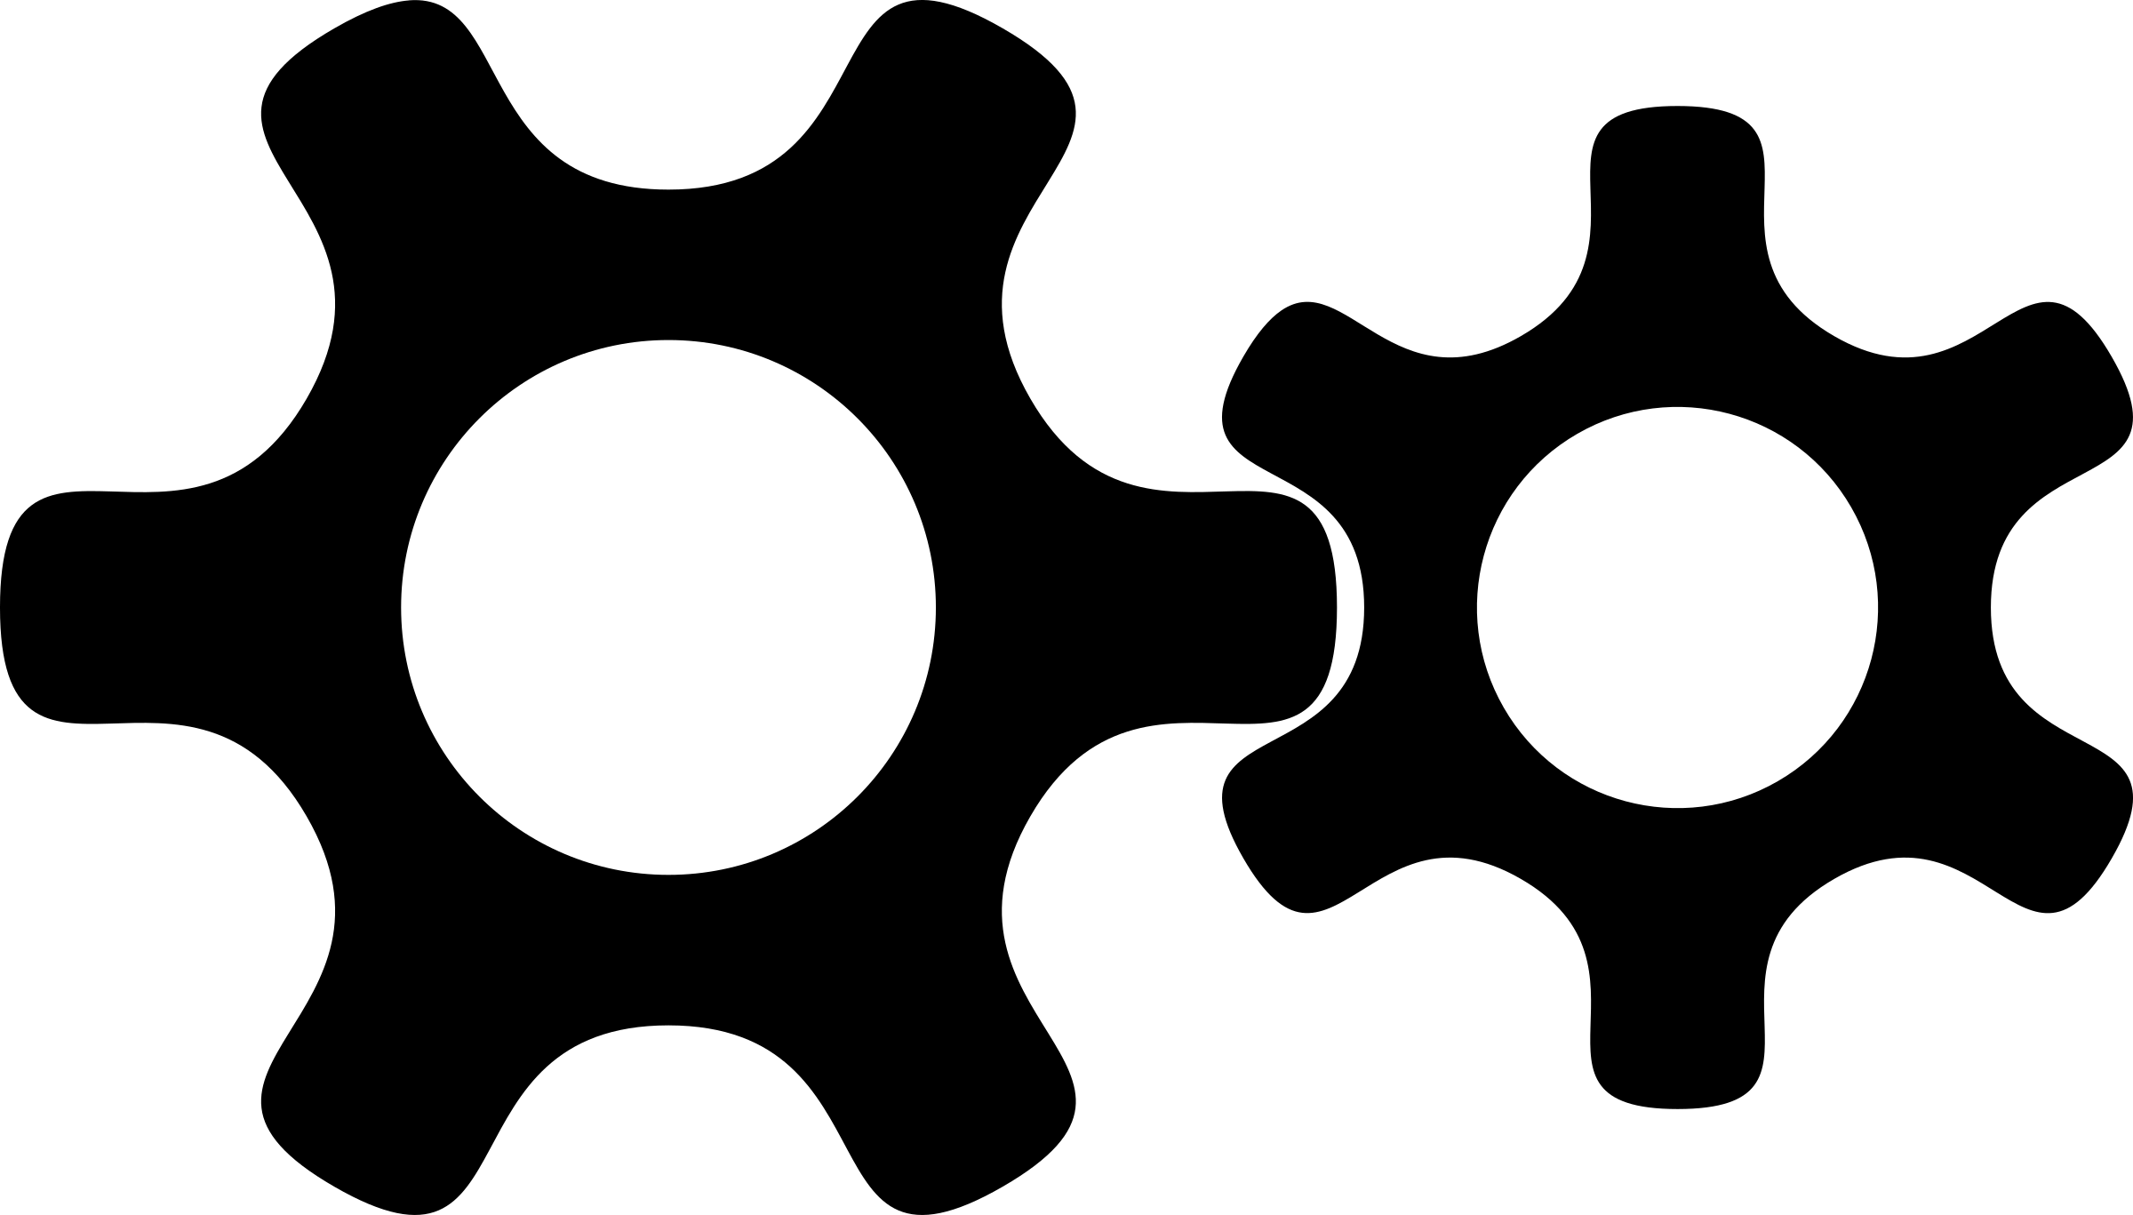
Example: Factory Floor
Production processes are getting split up
into multiple separate businesses
  E.g. a brewery may outsource the bottling
  of the beer to a specialized company
    Instead of the brewery buying the bottling
    plant and taking care of the logistics by itself
    The manufacturer of the bottling plant may prefer to sell a bottling service instead of only the machinery.
Subcontractors will require their own networks at the production plant
  Not only a networking service of the production plant
    Responsiveness
    Liability

Slide 8
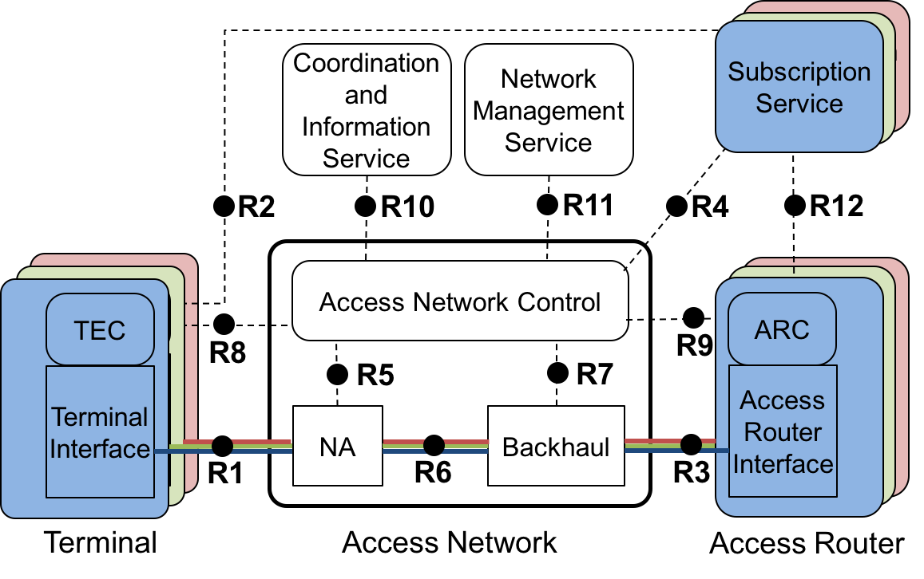
Virtual Networks
IEEE 802 supports virtual networks. (VLAN, multi-SSID)
Virtual networks separate the data paths but do not isolate control and management
(meta data).

Slide 9
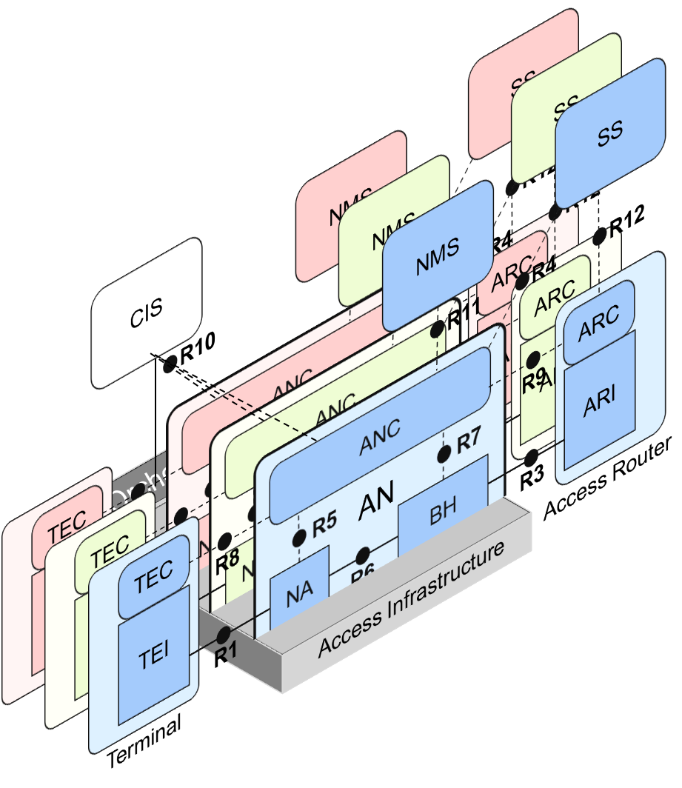
Virtualized Networks
Virtualization separates data path as well control and management.
Can be implemented
through virtualized
SDN.

Slide 10
Standardization demand
Landlord
Tenant
Owns and operates the network infrastructure
Assigns resources to multiple tenants according to contractual agreements
A common template of a virtualized network would simplify business
Produces a service at multiple locations
Requires same kind of virtualized network at all of the locations.
A common template of a virtualized network would simplify the business.
A common template of a virtualized network could be a YANG data model of a network connecting terminals among each others and with remote locations (access network).

Slide 11
P802.1CF
P802.1CF defines Network Reference Model and Functional Description of IEEE 802 Access Network
Network model fits well the deployment scenario in shopping malls and production plants.
  Plain Layer-2 data path avoids interdependencies with network layer configurations
Specification contains generic information model (UML) of IEEE 802 Access Network
Specification of YANG data model of IEEE 802 Access Network for particular deployment scenario could be based on the generic concepts described in P802.1CF

Slide 12
Way forward
Does it really make sense to standardize a YANG data model of a virtualized IEEE 802 Access Network.
  For which deployment scenario?
    IMHO: There is not the one-fits-all solution.
  Where are the market drivers?
  Who are the opponents?
Is a YANG data model the right approach?
Who would be interested in progressing the idea further?

