Slide 1
TSN in OmniRAN
Max Riegel
(Nokia)
2017-07-13

Slide 2
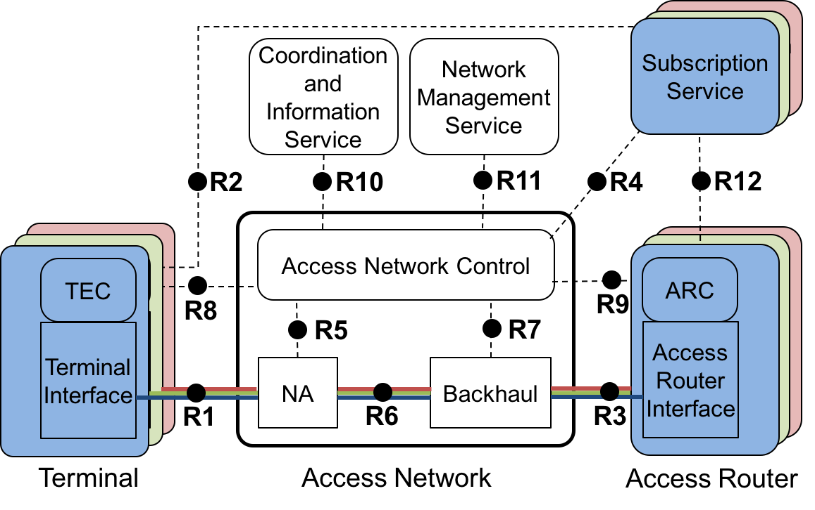
TSN and OmniRAN architectural models
OmniRAN will include TSN functions into P802.1CF
  Amending the ‘Data path’ and ‘Authorization, QoS, and policy control chapters’
How does it fit together?

Slide 3
Questions
Which specifications describe architectural aspects of management and configuration of TSN?
  BTW: P802.1CF is about architecture for management of user sessions.
  Which specs? 802.1Qcc, anything else?
802.1Qcc describes centralized as well as distributed management models?
  What are the use cases of the distributed management models?
Hints for including TSN config & management into P802.1CF?
Who are the experts for TSN configuration?
  Could we contact them for advise and review?
Anyhow, we will prepare presentation to TSN TG for the next F2F meeting.

