Slide 1
Information Model Structure
Date: [2017-10-10]
Authors:
Name | Affiliation | Phone | Email
Hao Wang | Fujitsu R&D Center | +86-10-59691000 | wangh@cn.fujitsu.com
Xiaojing Fan | Fujitsu R&D Center | +86-10-59691000 | fanxiaojing@cn.fujitsu.com
Ryuichi Matsukura | Fujitsu/Fujitsu Laboratory | +81-44-754-2667 | r.matsukura@jp.fujitsu.com
Notice: This document does not represent the agreed view of the IEEE 802.1 OmniRAN TG. It represents only the views of the participants listed in the ‘Authors:’ field above. It is offered as a basis for discussion. It is not binding on the contributor, who reserve the right to add, amend or withdraw material contained herein.
Copyright policy: The contributor is familiar with the IEEE-SA Copyright Policy <http://standards.ieee.org/IPR/copyrightpolicy.html>.
Patent policy: The contributor is familiar with the IEEE-SA Patent Policy and Procedures: <http://standards.ieee.org/guides/bylaws/sect6-7.html#6> and <http://standards.ieee.org/guides/opman/sect6.html#6.3>.
Abstract
This presentation provides further thoughts on the 802.1CF information model structure.

Slide 2
Information Model Structure
2017-10-10
Hao Wang
Fujitsu R&D Center

Slide 3
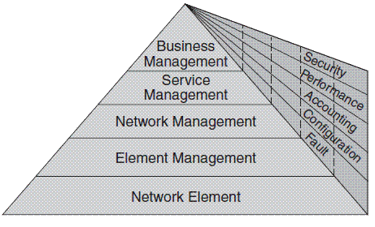
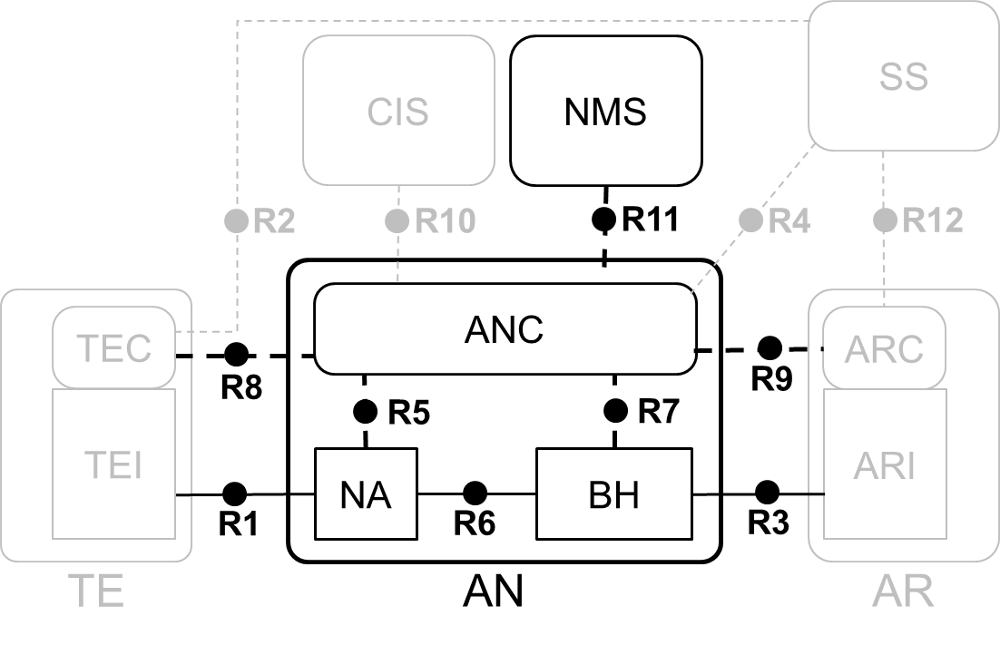
TMN 5-Layer Management Architecture
Every layer suggests certain management functionalities
  EML provides management functions for network elements on an individual or group basis. It also supports an abstraction of the functions provided by the network element layer.
  NML offers a holistic view of the network, independent of device types and vendors. It manages a network as supported by the element management layer.
FCAPS have different tasks at each layer.
EML-NML interface is the point

Slide 4
Two Basic Questions
What should be modeled?
  Access network management functions (EMS on ANC)
  Access network elements (NA, BH)
  Additional managed objects to support AN management functions
    Network Resources: data interfaces R1, R3, R6
    Virtual entities: control interfaces R8, R9
What management purpose should the information model be used for?
  FCAPS vs. OAMPT?
  The ‘C’ only (YANG data model for configuration management)

Slide 5
A Simple Information Model
Access Network Management
AN-ID
1
Backhaul
BH-ID
1+
Node of Attachment
NA-ID
1
Access Network Control
ANC-ID
1+
Data interface
Port-ID, State
1+
Datapath
Datapath-ID, State
1+
User service (session)
Session-ID, State
…
1
Subscription
NAI
1+
Service-Flow
ServiceFlow-ID
1+
Accounting record
AccountingRecord-ID
Association relationship may be required

Slide 6
‘State’ Attributes Associate to 802.1CF Control Functions
‘State’ Attributes | 802.1CF Control Functions
Data interface state | 7.1 AN setup 7.2 AN discovery and selection 7.3 Association and disassociation 7.4 Authentication and trust establishment | 7.8 Fault diagnostics and maintenance (FDM)
Datapath state | 7.5 Datapath establishment, relocation and teardown
User service state | 7.6 & 7.7
Service flow | 7.6 Authorization, QoS and policy control
Accounting records | 7.7 Accounting and monitoring

Slide 7
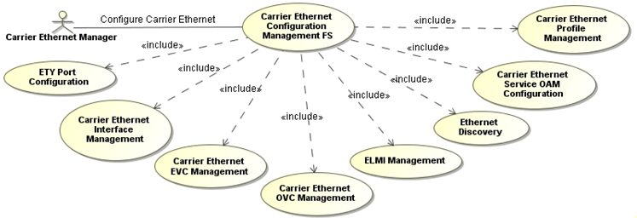
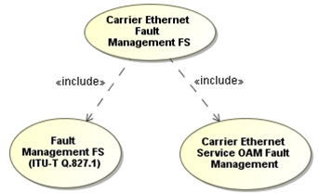
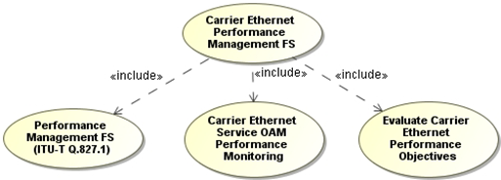
State of the Art (1)
MEF Information Model for different management purpose (MEF 7.x)
For configuration management
For performance management
For Fault management

Slide 8
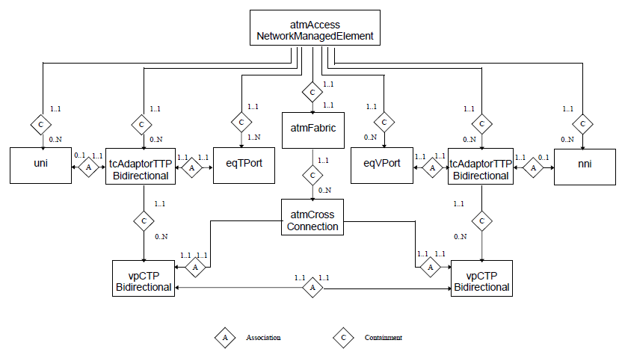
State of the Art (2.1)
Information Model for ATM access network [3]
  Physical resources and virtual entities aggregated
  Not a tree structure (w/ duplicated objects)

Slide 9
State of the Art (2.2)
The managed elements (objects) as shown on the information model [3]
  The atmAccessNetwork object represents the Access System as a whole, providing for state management.
  The tcAdaptorTTPBidirectional object represents the adaptation of the ATM layer to the underlying physical infrastructure.
  The uni / nni objects are used to configure and identify an ATM interface as User Network Interface (UNI) or Network Node Interface (NNI). It is associated to a tcAdaptorTTPBidirectional objects and provides also for OAM purposes.
  The eqTport and eqVport represents AN physical ports as linked to tcAdaptorTTPBidirectional object. State management is provided. The type of physical interface is shown in order to support a variety of architectures.
  The atmFabric object represents the function of managing the establishment an release of ATM crossconnections.
  The atmCrossConnection object represents an ATM cross-connect relationship between (bidirectional) links terminating in the AN. State management is supported.
  The vpCTPBidirectional objects is used to represent the termination of a VP link. Included is information about the VP link identifier (VPI), traffic descriptors, and Quality of Service (QoS).

Slide 10
Reference
ITU-T Recommendation M.3100: “Generic Network Information Model”
ITU-T Recommendation M.3010: “Principles for a Telecommunications Management Network”
ACTS GUIDELINE NIM-G2, “A Generic Information Model for Access Networks”
  http://cordis.europa.eu/pub/actsline/docs/nim2.pdf
Broadband Forum TR-035, “Protocol Independent Object Model for ADSL EMS-NMS Interface”
  https://www.broadband-forum.org/technical/download/TR-035.pdf
Metro Ethernet Forum MEF 7.1, “EMS-NMS Information Model”
Metro Ethernet Forum MEF 7.2, “Management Information Model”

Slide 11
Questions, Comments
Thank YOU!

