Slide 1
IEEE 802.1 OmniRAN TG
January 2018 F2F Meeting
Geneva, Switzerland
2018-01-24
Max Riegel, Nokia Bell Labs
(TG Chair)

Slide 2
January 2018 F2F Meeting
Venue:
  ITU Headquarters
    Rue de Varembé, 2,
    Geneva, Switzerland
OmniRAN TG sessions:
  Mon, Jan 22nd, 09:30-17:30
    Meeting room: Tower T103
  Tue, Jan 23rd, 10:00-17:30
    Meeting room: Tower T103
  Wed, Jan 24th, 08:00-17:30
    Meeting room: Tower D

Slide 3
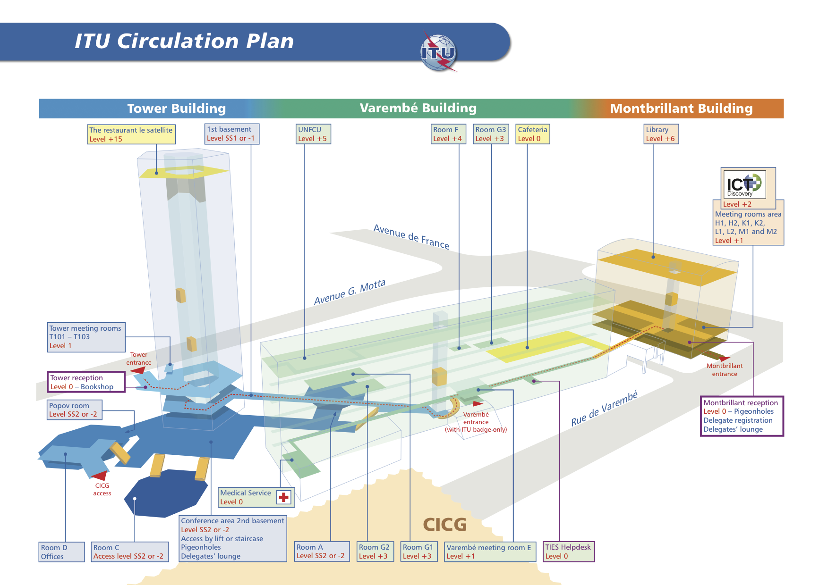

Slide 4
Agenda proposal for Jan 2018 F2F
Review of minutes
Reports
Result of P802.1CF WG ballot
Comment resolution on P802.1CF-D1.0
New content for P802.1CF
Plan for 802.1CF-D2.0 draft
IC NEND contributions review
Conference calls until Mar 2018 F2F
Status report to IEEE 802 WGs
Next meeting
AOB

Slide 5
January 2018 Agenda Graphics
 | Mon 1/22 | Tue 1/23 | Wed 1/24 | Thu 1/25 | Fri 1/26
09:00 10:30 | OmniRAN opening
11:00 12:30
14:00 15:30
16:00 17:30 |  |  | OmniRAN closing
18:15 19:15 |  | All editors’ web meeting |  | New Editors training

Slide 6
Participants have a duty to inform the IEEE
Participants shall inform the IEEE (or cause the IEEE to be informed) of the identity of each holder of any potential Essential Patent Claims of which they are personally aware if the claims are owned or controlled by the participant or the entity the participant is from, employed by, or otherwise represents
Participants should inform the IEEE (or cause the IEEE to be informed) of the identity of any other holders of potential Essential Patent Claims
Early identification of holders of potential Essential Patent Claims is encouraged

Slide 7
Ways to inform IEEE
  Cause an LOA to be submitted to the IEEE-SA (patcom@ieee.org); or
  Provide the chair of this group with the identity of the holder(s) of any and all such claims as soon as possible; or
  Speak up now and respond to this Call for Potentially Essential Patents
If anyone in this meeting is personally aware of the holder of any patent claims that are potentially essential to implementation of the proposed standard(s) under consideration by this group and that are not already the subject of an Accepted Letter of Assurance, please respond at this time by providing relevant information to the WG Chair.

Slide 8
Other guidelines for IEEE WG meetings
All IEEE-SA standards meetings shall be conducted in compliance with all applicable laws, including antitrust and competition laws.
  Don’t discuss the interpretation, validity, or essentiality of patents/patent claims.
  Don’t discuss specific license rates, terms, or conditions.
    Relative costs of different technical approaches that include relative costs of patent licensing terms may be discussed in standards development meetings.
      Technical considerations remain the primary focus
  Don’t discuss or engage in the fixing of product prices, allocation of customers, or division of sales markets.
  Don’t discuss the status or substance of ongoing or threatened litigation.
  Don’t be silent if inappropriate topics are discussed … do formally object.
For more details, see IEEE-SA Standards Board Operations Manual, clause 5.3.10 and Antitrust and Competition Policy:
What You Need to Know at http://standards.ieee.org/develop/policies/antitrust.pdf

Slide 9
Patent-related information
The patent policy and the procedures used to execute that policy are documented in the:
  IEEE-SA Standards Board Bylaws http://standards.ieee.org/develop/policies/bylaws/sect6-7.html#6
  IEEE-SA Standards Board Operations Manual http://standards.ieee.org/develop/policies/opman/sect6.html#6.3
Material about the patent policy is available at http://standards.ieee.org/about/sasb/patcom/materials.html
If you have questions, contact the IEEE-SA Standards Board Patent Committee Administrator at patcom@ieee.org

Slide 10
Participation in IEEE 802 Meetings
All participation in IEEE 802 Working Group meetings is on an individual basis
  Participants in the IEEE standards development individual process shall act based on their qualifications and experience. (https://standards.ieee.org/develop/policies/bylaws/sb_bylaws.pdf section 5.2.1)
  IEEE 802 Working Group membership is by individual; “Working Group members shall participate in the consensus process in a manner consistent with their professional expert opinion as individuals, and not as organizational representatives”. (http://ieee802.org/PNP/approved/IEEE_802_WG_PandP_v19.pdf section 4.2.1)
You have an obligation to act and vote as an individual and not under the direction of any other individual or group. Your obligation to act and vote as an individual applies in all cases, regardless of any external commitments, agreements, contracts, or orders.
You shall not direct the actions or votes of any other member of an IEEE 802 Working Group or retaliate against any other member for their actions or votes within IEEE 802 Working Group meetings, see
  https://standards.ieee.org/develop/policies/bylaws/sb_bylaws.pdf section 5.2.1.3 and
  http://ieee802.org/PNP/approved/IEEE_802_WG_PandP_v19.pdf section 3.4.1, list item x
By participating in IEEE 802 meetings, you accept these requirements. If you do not agree to these policies then you shall not participate.

Slide 11
Business #1
Call Meeting to Order
  Chair called meeting to order at 09:30
Minutes taker:
  Hao is taking notes.
Mandatory slides
  Mandatory slides were presented, no announcements came up.
Roll Call
Name | Affiliation |  | Name | Affiliation
Max Riegel | Nokia |  | Nader Zein | NEC
Hao Wang | Fujitsu |  | Glenn Parsons | Ericsson
Hajime Koto | NICT |  | Walter Pienciak | IEEE
Tomoki Ohsawa | NICT |  | Paul Nikolich | IEEE 802
Satoko Itaya | NICT |  | Patrick Slaats | IEEE
Kenichi Maruhashi | NEC
Roger Marks | EthAirNet Assoc.
Antonio de la Oliva | UC3M
Yonggang Fang | ZTE TX

Slide 12
Agenda for Jan 2018 F2F
Review of minutes
Reports
Result of P802.1CF WG ballot
Comment resolution on P802.1CF-D1.0
New content for P802.1CF
Plan for 802.1CF-D2.0 draft
IC NEND contributions review
Conference calls until Mar 2018 F2F
Status report to IEEE 802 WGs
Next meeting
AOB

Slide 13
Schedules
Mon
  Review of minutes
  Reports
  Result of P802.1CF WG ballot
  Comment resolution on P802.1CF-D1.0
Tue
  Comment resolution on P802.1CF-D1.0
  IC NEND contributions review (after lunch break)
Wed
  Comment resolution on P802.1CF-D1.0
  New content for P802.1CF
  Plan for 802.1CF-D2.0 draft
  Conference calls until Mar 2018 F2F
  Status report to IEEE 802 WGs
  Next meeting
  AOB

Slide 14
Business #2
Agenda approval
  Agenda and scheduling approved.
Review of minutes
  https://mentor.ieee.org/omniran/dcn/17/omniran-17-0091-00-00TG-nov-2017-f2f-meeting-minutes.docx
  https://mentor.ieee.org/omniran/dcn/17/omniran-17-0094-00-00TG-nov-28th-confcall-notes.docx
  https://mentor.ieee.org/omniran/dcn/17/omniran-17-0096-00-00TG-dec-5th-confcall-minutes.docx
  https://mentor.ieee.org/omniran/dcn/17/omniran-17-0104-00-00TG-dec-12th-confcall-minutes.docx
  No issues reported with any of the minutes.
Reports
  New layout of 802.1 website
  New editors’ training on Thursday evening.
  Outcome and plans of last IC NEND conference call

Slide 15
Business #3
Result of P802.1CF-D1.0 WG ballot
  41 (of 56) votes submitted
  21 Abstain, 13 Approve, 7 Disapprove
    Approval rate: 65% (< 75%)
    159 comments
      92 Editorial, 67 Technical, 63 binding comments
      3 Approve votes with comments
        (Rodney Cummings, Hao Wang, Walter Pienciak)
      1 comments submission from non-voter (Antonio)

Slide 16
Business #4
Comment resolution on P802.1CF-D1.0
  Comments collected in Excel document
    https://mentor.ieee.org/omniran/dcn/18/omniran-18-0006-00-CF00-d1-0-collected-comments.xls
  Result of discussions captured in
    https://mentor.ieee.org/omniran/dcn/18/omniran-18-0006-02-CF00-d1-0-collected-comments.xls
    Spreadsheet requires editorial rework to create appropriate output for report to WG
    Chair will derive document for both reporting the results and tracking the implementation of the comments.
IC NEND contributions review
  https://mentor.ieee.org/omniran/dcn/18/omniran-18-0009-00-00ic-draft-report-wired-wireless-flexible-factory-iot.zip
    Presentation of initial draft of report with rich discussion about potential improvements of structure and content.

Slide 17
Business #5
New content for P802.1CF
  Nothing contributed outside of comments to D1.0
Plan for 802.1CF-D2.0 draft
  Next draft will be D1.1 as WG ballot failed.
  Still quite a number of contributions needed for completion of input for D1.1
    Max will create action item list out of comment resolution
  Walter will start implementing agreed edits
    Important: find method to make text in figures searchable
  Information model conclusion
    Start with configuration information model
    Proceed after with definition of FDM model
    Refine content split of clause 7.7 and 7.8
  March F2F: Conclude on text going into D1.1
    Get the D1.1 WG ballot closed before May F2F on May 21st.

Slide 18
Business #6
Conference calls until Mar 2018 F2F
  February 13th, and February 27th
  Usual 09:30AM ET
Status report to IEEE 802 WGs
  Drafted by chair, agreed in the group
    https://mentor.ieee.org/omniran/dcn/18/omniran-18-0010-00-00TG-jan-2018-report-to-ieee802-wgs.pptx
AOB
  None
Next meeting
  Conference call on February 13th, 09:30AM ET
Meeting adjourned by chair at 17:35

