Slide 1
Recommended Practice for Privacy Considerations for IEEE 802 Technologies
Date: 2016-01-18
Authors:
Name | Affiliation | Phone | Email
Jerome Henry | Cisco Systems | +1 919 392 2503 | jerhenry@cisco.com
Notice: This document does not represent the agreed view of the IEEE 802.1 TG. It represents only the views of the participants listed in the ‘Authors:’ field above. It is offered as a basis for discussion. It is not binding on the contributor, who reserve the right to add, amend or withdraw material contained herein.
Copyright policy: The contributor is familiar with the IEEE-SA Copyright Policy <http://standards.ieee.org/IPR/copyrightpolicy.html>.
Patent policy: The contributor is familiar with the IEEE-SA Patent Policy and Procedures: <http://standards.ieee.org/guides/bylaws/sect6-7.html#6> and <http://standards.ieee.org/guides/opman/sect6.html#6.3>.
Abstract
The slide set provides some very initial thoughts about how privacy aspects may be approached in the 802E specification.

Slide 2
References
The Privacy Engineer’s Manifesto - Getting from Policy to Code to QA to Value (Michelle Finneran Dennedy Jonathan Fox Thomas R. Finneran; ApressOpen)
  http://www.apress.com/9781430263555
Privacy Engineering Framework (MITRE Privacy Community of Practice (CoP) July 18, 2014)
  http://www.mitre.org/publications/technical-papers/privacy-engineering-framework
Engineering Privacy (Sarah Spiekermann, Lorrie Faith Cranor; IEEE Transactions on Software Engineering, Vol. 35, No. 1, Jan/Feb 2009)
  http://ssrn.com/abstract=1085333
OmniRAN Privacy Engineered Access network presentation, Max Riegel (Nokia)
  https://mentor.ieee.org/omniran/dcn/15/omniran-15-0015-00-CF00-privacy-engineered-access-network.pptx

Slide 3
Privacy
Some common definitions:
Merriam-Webster’s Dictionary:
  1a: the quality or state of being apart from company or observation: seclusion
  1b: freedom from unauthorized intrusion one’s right to privacy
  2. archaic: a place of seclusion
  3a: secrecy
  3b: a private matter: secret
According to Yael Onn et al., Privacy in the Digital Environment. Haifa Center of Law & Technology, 2005:
  “The right to privacy is our right to keep a domain around us, which includes all those things that are part of us, such as our body, home, thoughts, feelings, secrets, and identity. The right to privacy gives us the ability to choose which parts in this domain can be accessed by others, and to control the extent, manner, and timing of the use of those parts we choose to disclose.”

Slide 4
Privacy a targeted definition
Taken from: The Privacy Engineer’s Manifesto - Getting from Policy to Code to QA to Value (Michelle Finneran Dennedy Jonathan Fox Thomas R. Finneran; ApressOpen)

Slide 5
PII
Personally Identifiable Information
Privacy:
  “The fair and authorized “processing” of Personally Identifiable Information (PII)
Personally Identifiable Information
  Formally: Any data that identifies an individual or from which identity or contact information of an individual can be derived
  Practically: Includes otherwise non-personal information when associated or combined with personal information

Slide 6
Privacy by Design (PbD)
Based on the assumption that privacy cannot be assured only by compliance with regulatory frameworks
  Although compliance and regulatory frameworks play a crucial role
Privacy assurance must be included into the organization and mode of operation of a system
Adequate privacy requires thoughtful integration with every layer of an organization, including:
  Organization policies and governance;
  Business processes;
  Standard operating procedures;
  System and network architectures;
  IT system design and development practices;
  Management of data sources.

Slide 7
PbD Foundational Principles
Proactive not Reactive; Preventative not Remedial
  Anticipate issues; prevent problems before they arise
Privacy as the Default Setting
  Personal data protected from inception; individuals need not act to protect data
Privacy Embedded into Design
  Privacy protections are core, organic functions; not bolted on after the fact
Full functionality—Positive-sum, not Zero-sum
  Privacy should enhance, not degrade, security and functionality
End-to-End Security—Full Lifecycle Protection
  Security applied to each data lifecycle stage, from creation to archiving or deletion
Visibility and Transparency—Keep it Open
  Individuals understand data use; privacy practices audited
Respect for User Privacy—Keep it User-Centric
  Organizational imperative = privacy is about personal control and free choice
Privacy is not a substitute for security
  Privacy complements other security parameters

Slide 8
What does this mean for 802?
Three dimensions:
  Fair information principles
  Information processing
  Personal Identifiable Information
IEEE 802 privacy deals with:
  PII in our standards, PII that is directly derived from our standards (e.g. IP derived from MAC), and PII in other standards that we use

Slide 9
Now that we know what we protect,
A bit more on the threats

Slide 10
Threats Considerations
Attack possible categorization:
  Where
    Is the attacker local to your L2 network (direct visibility)?
  Who
    Is the attacker occasional/opportunist or systematic/traceable?
  When
    Has the attacker ephemeral access or long term access to your network?
  “Why” and “How” may also be of importance, in relation to the other 3 Ws… and of course “What” (next slides)

Slide 11
802E Threat Model
Some relevant attack classes:
  Passive observation (Directly capture data in transit)
  Passive inference (Infer from reduced/encrypted)
  Active (Manipulate / inject data in transit)

Slide 12
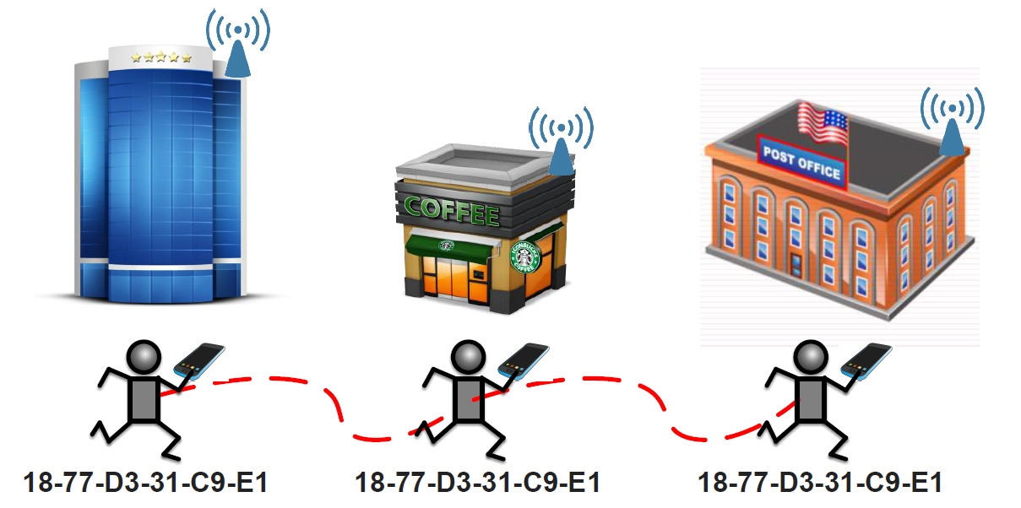
Passive Inference / Correlation
The combination of various pieces of information related to an individual or that obtain that characteristic when combined

Slide 13
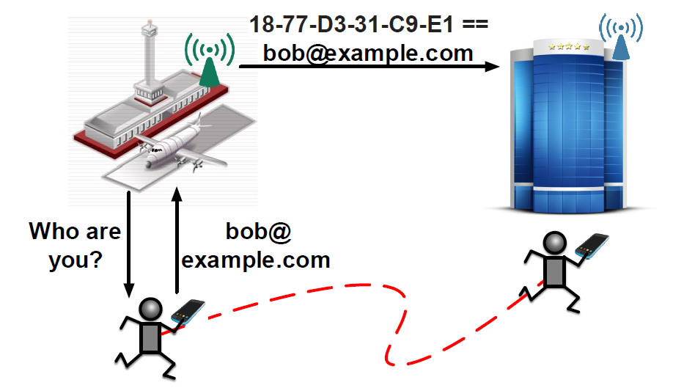
Passive Inference / Identification
The linking of information to a particular individual to infer an individual's identity or to allow the inference of an individual's identity.

Slide 14
Passive Observation
Possible mechanisms to limit the effect of passive observation:
  Mitigation: Hide information on the wire
  Minimization: Don’t send the information
  Encryption: Make the information unintelligible
  Anonymization: Disassociate the senders and the information

Slide 15
Active Attacks
Attacker can observe and modify communications
  Both-side identification is crucial
Pervasive attacker may have access to multiple Layers, and multiple locations

Slide 16
Summary
802E purpose is to promote a consistent approach by IEEE 802 protocol developers to mitigate privacy threats identified in the specified privacy threat model and provide a privacy guideline.
First step is to identify threat models for Personal Identifiable Information (PII)
  Identify PIIs
  Decide which PII elements require protection
  Identify the potential threats
  Understand the possible effects of protecting target PII
  Provide privacy guidelines
An initial draft will be built to host contributions

